Slide 1

Michael J. Pishvaian, MD, PhD Associate Professor, Department of Oncology, Johns Hopkins University School of Medicine

Slide 2
Most Important Practice-Changing Advances in GI Cancers in 2025
Michael Pishvaian, MD, PhD
Associate Professor, Department of Oncology
Director of the Gastrointestinal, Developmental Therapeutics, and Clinical Research Programs at the NCR Kimmel Cancer Center at Sibley Memorial Hospital
Johns Hopkins University School of Medicine

Slide 3
Disclosures (3 years)
Consultant/Ad Hoc Advisory:
Astra Zeneca, Ideaya, Seattle Genetics, Merus, Merck, Pfizer, Novartis
Steering Committee/Advisory Board
Astellas, Merck
Travel, accommodations and expenses support:
Astellas, RenovoRx
Stock:
Perthera
Research funding to my institution:
Tesaro, Arcus Bio, Ideaya, Repare Tx, Novartis, Pfizer, Merck, Tizonia, Biomed Valley Discoveries, Amgen, RenovoRx, Boerhinger Ingelheim, Astellas, Hutchinson Medipharma, Takeda, Actuate, MEI Pharma, Elevation Oncology, Recursion Pharma
The speaker is being compensated for his presentation today by International Oncology Network (“ION”). However, neither ION nor any pharmaceutical company has influenced the content of this presentation nor has ION independently verified the presentation for accuracy

Slide 4
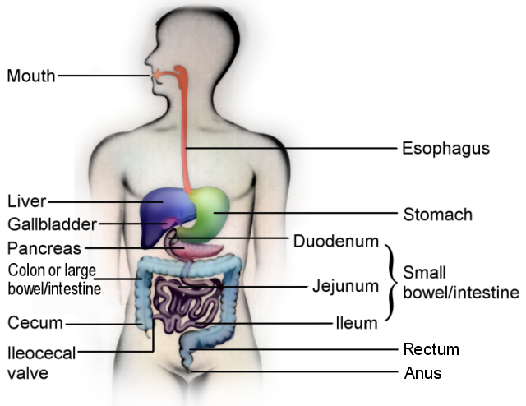
Overview
Updates in colorectal cancer
Updates in upper GI cancers
Updates in pancreatic cancer
Updates in biliary cancer
Updates in HCC
Image from:
https://aboutgimotility.org/wp-content/uploads/sites/14/giguy-web2-labeled.png

Slide 5
Updates in Colorectal Cancer

Slide 6
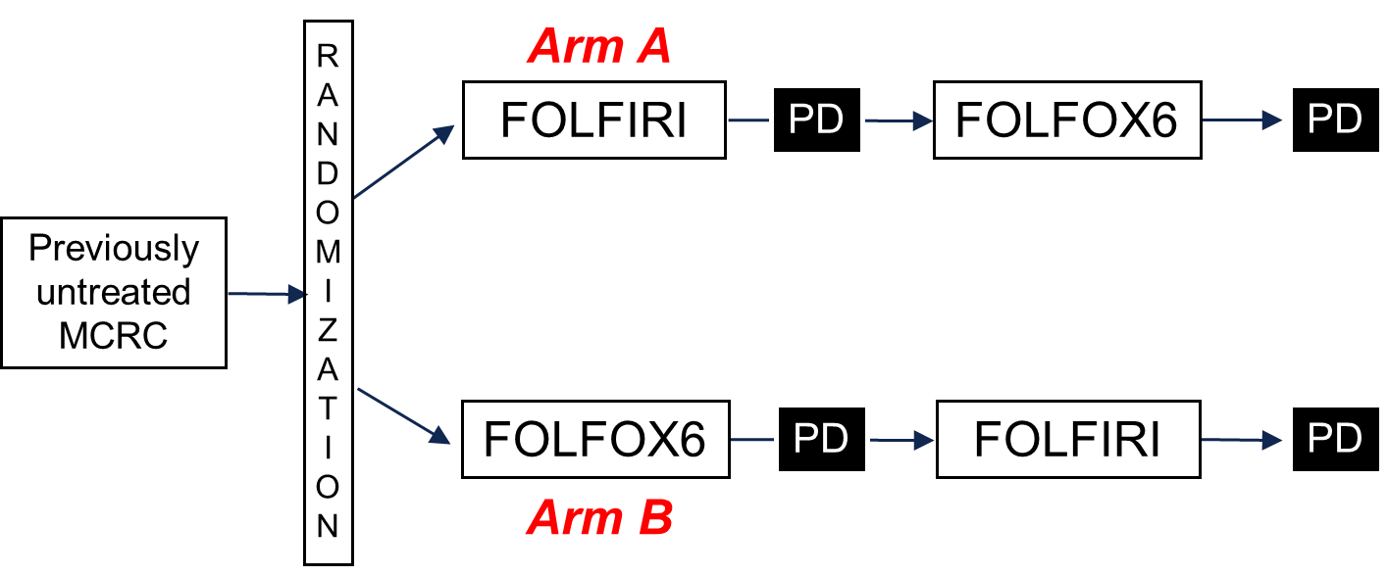
Metastatic MSS Colorectal Cancer
We learned >2 decades ago that the foundation of chemotherapy for mCRC is FOLFOX or FOLFIRI
The Tournigand Trial in 2004 taught us that starting with either regimen results in equivalent overall survival rates
 | Arm A (n=109) | Arm B (n=111)
 | FOLFIRI → FOLFOX | FOLFOX → FOLFIRI | P-value
1st RR | 54% | 56% | NS
1st mPFS (mo) | 8.5 | 8.0 | 0.26
mOS (mo) | 21.5 | 20.4 | 0.99
Tournigand et al. J Clin Oncol. 2004 Jan 15;22(2):229-37

Slide 7
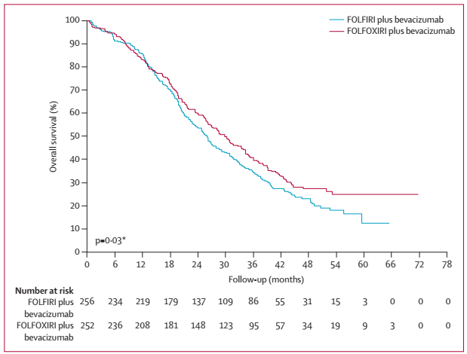
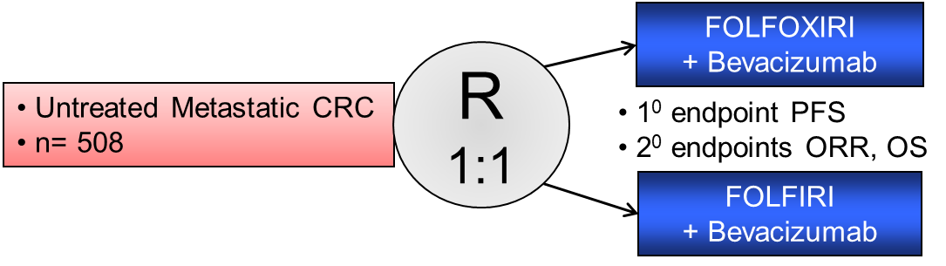
Metastatic MSS Colorectal Cancer
Adding to doublet therapy can result in a significant increase in mOS
For unselected patients, FOLFOXIRI + Bev should be considered the standard of care (The Phase III TRIBE trial)
 | ORR (%) | PFS | OS
FOLFOXIRI + Bev | 65 | 12.1 | 29.8
FOLFIRI + Bev | 53 | 9.7 | 25.8
p-value |  | .0006 | 0.03
Cremolini C, et al; Lancet Oncol 2015; 16: 1306–15

Slide 8
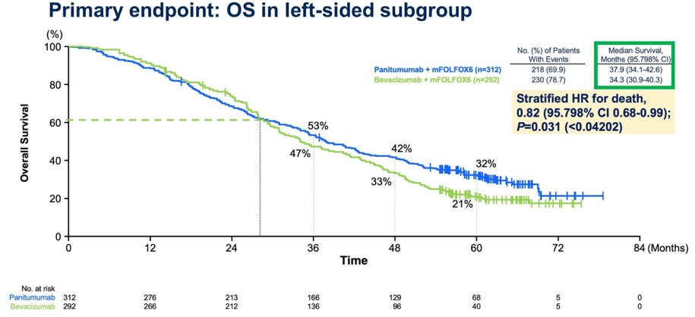
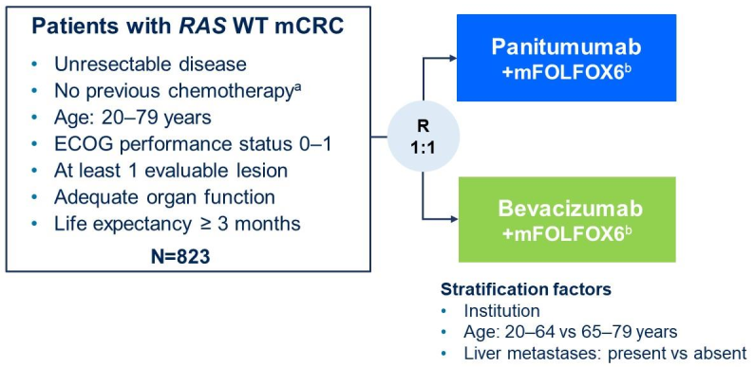
Metastatic MSS Colorectal Cancer
But biomarker-selected therapy can provide even greater mOS
For RAS/RAF Wild-Type mCRC patients – FOLFOX + Panitumumab resulted in the greatest OS observed to date (The Paradigm Trial)
 | ORR (%) | PFS (Mos) | OS (Mos)
FOLFOX + Pani | 80.2 | 13.7 | 37.9
FOLFOX + Bev | 68.6 | 13.2 | 34.3
p-value |  | NS | 0.031
Watanabe J, et al, JAMA. 2023 Apr 18;329(15):1271-1282

Slide 9
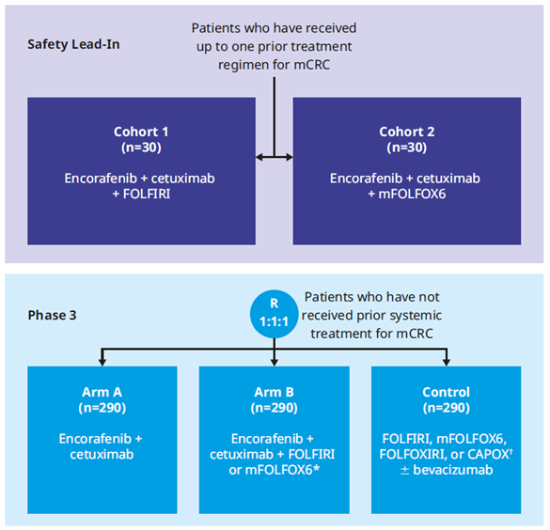
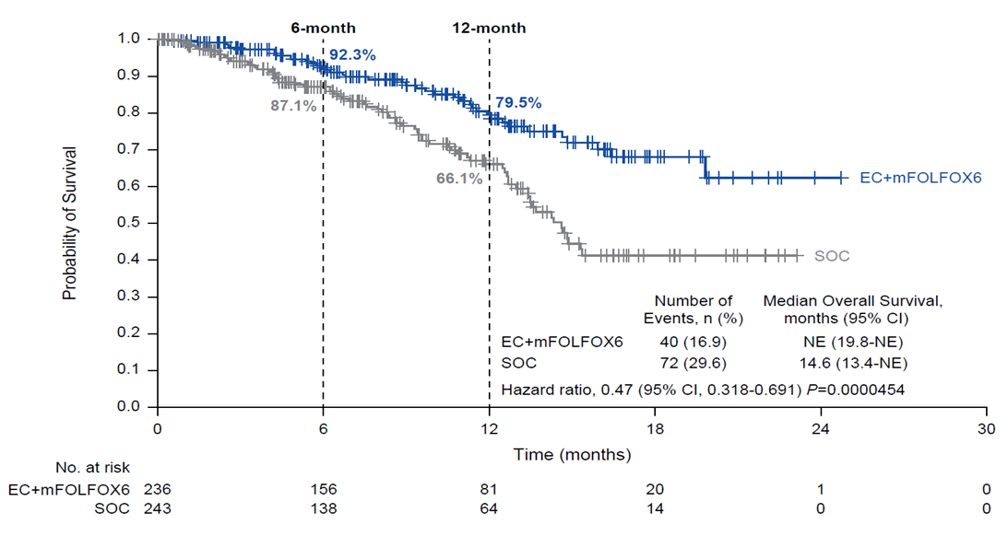
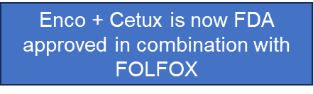
Metastatic MSS Colorectal Cancer
ASCO-GI 2025 – a new standard of care was set
For BRAF^{V600E}-mutated mCRC – Encorafenib + Cetuximab ± Chemotherapy resulted in a significant improvement in mOS (The BREAKWATER Trial)
Key Eligibility Criteria
(N=930)
Patients aged ≥16 (phase 3)
Measurable, histologically or cytologically confirmed CRC adenocarcinoma (phase 3)
Presence of metastatic disease
BRAF V600E mutation present in tumor tissue or blood
No dMMR/MSI-H disease
Participants who received ≤1 (safety lead-in) or no (phase 3) prior systemic regimens for metastatic disease; No previous treatment with BRAFi or EGFRi
ECOG PS of 0 or 1
Kopetz S, et al, ASCO-GI 2025

Slide 10
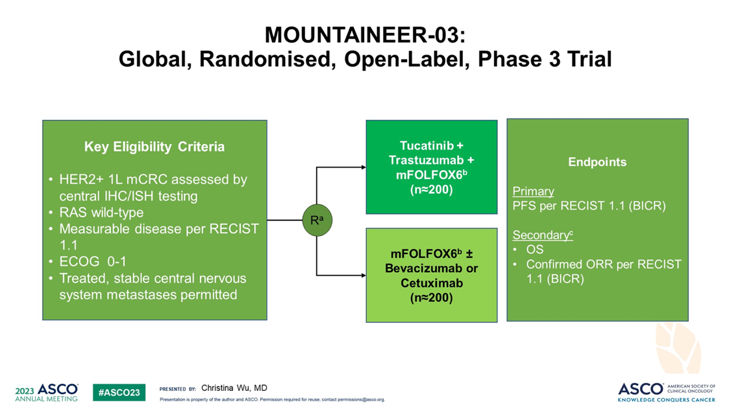
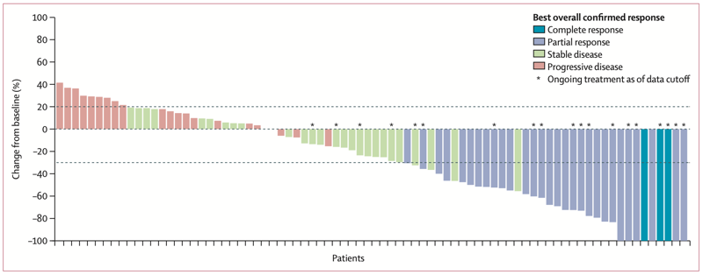
Metastatic MSS Colorectal Cancer
Coming soon for HER2 positive mCRC
MOUNTAINEER-03: A randomized Phase 3 trial of tucatinib + trastuzumab + FOLFOX vs. FOLFOX + cetux or bev for RAS WT HER2 + mCRC
Tucatinib + Trastuzumab is FDA approved for RAS WT, HER2 Amplified mCRC Patients
38% ORR
Stickler J, et al. Lancet Oncol. 2023 May;24(5):496-508

Slide 11
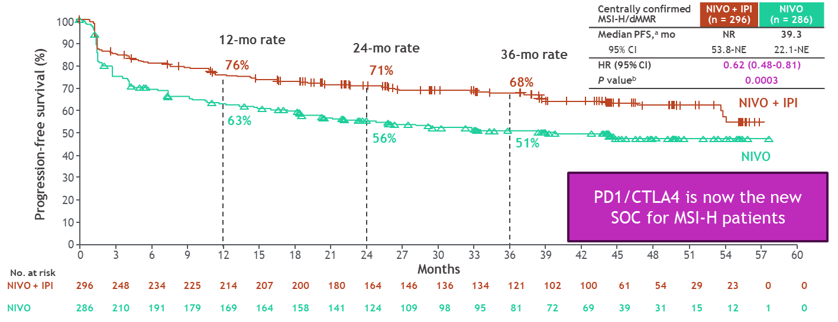
A New Standard for MSI-High mCRC
CheckMate 8HW is a randomized, multicenter, open-label phase 3 study in MSI-high met CRC
For 1st line therapy for MSI-high mCRC patients – Ipi + Nivo should definitely be considered the new standard of care
With a potential “cure rate” of up to 50%
Key eligibility criteria:
Histologically confirmed unresectable or metastatic CRC
MSI-H/dMMR status by local testing
Immunotherapy-naive
ECOG PS 0 or 1
NIVO 240 mg Q2W for 6 doses, followed by NIVO 480 mg Q4W^{b}
N = 353
R
2:2:1
N = 354
NIVO 240 mg + IPI 1 mg/kg Q3W for 4 doses, followed by NIVO 480 mg Q4W^{b}
N = 132
Investigator’s choice chemo^{c} (mFOLFOX6 or FOLFIRI ± bevacizumab or cetuximab)
Stratification factors:
Prior lines of treatment (0 vs 1 vs ≥ 2)
Primary tumor location (right vs left)
Treatment until disease progression, unacceptable toxicity, withdrawal of consent (all arms), or a maximum treatment duration of 2 years (NIVO and NIVO + IPI arms only)
Andre T, et al. Lancet. Published online January 25, 2025

Slide 12
Management of mCRC
Biomarker testing from the outset is absolutely critical
MMR testing can be done by IHC before the first new patient visit
All other testing can be ordered at the first visit, and should be available within 2-4 weeks
Newly Diagnosed Unresectable mCRC
MMR-Deficient/
MSI-high (3-5%)
Ipilimumab +
Nivolumab
BRAF^{V600E}
Mutated (7-12%)
Encorafenib +
Cetuximab + FOLFOX
Start FOLFOX ASAP
RAS/RAF
Wild Type (40%)
FOLFOX + Panitumumab (or Cetuximab)
*
*
HER2 Amplified
(5%)
FOLFOX + Tucatinib + Trastuzumab
RAS mutated
(40%)
FOLFOXIRI +
Bevacizumab

Slide 13
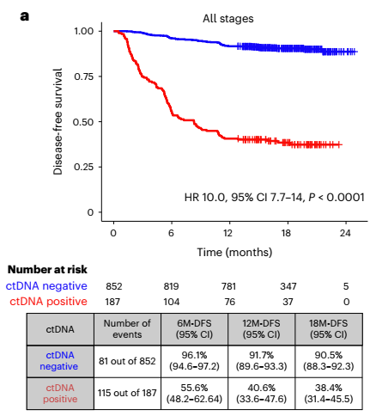
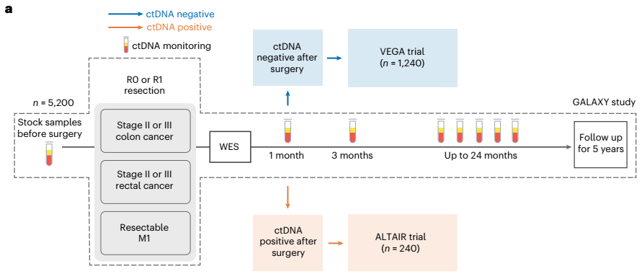
The Use of ctDNA in CRC
Post-operative ctDNA is prognostic for recurrence and survival
First Report: GALAXY Arm of CIRCULATE-JAPAN
Observational study of 1039 Stage 2-4 resectable CRC patients
82% ctDNA negative at 4 weeks post-surgery
Median follow-up of 16.74 months
ctDNA positive – 61.4% recurrence, 18mos DFS 38.4%
ctDNA negative – 9.5% recurrence, 18 mos DFS 90.5%
Hazard Ratio = 10.0, P < 0.0001
Kotani D, et al, Nat Med. 2023 Jan;29(1):127-134

Slide 14
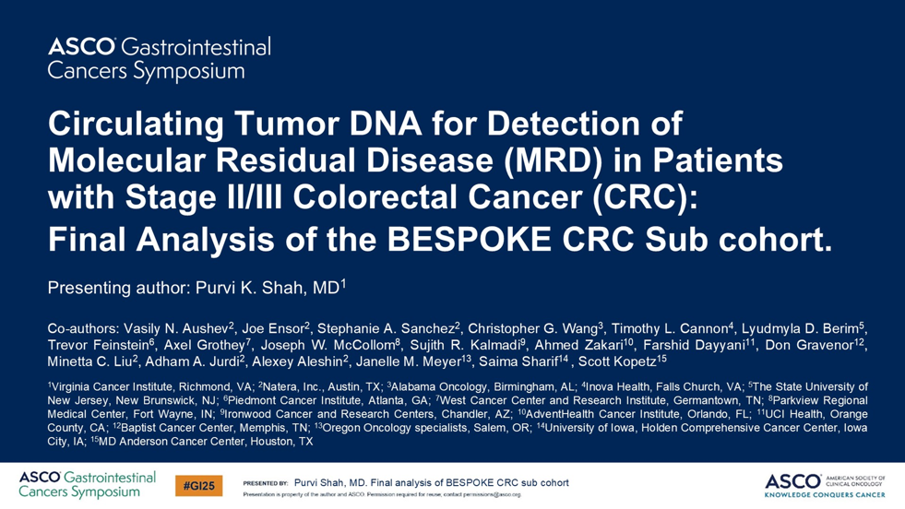
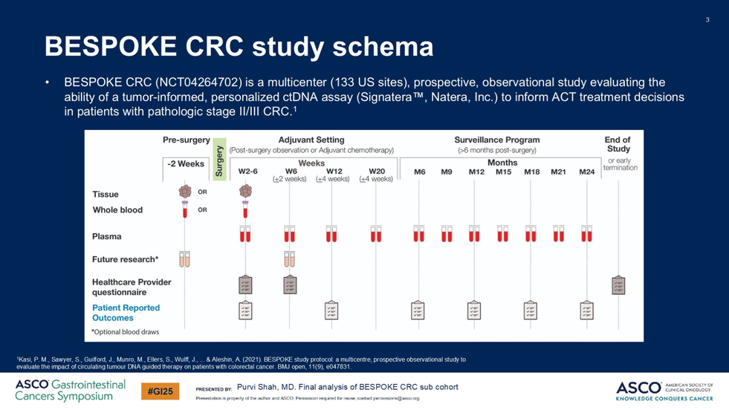
The Use of ctDNA in CRC
BESPOKE was the largest ctDNA MRD trial in colorectal cancer to date
BESPOKE used signatera testing

Slide 15
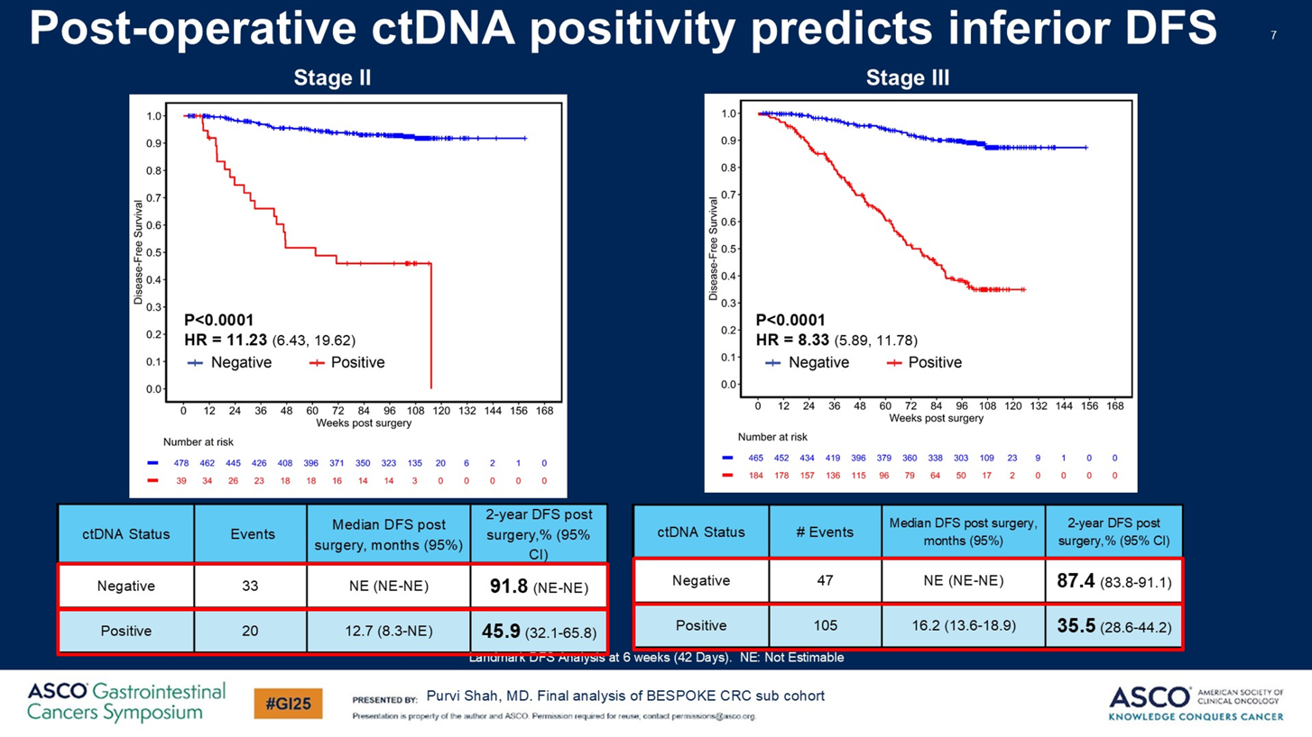
The Use of ctDNA in CRC

Slide 16
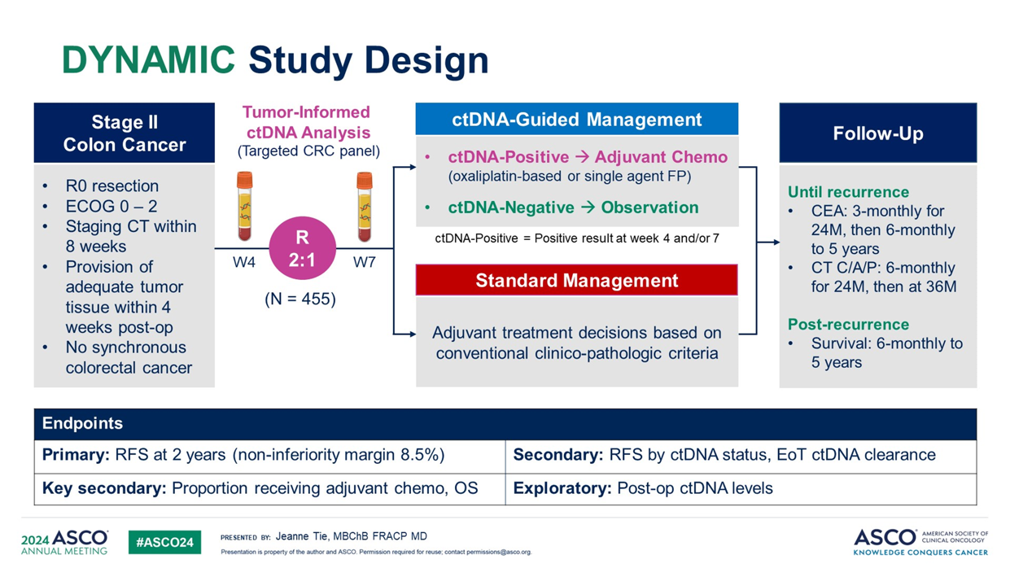
The Use of ctDNA in CRC
But – can a ctDNA-informed approach to adjuvant therapy selection?
Adjuvant therapy for Stage II colon cancer is an area of debate and a physician’s assessment of the clinical-pathological factors
Could the use of ctDNA-guided therapy reduce chemotherapy use without compromising survival outcomes?
Tie J, et al presented the updated 5-year results of the DYNAMIC trial
Tie J, N Engl J Med. 2022 Jun 16;386(24):2261-2272

Slide 17
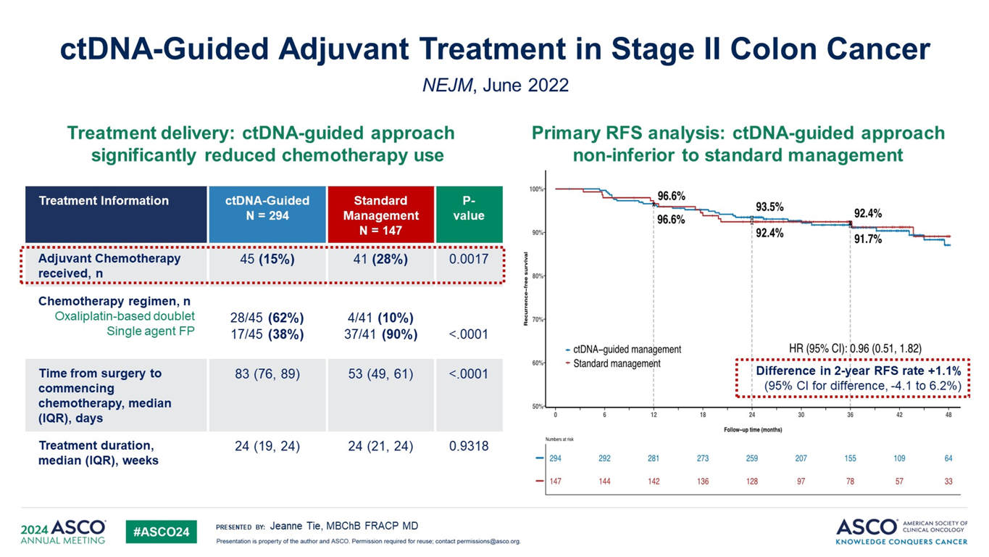
The Use of ctDNA in Colorectal Cancer
The use of ctDNA testing significantly reduced chemotherapy use
Ironically, when chemo is used in ctDNA positive patients, oxaliplatin is added much more often
Tie J, N Engl J Med. 2022 Jun 16;386(24):2261-2272

Slide 18
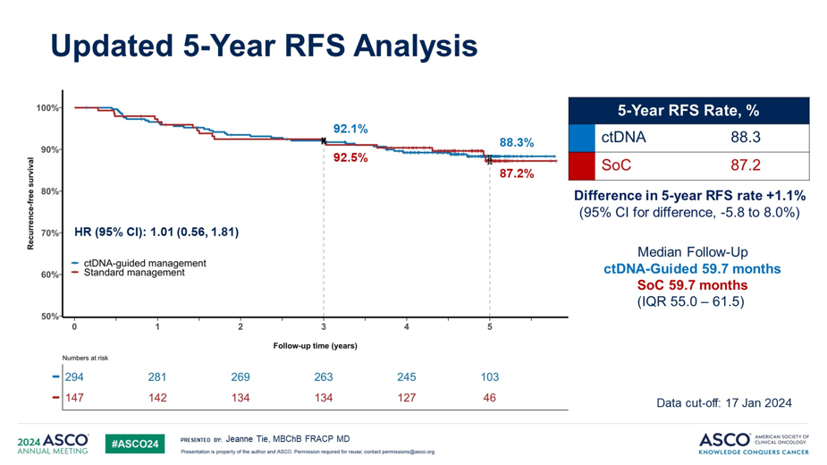
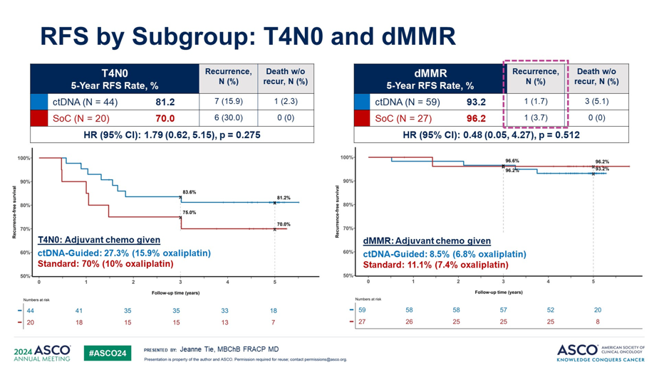
The Use of ctDNA in Colorectal Cancer
The use of ctDNA testing did not compromise RFS or OS
In fact, RFS was greater in the higher risk patients
Tie J, N Engl J Med. 2022 Jun 16;386(24):2261-2272

Slide 19
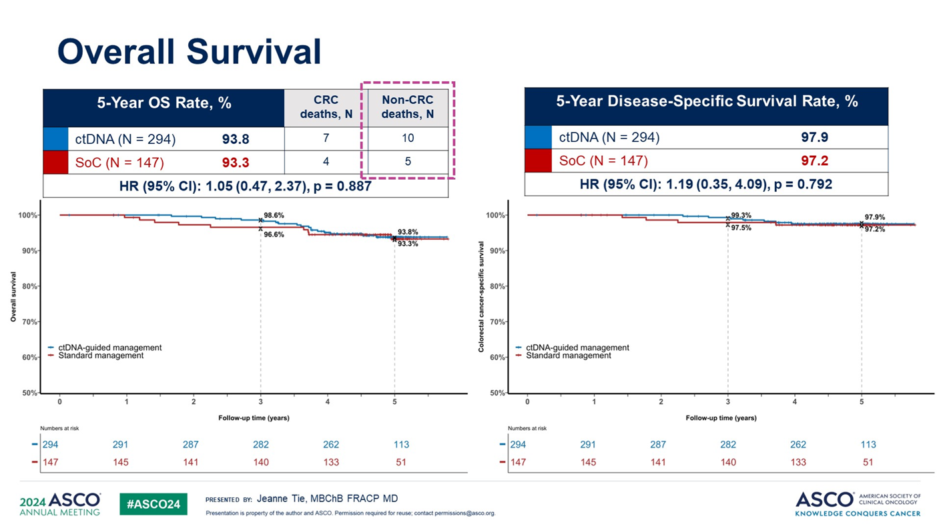
The Use of ctDNA in Colorectal Cancer
Tie J, N Engl J Med. 2022 Jun 16;386(24):2261-2272

Slide 20
Updates in
Gastroesophageal Cancer
G = Gastric
GEJ = Gastroesophageal Cancer
E = Esophageal

Slide 21
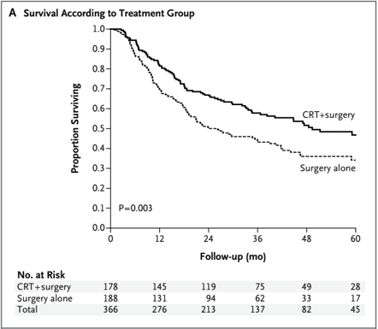
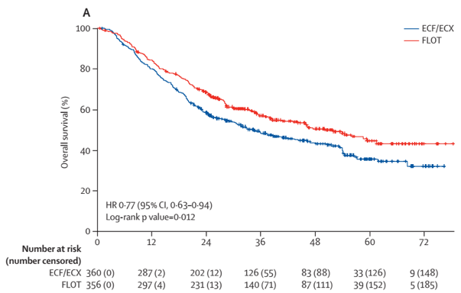
Adjuvant/Neoadjuvant Therapy for Esophageal/GEJ Cancer
In 2012, the CROSS regimen of carboplatin, paclitaxel and radiation delivered pre-operatively was shown to improve survival over surgery alone for patients with E/GEJ cancer
In 2019, peri-operative 5FU, oxaliplatin, and docetaxel (without radiation) became the new standard of care for G/GEJ cancers
So which regimen should we be using for GEJ cancers?
Van Hagan P, et al, N Engl J Med 2012;366:2074-84; Al-Batran SE, et al, Lancet 2019; 393: 1948–57

Slide 22
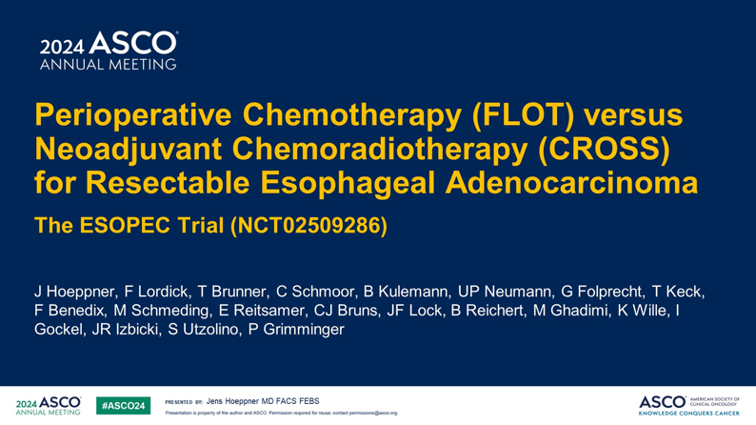
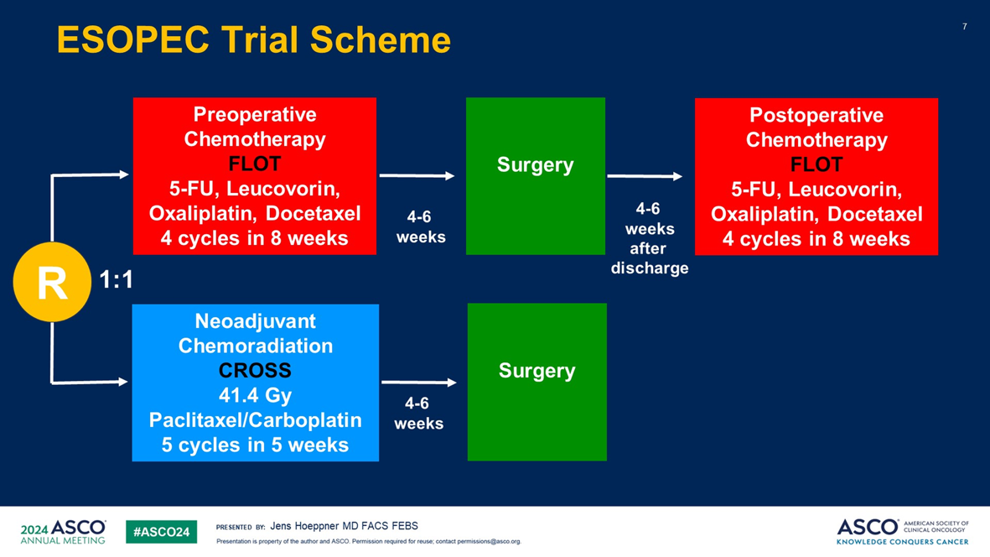
Adjuvant/Neoadjuvant Therapy for Esophageal/GEJ Cancer
Hoeppner J, et al aimed to answer the chemo vs. chemoradiation question in the ESOPEC trial
E/GEJ adenocarcinoma patients with localized disease were randomized to FLOT vs. CROSS, followed by surgery

Slide 23
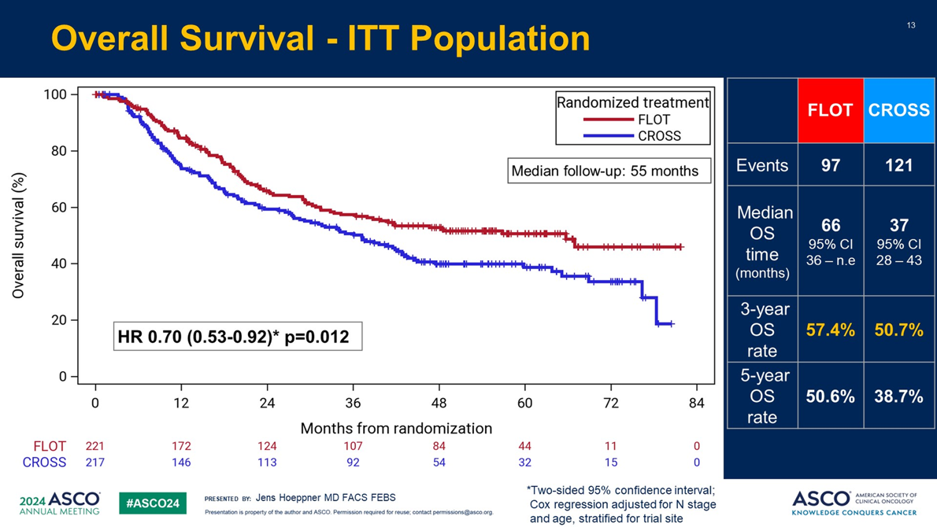
Adjuvant/Neoadjuvant Therapy for Esophageal/GEJ Cancer
Chemotherapy (FLOT) clearly improved mOS compared to chemoradiation (FLOT)
FLOT represents the new standard of care for E/GEJ adenocarcinoma patients with localized disease
But what about post-adjuvant immunotherapy?

Slide 24
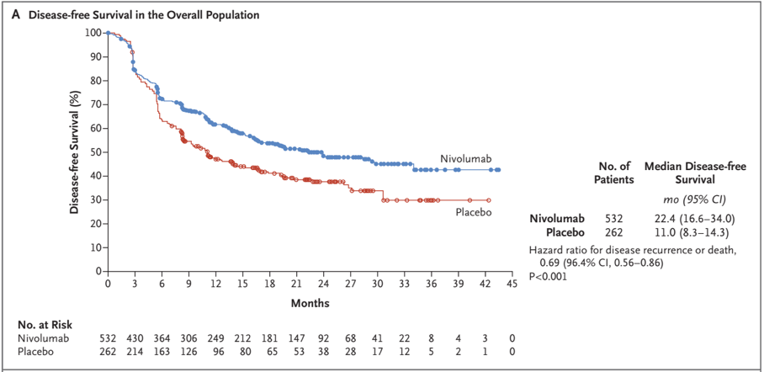
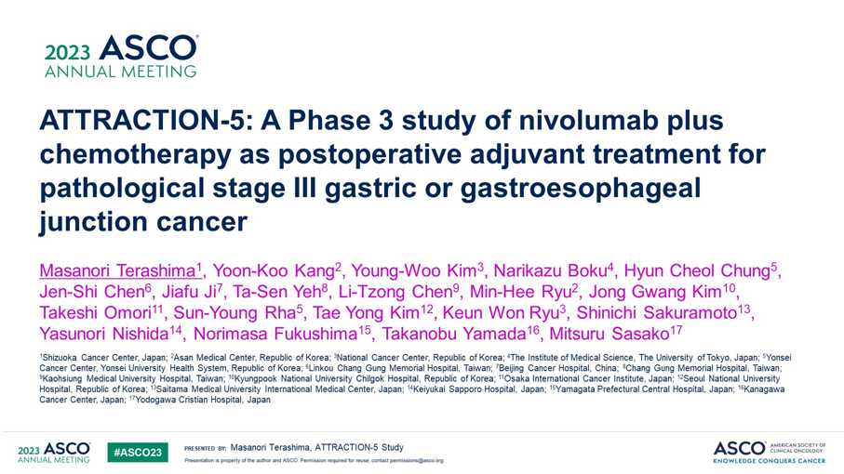
Adjuvant Nivolumab After E/GEJ/G Cancer Resection
In 2021, Dr. Kelly, et al showed that the addition of nivolumab post-operatively in patients with E/GEJ cancers with positive residual disease (i.e. a non-CR) after chemoXRT improved OS
In 2021, Dr. Janjigian, et al showed that the addition of nivolumab to chemotherapy in metastatic G/GEJ cancer improved mOS
But what about post-operative therapy for GASTRIC cancer?
Janjigian Y, et al, Lancet. 2021 Jul 3;398(10294):27-40. doi: 10.1016/S0140-6736(21)00797-2; ; Kelley RJ, et al, N Engl J Med. 2021 Apr 1;384(13):1191-1203. doi: 10.1056/NEJMoa2032125
Terashima M, et al, ASCO 2023, Abstract 4000

Slide 25
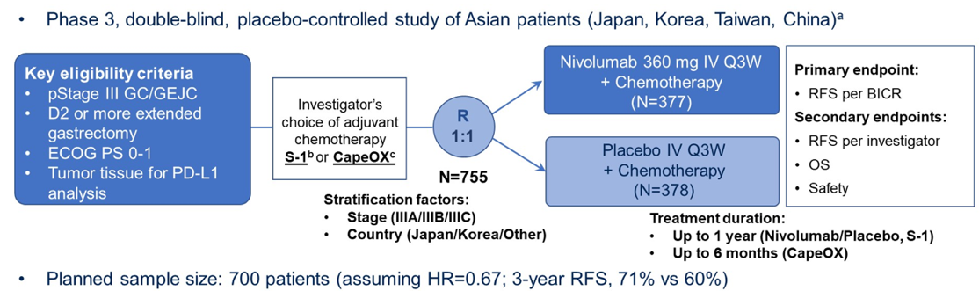
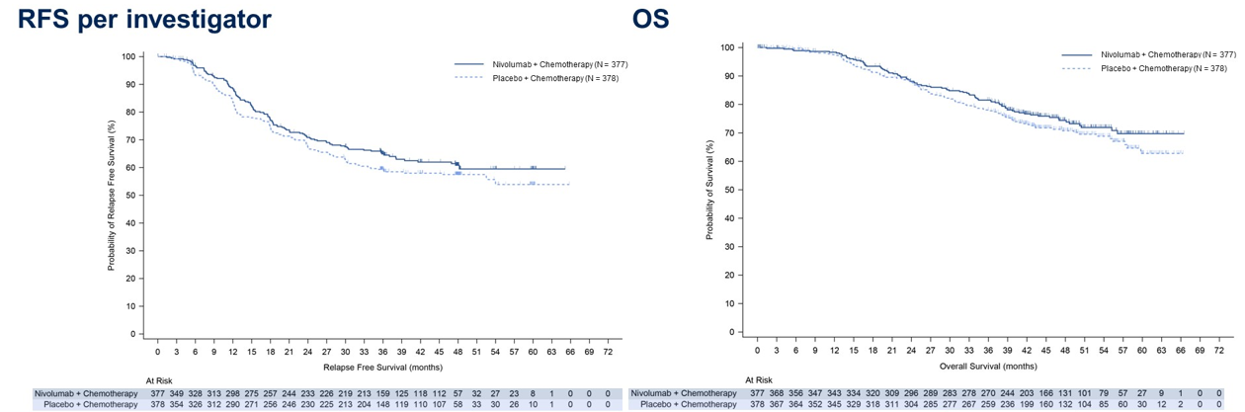
Adjuvant Nivolumab After Gastric Cancer Resection
 | Nivo | Placebo
mRFS (mos) | NE | NE
3y RFS (%) | 68.4 | 65.3
mOS (mos) | NR | NR
3y OS (%) | 81.5 | 78.0
No improvement in RFS or OS
So currently – there is no role for adjuvant nivo for resected gastric cancer
Terashima M, et al, ASCO 2023, Abstract 4000

Slide 26
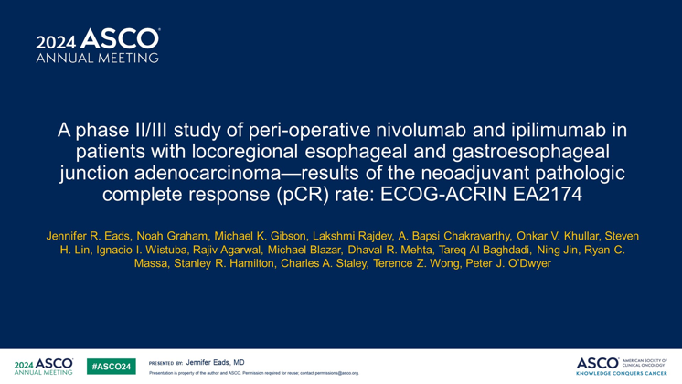
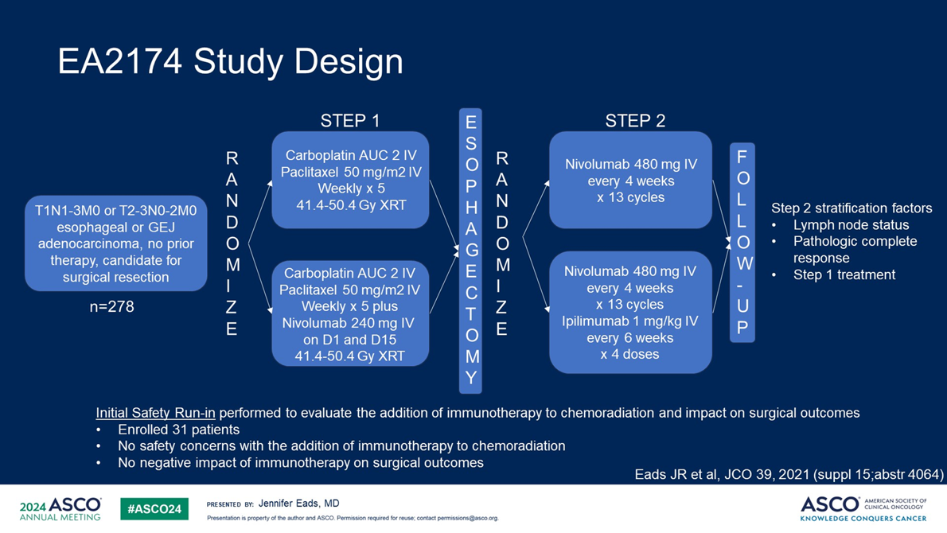
Adj/Neoadj Immunotherapy Therapy for Esophageal/GEJ Cancer
Eads J, et al, and ECOG-ACRIN asked whether peri-operative immunotherapy could improve outcomes when combined with chemoradiation (CROSS) for localized E/GEJ adenocarcinoma

Slide 27
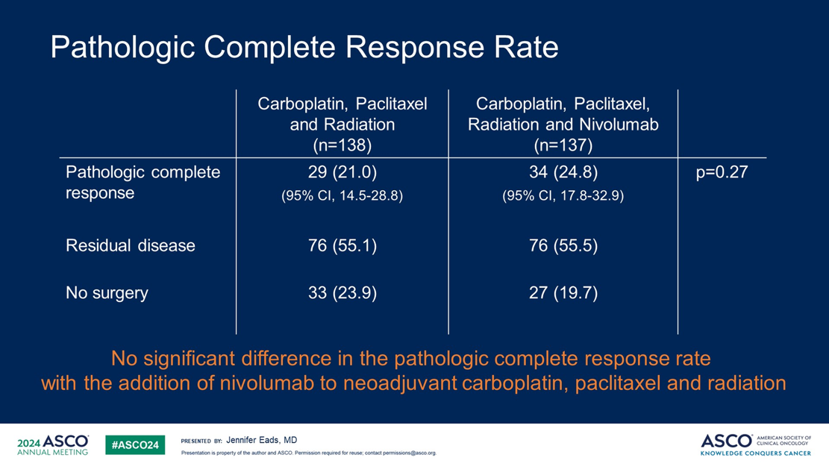
Adj/Neoadj Immunotherapy Therapy for Esophageal/GEJ Cancer
Take home for all of these studies:
For E/GEJ/Gastric adenocarcinoma the standard of care is peri-operative FLOT
There may still be patients who need radiation – and so pre-operative CROSS might still be applicable
Post-adjuvant immunotherapy has no benefit for resected gastric patients
Unanswered Questions:
Should we give post-adjuvant immunotherapy after FLOT (i.e. without radiation)?
What about esophageal SCC patients (25% of the CROSS trial participants)

Slide 28
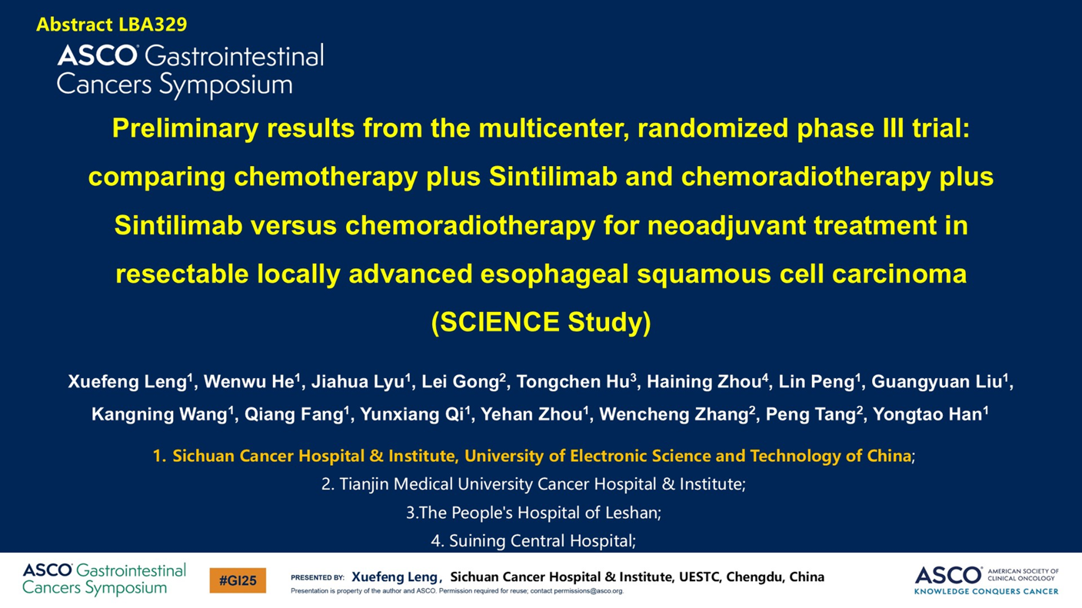
Is There a Difference in Esophageal Squamous Cell Cancer?
Leng X, et al, presented a trial of peri-operative immunotherapy combined with chemo +/- radiation (CROSS) for esophageal squamous cell cancer

Slide 29
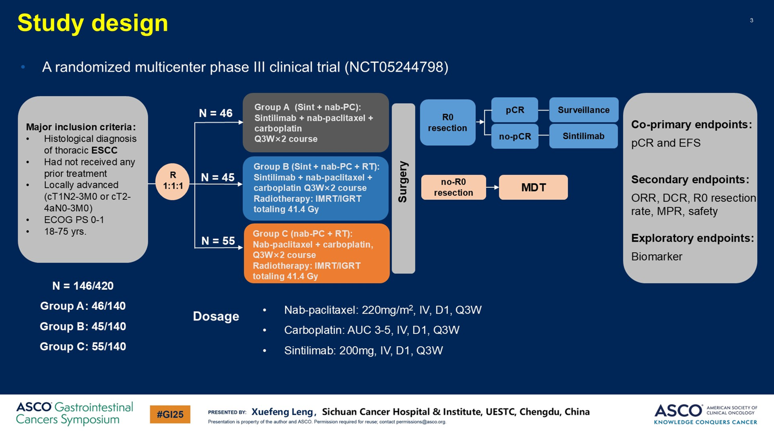
Is There a Difference in Esophageal Squamous Cell Cancer?

Slide 30
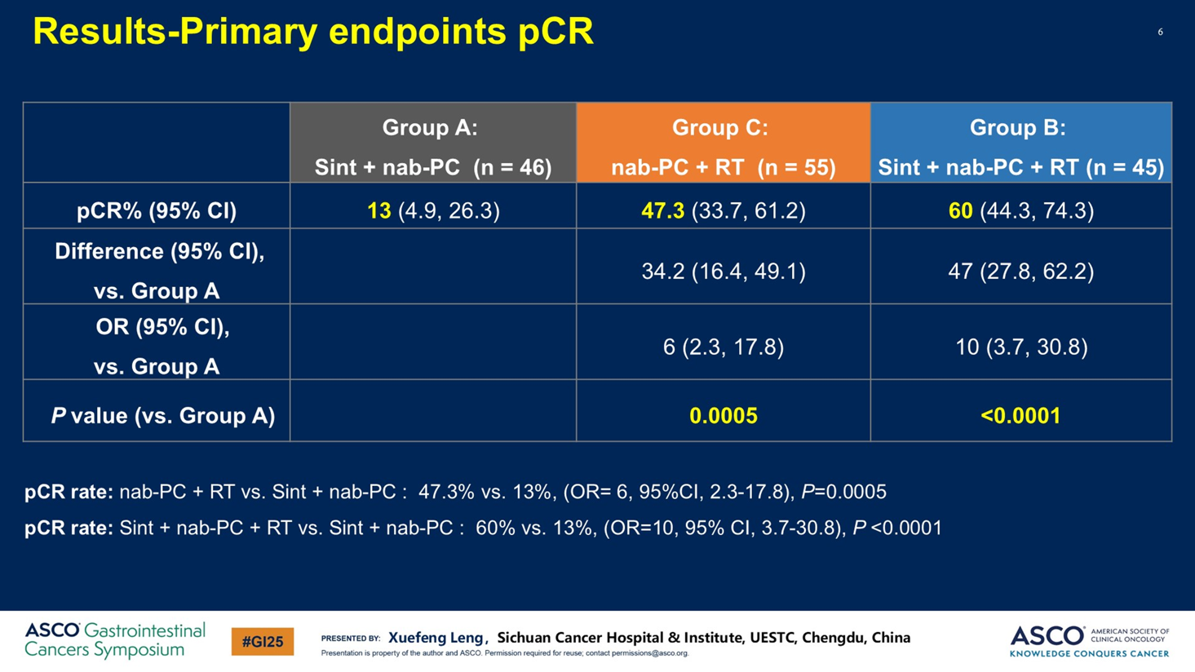
Is There a Difference in Esophageal Squamous Cell Cancer?

Slide 31
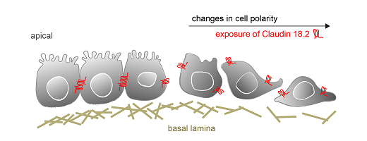
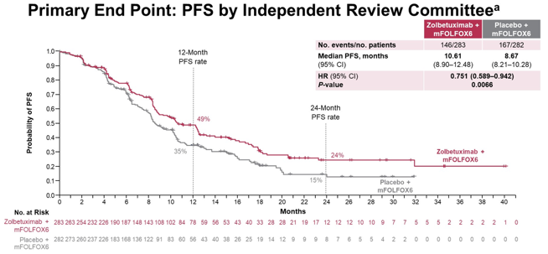
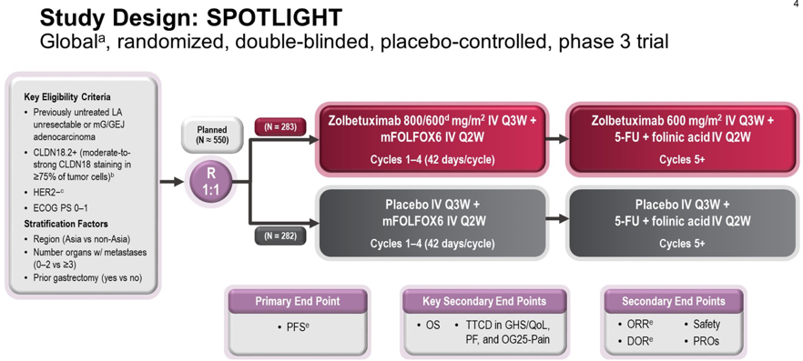
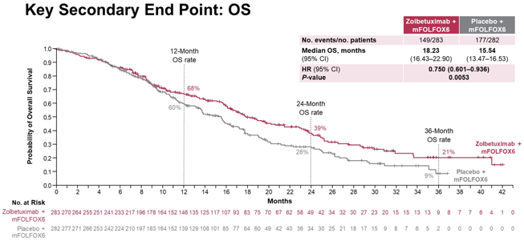
Metastatic Gastric Cancer: Claudin 18.2 – SPOTLIGHT Trial
Claudin 18.2 is a tight junction protein normally expressed in gastric mucosal cells, and is retained in G/GEJ cancer cells
But, in cancer cells, tight junctions are disrupted and Claudin 18.2 becomes exposed on the surface of the G/GEJ cancer cells
Zolebetuximab in an anti-Claudin 18.2 mAb
 | Zolbe | Placebo
ORR (%) | 60.7 | 62.1
mPFS (mos) | 10.61 | 8.67
mOS (mos) | 18.23 | 15.54
10% MORE Gr3/4 N/V
On target AE
2244 patients screened; 38.5% were Claudin 18.2+
Shitara K, et al, Lancet . 2023 May 20;401(10389):1655-1668. doi: 10.1016/S0140-6736(23)00620-7; Image from https://www.arigobio.com/news/claudin-18.2

Slide 32
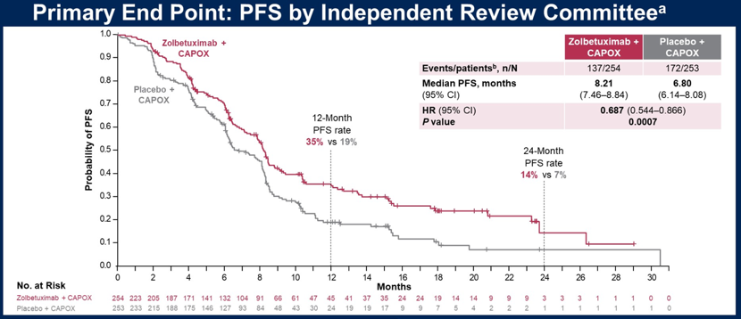
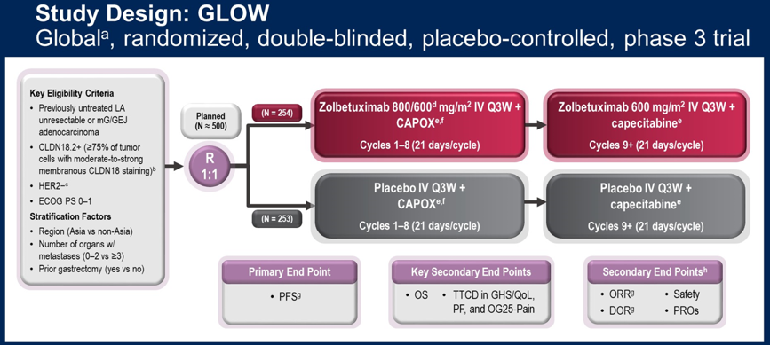
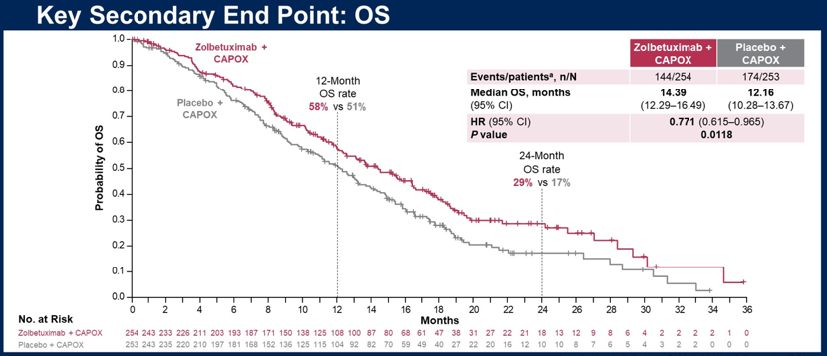
Metastatic Gastric Cancer: Claudin 18.2 – GLOW Trial
GLOW was a Phase 3 trial of CAPOX +/- Zolbetuximab
2333 patients screened; 38.4% were Claudin 18.2+
 | Zolbe | Placebo
ORR (%) | 53.8 | 48.8
mPFS (mos) | 8.21 | 6.80
mOS (mos) | 14.39 | 12.16
Many, many other Claudin 18.2 targeted therapies in development
Xu RH, et al, ASCO 2023 Abstract 405736; Image from https://www.arigobio.com/news/claudin-18.2

Slide 33
Updates in Pancreatic Cancer

Slide 34
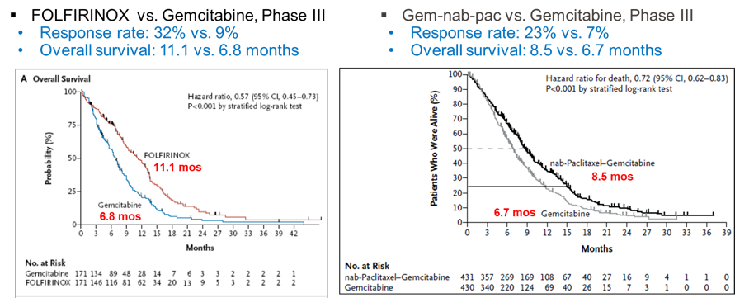
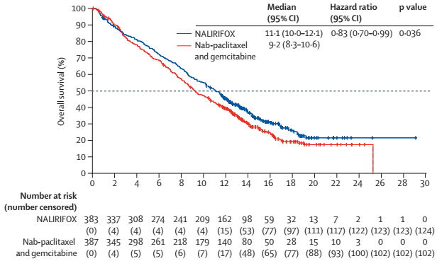
Extending Survival
FOLFIRINOX and Gemcitabine + Nab-paclitaxel have been our SOC regimens for mPDAC for 10+ years
There has never been a head to head comparison of these two regimens
NAPOLI-3 was a Phase 3 trial comparing NALIRIFOX to gem-nab-pac
Improved PFS and OS with NALIRIFOX
More GI tox with NALIRIFOX
More heme tox with gem-nab-pac
 | NFOX | Gnab
ORR (%) | 41.8 | 36.2
mOS (mos) | 11.1 | 9.2
mPFS (mos) | 7.4 | 5.6
Conroy T, et al. N Engl J Med. 2011;364:1817-1825; Von Hoff, NEJM, 2013, 369(18): 1691-1703 ; Wainberg, ZA, Lancet. 2023 Sep 11;S0140-6736(23)01366-1

Slide 35
JCOG1611: Japanese Randomized Phase 2/3: Gem-nab-pac vs. FOLFIRINOX
Gem-Nab-Pac vs. FOLFIRINOX vs. S-IROX in Japan
426 patients randomized 1:1:1
Median OS
Gem-nab-pac = 17.1 months
FOLFIRINOX = 14 months
S-IROX = 13.6 months
Gem-nab-pac is the first line standard in Japan
A Ohba, et al, Eur J Cancer. 2023 Mar;181:135-144. doi: 10.1016

Slide 36
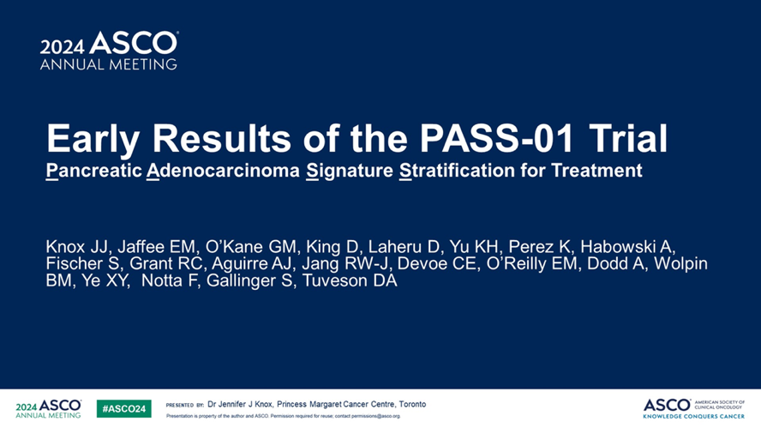
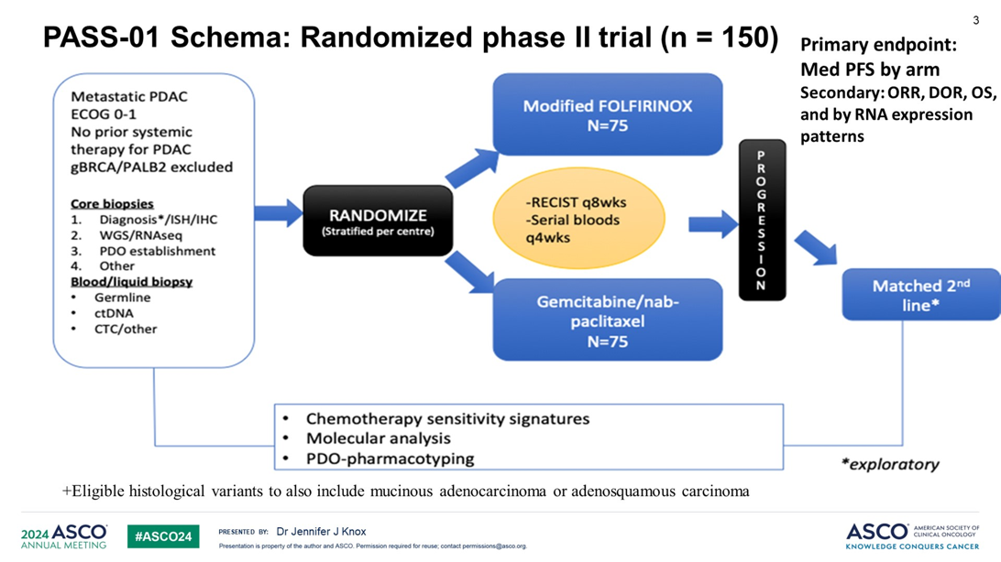
PASS-01 Trial
SU2C-led 1st line trial
Biopsies and extensive molecular analysis for each patient
Excluded gBRCA1/2/PALB2 patients

Slide 37
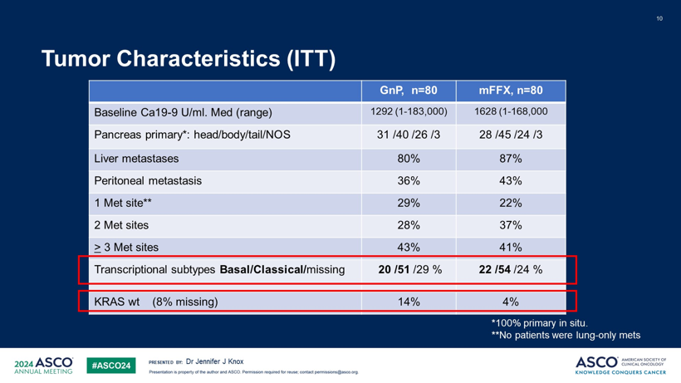
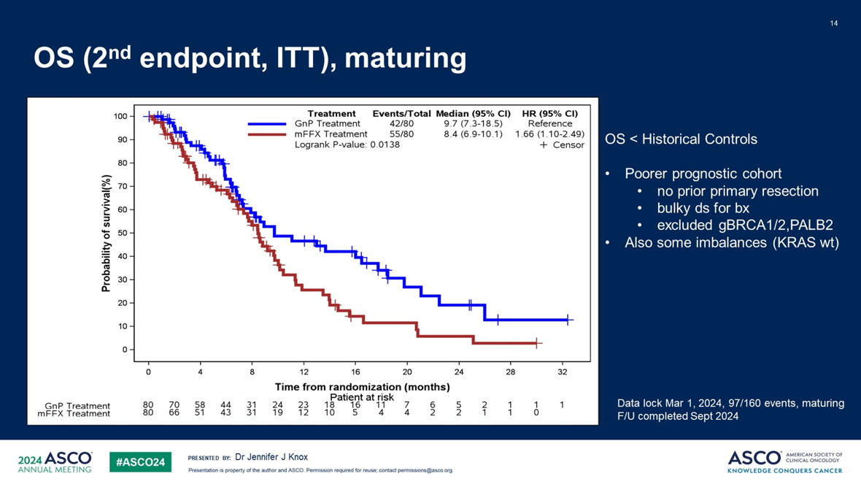
PASS-01 Trial
PFS and OS slightly greater with gem-nab-pac

Slide 38


PASS-01 Trial
Basal subtype = worse prognosis
Gem-nab-pac does better in basal subtype

Slide 39


RTOG 0848
Adjuvant chemo +/- radiation for resected HOP cancers
2 step randomization
2009: Original trial randomized to gem +/- erlotinib (N=336)
2016: Amendment allowed other gem-based regimens (N=210)

Slide 40


RTOG 0848
DFS and OS benefit for radiation in the node-negative patients

Slide 41


KRAS Mutations in Pancreatic Cancer
KRAS mutations occur in 90 – 95% of pancreatic cancers
KRAS mutations are a key event in the initiation and development of PDAC
KRAS cycles between a GTP-on state and a GDP-off state
The protein resynthesis half life is 24 hours
Craig Logsdon and Weiqin Lu, Int J Bio Sci, 2016; 12(3): 338–346

Slide 42



KRAS^{G12C} Inhibitors in Pancreatic Cancer
Sotorasib
Adagrasib
Strickler J, et al, N Engl J Med 2023;388:33-43; Pant S, et al, ASCO 2023; Saab T, et al, J Clin Oncol. 2023 Sep 1;41(25):4097-4106; Li J, et al, GI-ASCO, Abstract #604

Slide 43

Targeting Other KRAS Mutations in Pancreatic Cancer
Targeting KRAS is going to be a “game changer” in pancreatic cancer
Garrido-Laguna I, et al presented an updated on the pan-RAS(on) inhibitor, Daraxonrasib (RMC-6236)
Spira A, et al presented an updated on the KRAS G12D inhibitor, Zoldonrasib (RMC-9805)
Garrido-Laguna I, et al, Abstract #722; Spira A, et al, Abstract #724, GI-ASCO 2025

Slide 44



The pan-RAS(on) inhibitor, Daraxonrasib (RMC-6236) as 2L Tx in Pancreatic Cancer
mPFS in KRAS^{G12X} = 8.8 months (and increasing)
mOS in KRAS^{G12X} = 14.5 months (and increasing)
Garrido-Laguna I, et al, Abstract #722, GI-ASCO 2025

Slide 45

The KRAS G12D inhibitor, Zoldonrasib (RMC-9805)in Pancreatic Cancer
Spira A, et al, Abstract #724, GI-ASCO 2025

Slide 46


Slight Differences in the Safety Profile of the KRAS inhibitors
These agents have NOT yet been compared head to head, but:
PanRas inhibitor
Much higher incidence of a rash, diarrhea, and fatigue
KRASG12D specific inhibitor
Higher incidence of nausea – sometimes very early onset
Garrido-Laguna I, et al, Abstract #722; Spira A, et al, Abstract #724, GI-ASCO 2025

Slide 47
Updates in Biliary Tract Cancer

Slide 48


TOPAZ-1: Gem-Cis +/- Durvalumab in Cholangiocarcinoma
For more than a decade, gemcitabine + cisplatin had been the standard of care in advanced biliary cancer
Gem-cis vs. gemcitabine alone
mOS 11.7 vs. 8.1 months
ORR 26.1 vs. 15.5%
TOPAZ-1 was a Phase III randomized trial of gemcitabine + cisplatin +/- durvalumab for advanced biliary cancer
Note that gem-cis was stopped in both arms after 8 cycles
Patients with advanced, untreated biliary cancer
685 patients were randomized
1:1 randomization
Balanced arms
Valle J, et al, NEJM 2010; 362: 1273 – 1281
Oh DY, et al, 2022 ASCO Gastrointestinal Cancers Symposium, Abstract 378

Slide 49


TOPAZ-1: Gem-Cis +/- Durvalumab in Cholangiocarcinoma
Overall survival was significantly greater for gem-cis-durva vs. gem-cis
mOS 12.8 vs. 11.5 months
HR = 0.80, p = 0.021
HR after 6 months was 0.74
Progression-free survival was significantly greater for gem-cis-durva vs. gem-cis
mPFS 7.2 vs. 5.7 months
HR = 0.75, p = 0.001
Overall survival benefit held true for virtually all subgroups analyzed including PD-L1 status
Oh DY, et al, 2022 ASCO Gastrointestinal Cancers Symposium, Abstract 378

Slide 50


KEYNOTE-966: Gem-Cis +/- Pembro in Cholangiocarcinoma
In April, 2023, Dr. Kelley presented a very similar trial
KEYNOTE-966 was a Phase III randomized trial of gemcitabine + cisplatin +/- pembrolizumab in advanced biliary cancer
Here ONLY cisplatin was stopped in both arms after 8 cycles (gem was continued)
Outcomes were very similar to TOPAZ-1
 | TOPAZ-1 |  | KEYNOTE-966
 | Gem-Cis | Gem-Cis-Durva | Gem-Cis | Gem-Cis-Pembro
ORR (%) | 19 | 27 | 29 | 29
mPFS (mos) | 5.7 | 7.2 | 5.6 | 6.5
mOS (mos) | 11.5 | 12.8 | 10.9 | 12.7
Kelley RR, et al, Lancet. 2023 Jun 3;401(10391):1853-1865. doi: 10.1016/S0140-6736(23)00727-4. Epub 2023 Apr 16. PMID: 37075781

Slide 51


Cholangiocarcinoma is “Target-Rich”
Molecular profiling is critical to the care of patients with advanced intrahepatic cholangiocarcinoma
“Precision Medicine” in BTC (2020)
“Precision Medicine” in BTC (2023)
Lamarca A, et al. J Hepatol. 2020;73 (1):170-185. Kendre G, et al. J Hepatol. 2023;78(3):614-626.

Slide 52
FDA Approvals in Biliary Tract Cancer
3 targets with FDA cholangiocarcinoma- or BTC-specific approval
FGFR2 fusions (10%)
IDH1 mutations (10%-15%)
HER2 expression (10%-15%)
6 targets with disease-agnostic approvals
HER2 expression (10%-15%)
BRAF V600E mutations (4%-5%)
NTRK fusions (< 1%)
RET fusions (< 1%)
Microsatellite instability-high (MSI-H/dMMR; 1%-3%)
High Tumor Mutational Burden (TMB-H; 1%-3%)
1. NCCN Guidelines for Biliary Tract Cancer. https://www.nccn.org/professionals/physician_gls/pdf/btc.pdf; 2. Zanidatamab prescribing information. https://www.accessdata.fda.gov/drugsatfda_docs/label/2024/761416s000lbl.pdf.

Slide 53




Targeting HER2 Overexpression and/or Amplification (10%-15% of BTCs)
Trastuzumab/Pertuzumab (2 monoclonal antibodies) | Zanidatimab (bi-specific antibody) | Trastuzumab/Tucatinib (monoclonal Ab/small molecule) | Trastuzumab-deruxtecan (antibody drug conjugate)
MyPathway (N = 39) HER2 3+ by IHC, HER2:CEP17 >2.0 or HER2 CN>6.0 by FISH/CISH, or HER2 amp by NGS | HERIZON-BTC-01 (N = 80) HER2 2+ or 3+ by IHC | SGNTUC-019 (N = 30) HER2 3+ by IHC, HER2:CEP17 >2.0 or HER2 CN>6.0 by FISH/CISH, or HER2 amp by NGS | DESTINY-PanTumor 02 (N = 41 with BTC) HER2 2+ or 3+ by IHC
ORR: 23% DoR: 10.8 months | ORR: 41.3% DoR: 12.9 months ORR 51.6%/5.6% for IHC 3+/2+ | ORR: 46.7% DoR: 6.0 months | ORR 22% DOR 8.6 months ORR 56.3%/0% for IHC 3+/2+
Javle M, et al. Lancet Oncol. 2021;22:129-1300. | Harding J, et al. Lancet Oncol. 2023;24:772-782. | Nakamura Y, et al. J Clin Oncol. 2023;41:5569-5578. | Meric-Bernstam F, et al. J Clin Oncol. 2024;42:47-58.

Slide 54
Updates in HCC

Slide 55

Bev-Atezo in vs Sorafenib in Hepatocellular Cancer
For more than a decade, sorafenib was the standard of care first line therapy for advanced HCC
In 2018, Lenvatinib was demonstrated to be non-inferior to sorafenib as first-line therapy for advanced HCC
Lenvatinib vs. Sorafenib
mOS 13.6 vs. 12.3 months
ORR 18.8 vs. 6.5%
In 2020, atezolizumab + bevacizumab became the new 1st line standard of care
Atezo + Bev vs. Sorafenib
mOS NR vs. 13.2 months
ORR 27.3 vs. 11.9%
Llovet et al, NEJM 2008; 359: 378 – 390; Kudo M, et al, Lancet, 2018 Marl 391: 1163-1173; Finn R, et al, NEJM 2020: 1894 - 1905

Slide 56


HIMALAYA: Tremilimumab + Durvalumab vs Sorafenib in Hepatocellular Cancer
Phase III randomized trial of tremi + durva vs. durva alone vs. sorafenib
Patients with advanced, untreated HCC
1324 patients evenly distributed among 3 arms
1:1:1 randomization
mOS was significantly greater for tremi + durva vs. sorafenib
mOS 16.4 vs. 13.8 months
HR = 0.78, p = 0.0035
Secondary objective showed non-inferiority of single agent durvalumab vs. sorafenib
mOS 16.6 vs. 13.8 months
HR = 0.86
Overall survival benefit held true for virtually all subgroups analyzed
Abou-Alfa G, et al, 2022 ASCO Gastrointestinal Cancers Symposium, Abstract 379

Slide 57


Nivolumab + Ipilimumab vs. Sorafenib/Lenvatinib for HCC
Tremi + Durva is a standard of care dual-immunotherapy option
What about nivo + ipi?
Virtually identical patient population as for HIMALAYA
Except that 85% of patients received lenvatinib

Slide 58

Nivolumab + Ipilimumab vs. Sorafenib/Lenvatinib for HCC
Nivo + ipi improved mOS compared to sorafenib/lenvatinib
3 options now available
Which do you choose?
Study | Experimental | Control
ImBrave150 | Atezo + Bev | Sorafenib
 | 19.2 | 13.4
HIMALAYA | Tremi + Durva | Sorafenib
 | 16.4 | 13.8
CheckMate 9DW | Nivo + Ipi | Sorafenib/Lenva
 | 23.7 | 20.6

Slide 59


What About Local Therapy + Concurrent Immunotherapy for HCC?
Note that this was technically not a trial of IO +/- TACE
But, it still gives an assessment in a Phase 3 trial of TACE + IO

Slide 60


EMARALD-1: TACE + IO for HCC
The mPFS of TACE + Durva + Bev was 15.0 months
Compared to a mPFS of 6.8 months with bev + atezo
A trial of IO +/- TACE also needs to be done

Slide 61
Conclusions – Key Takeaways
Colorectal cancer:
Biomarker testing is crucial even early on for first-line therapy for metastatic CRC
MSI-H: Ipi + Nivo
BRAFV600E-mutated: Encorafenib + cetuximab + FOLFOX
RAS/RAF Wild Type: FOLFOX + Panitumumab
RAS-Mutated: FOLFOXIRI + Bev
ctDNA testing for Stage 2/Stage 3 colon cancer is now standard and, for stage 2 could be used to decide treatment
Upper GI cancers:
FLOT is superior to chemoradiation (CROSS) for esophageal adenocarcinoma
Immunotherapy + chemoradiation (CROSS) might be an upcoming standard for localized esophageal squamous cell cancer
Post-adjuvant immunotherapy improves survival for residual disease positive esophageal/GEJ cancers but not gastric cancer
Zolbetuximab is now approved for Claudin 18.2 positive, metastatic gastric cancer
Pancreatic cancer
FOLFIRINOX, NALIRIFOX, and Gem-nab-pac are all still reasonable regimens in the first line
Adjuvant radiation does not improve survival after pancreatic cancer resection
KRAS inhibitors are going to make a major impact
Biliary Tract cancer
Biomarker testing, biomarker testing, biomarker testing!!!
HCC:
3 Phase 3 proven immunotherapy options
Consider TACE + IO for TACE-appropriate patients
Thank you and Questions?

Slide 62


