Slide 1



Best of San Antonio Breast Cancer
January 25, 2025

Slide 2
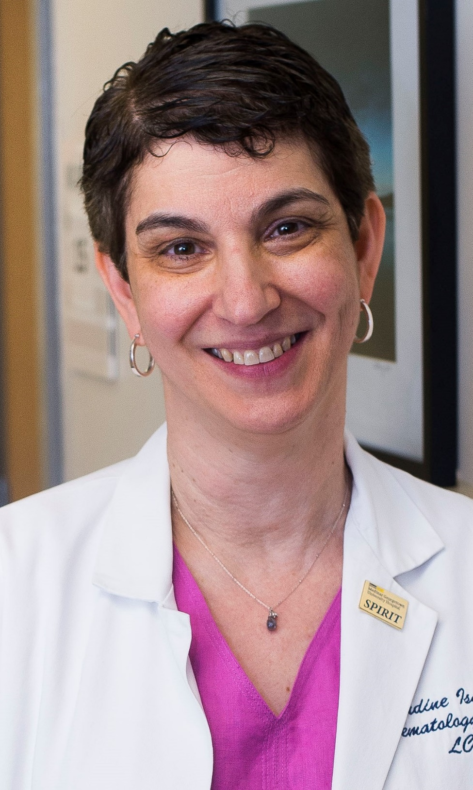
Claudine Isaacs, MD
Dr. Claudine Isaacs is a Professor of Medicine and Oncology, Associate Director of Clinical Research and Leader of the Clinical Breast Cancer Program at the Lombardi Comprehensive Cancer Center (LCCC) at Georgetown University. She is also the Medical Director of the Jess and Mildred Fisher Center for Hereditary Cancer and Clinical Genomics Research. She has extensive experience in the conduct of clinical trials focusing on all aspects of breast cancer and currently serves as Co-Chair Endocrine Resistance Working Group of the Translational Breast Cancer Research Consortium (TBCRC) and as Co-Chair of the Clinical Trials Operations Working Group for the I-SPY 2 Trial. She has authored over 200 peer-reviewed publications and edited two textbooks. She has served on a number of national committees including the Cancer Education and the Scientific Program Committees at ASCO, the Breast Oncology Local Diseases Task Force of the Breast Steering Committee of the NCI. She currently is a member of the ASCO Breast Cancer Guideline Advisory Group.

Slide 3

SABCS 2024 Updates in HR+/HER2- Breast Cancer
Claudine Isaacs, MD, FRCPC
Professor of Medicine and Oncology
Associate Director, Clinical Research
Leader, Clinical Breast Cancer Program
Georgetown University

Slide 4
Disclosures
Consultancies: AstraZeneca, Genentech, Gilead, ION, Merck, Medscape, MJH Holdings, Novartis, Pfizer, PUMA, Seagen
Royalties: Wolters Kluwer (UptoDate); McGraw Hill (Goodman and Gillman)
Research support (to institution): Tesaro/GSK; Seattle Genetics; Pfizer; AZ; BMS; Genentech; Novartis; Regeneron
Speaker is being compensated for his presentation today by International Oncology Network (“ION”). However, neither ION nor any pharmaceutical company has influenced the content of this presentation nor has ION independently verified the presentation for accuracy

Slide 5
SABCS 2024: Updates in HR+/HER2- BC
Early Stage Disease
Impact Anthra in high genomic risk LN- HR+/HER2- BC – GS3-03
nab-PAC vs sb-PAC WSG ADAPT HR+/HER2- – GS3-04
SOLTI VALENTINE: Neoadj HER3-DXd +/- Letrozole vs Chemo – LB1-06
Metastatic Disease
DESTINY-Breast06: Update by subset LB1-04
EMBER-3: Imnulestrant +/- Abema vs SOC ET GS1-01
PADMA: 1L ET+ CDK4/6i vs Chemo LB1-03

Slide 6
EARLY STAGE BREAST CANCER

Slide 7
Impact of Anthracyclines in High Genomic Risk Node-Negative HR+/HER2- Breast Cancer
Nan Chen MDª, Jincong Q Freeman MPH MS, Sudha Yarlagadda MD, Aishwarya Atmakuri, Kevin Kalinsky MD, Lajos Pusztai MD DPhil, Dezheng Huo MD PhD, Rita Nanda MD, Frederick M Howard MDª
Presentation ID: GS3-03
ª Department of Internal Medicine, Section of Hematology/Oncology, University of Chicago, Chicago, IL, USA
Notes:
Good morning. I would like to thank the organizers for allowing me the pleasure of speaking with everyone today. I would like to thank my co-authors in this work.

Slide 8
Study Design
Key Eligibility Criteria
Node-negative
ER-pos, HER2-neg
T1c-T2 (high-risk T1b)
21 gene RS (N=11,232)
Register (N=10,273)
Mid-Range RS 11-25 (N=6711 evaluable)
RANDOMIZE
ARM A: Low RS 0-10
(N=1619 evaluable)
Endocrine Therapy (ET)
ARM B: Experimental Arm
(N=3399)
ET Alone
ARM C: Standard Arm
(N=3312)
ET + Chemo
ARM D: High RS 26-100
(N=1389 evaluable)
ET + Chemo
2,549 Cases Received TC or T-AC and Included in Analysis
92 missing covariates excluded
Reference: Sparano et al. NEJM 2018
Notes:
Cut down on TAILORx data

Slide 9
Patient Characteristics
 | T-AC n = 438 | TC n = 2111
Age, mean (SD) | 53.0 (9.3) | 55.1 (9.1)
Menopausal Status, n (%)
Postmenopausal | 256 (58.4) | 1359 (64.4)
Premenopausal | 182 (41.6) | 752 (35.6)
Tumor Size (mm), mean (SD) | 19.6 (9.0) | 17.7 (8.1)
Grade, n (%)
Low | 63 (14.4) | 461 (21.8)
Medium | 203 (46.3) | 1096 (51.9)
High | 159 (36.3) | 504 (23.9)
PR Status
Positive | 348 (79.5) | 1810 (85.7)
Negative | 90 (20.5) | 301 (14.3)
 | T-AC n = 438 | TC n = 2111
Recurrence Score, mean (SD) | 29.6 (14.2) | 22.3 (9.5)
Recurrence Score, n (%)
11-25 | 196 (44.7) | 1554 (73.6)
26-30 | 69 (15.8) | 251 (11.9)
31-100 | 173 (39.5) | 306 (14.5)
Chemotherapy Regimen, n (%)
Dose dense AC-T | 186 (42.5)
Standard AC-T | 110 (25.1)
Concurrent TAC | 57 (13.0)
Other Anthracycline / Taxane | 85 (19.4)
TC |  | 2111 (100.0)

Slide 10
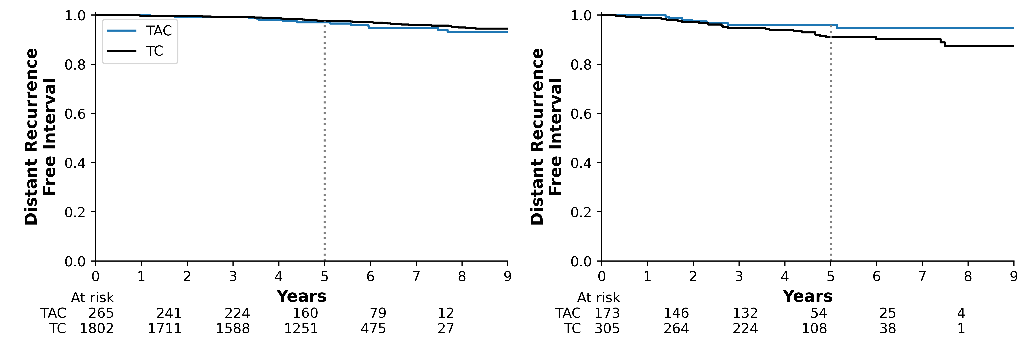
Primary Survival Outcome: Distant Recurrence-Free Interval at 5 years
RS < 31
RS ≥ 31
 | TAC | TC
5 Year Rate | 97.0 | 97.6
(95% CI) | (93.9 – 98.6) | (96.7 – 98.2)
Adj HR | 1.24, p = 0.484
 | TAC | TC
5 Year Rate | 96.1 | 91.0
(95% CI) | (91.5 – 98.2) | (86.7 – 94.0)
Adj HR | 0.32, p = 0.009
**Interaction p value = 0.009
*Adjusted hazard ratios controlling for age, ER/PR status, RS, tumor size, treatment received, and interaction of treatment with RS
Notes:
We chose DRFI as our primary endpoint to provide the clearest correlation between this biomarker and focus on breast cancer endpoints.
Make a comment that there is a 5% difference at 5 years, and this was not randomized and tAC group was generally higher risk.

Slide 11
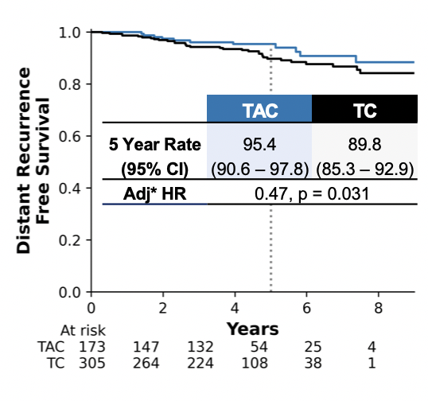
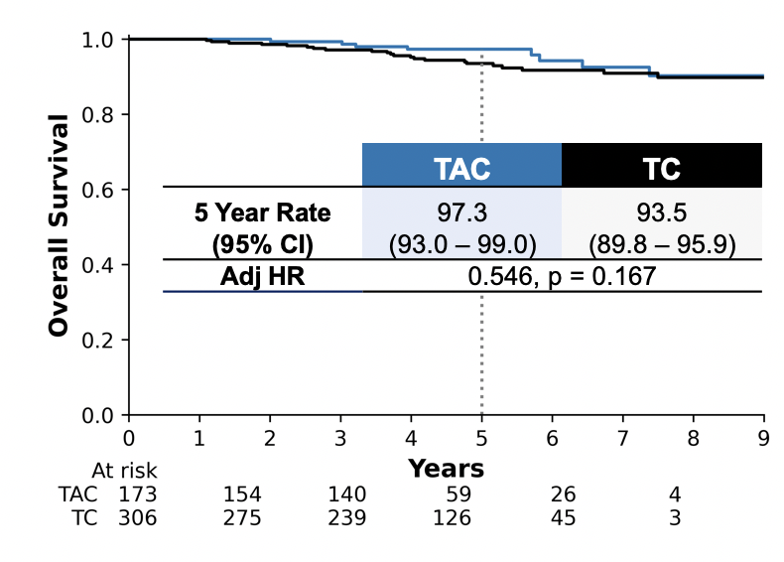
Selected Secondary Survival Outcomes: DRFS and OS at 5 years in RS > 31
DRFS
OS
*Adjusted hazard ratios controlling for age, ER/PR status, RS, tumor size, treatment received, and interaction of treatment with RS
Notes:
Add abbreviations to the top
We will do DRFS, OS
Take out RFI, RFS

Slide 12
Subgroup Analyses of T-AC vs TC with OncotypeDX RS > 31
Notes:
RED BOX AROUND TUMOR 2CM
In unadjusted data,
N = greater than 2 = few
NEEDS TO ADD N

Slide 13
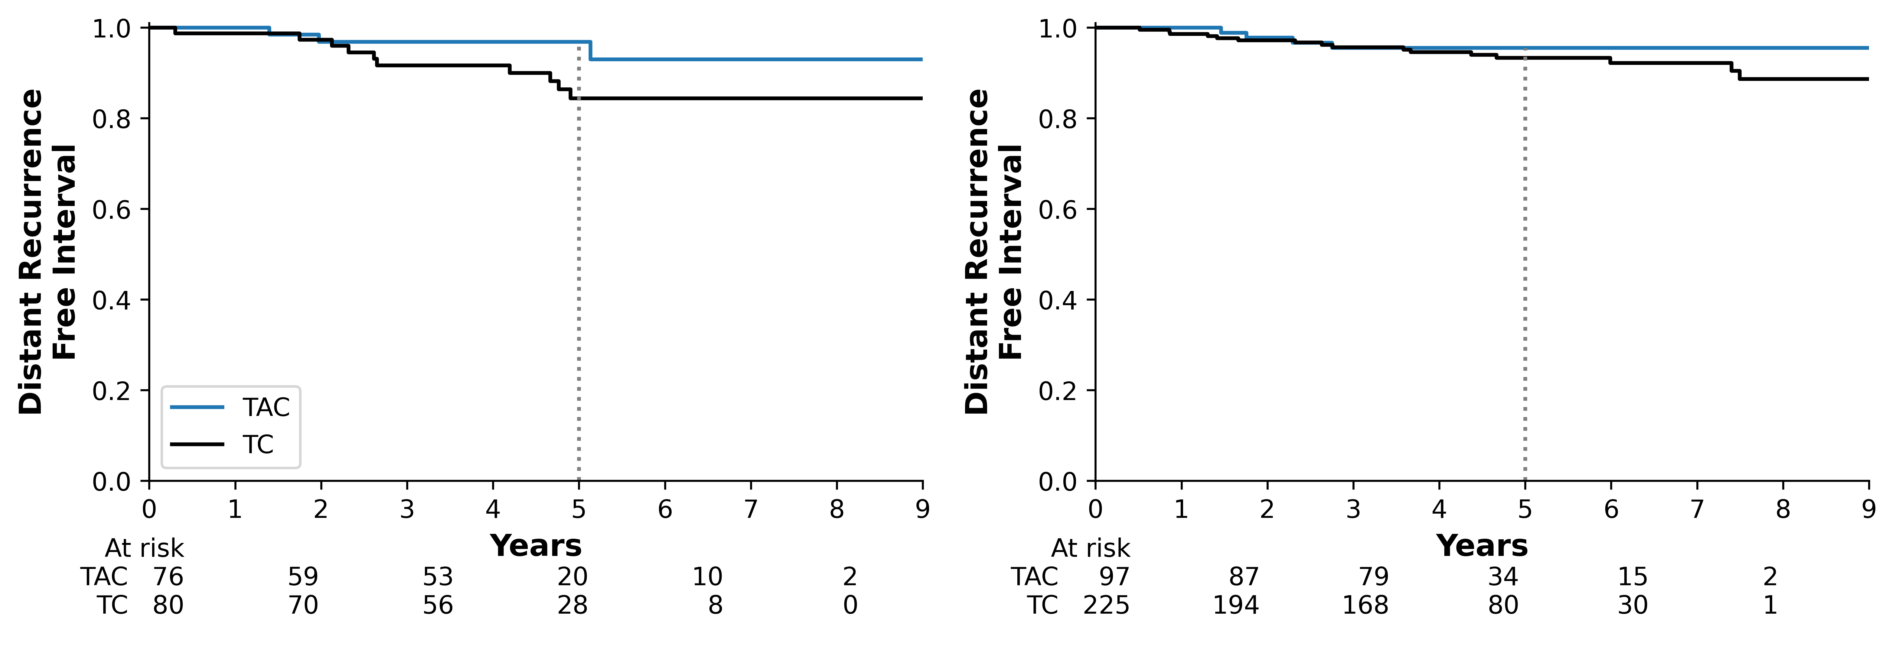
DRFI by Menopausal Status in RS > 31
Premenopausal
Postmenopausal
 | TAC | TC
5 Year Rate | 96.9 | 84.4
(95% CI) | (88.1 – 99.2) | (72.7 – 91.4)
Adj HR | 0.20, p = 0.032
 | TAC | TC
5 Year Rate | 95.6 | 93.4
(95% CI) | (88.6 – 98.3) | (88.8 – 96.1)
Adj HR | 0.25, p = 0.028
*Adjusted hazard ratios controlling for age, ER/PR status, RS, tumor size, treatment received in high RS population
Notes:
DRFI isolates the effect of the cancer specifically

Slide 14
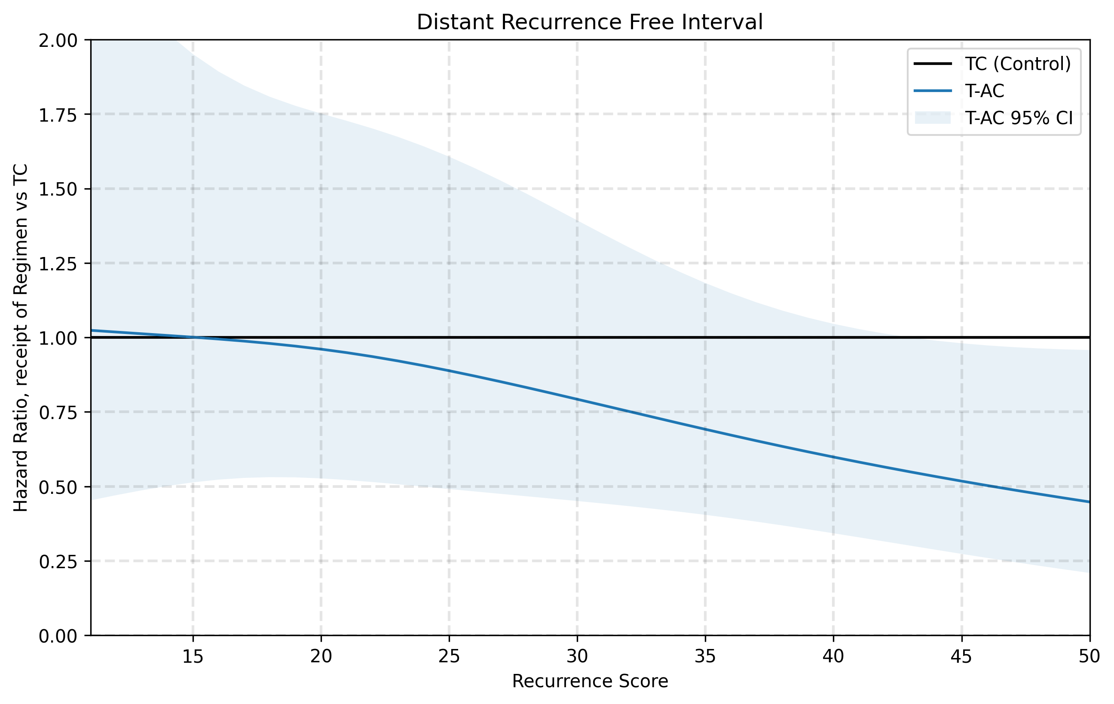
Increasing Benefit of Anthracyclines with Increasing RS
RS | Adj HR, DRFI
15 | 1.00 (0.51 - 1.95)
20 | 0.96 (0.53 - 1.75)
25 | 0.89 (0.49 - 1.61)
30 | 0.79 (0.45 - 1.39)
35 | 0.69 (0.40 - 1.18)
40 | 0.60 (0.34 - 1.05)
45 | 0.52 (0.27 - 0.98)
50 | 0.45 (0.21 - 0.96)
Notes:
Restricted cubic spline regression was used to estimate aHR for receipt of TAC, AC, CMF, or no chemotherapy (vs TC) for these endpoints as a function of RS, with L2 regularization to minimize overestimation of coefficients at extremes of RS
REVEAL DIFFERENT PARTS OF THE GRAPH AS YOU SEE IT BECOME SIGNIFICANT WITH INCREASING RS

Slide 15
MammaPrint High 2 predicts increased chemosensitivity to neoadjuvant anthracycline therapy in HR+HER2- EBC in the FLEX Registry Trial
Among High 1 cancers, pCR rates with AC-T/TAC vs TC were comparable
No High 2 cancer (n=10) developed pCR with TC
pCR rate with AC-T/TAC was significantly higher in High 2 compared to High 1 (p<0.001) cancers
Reference: Figure adapted from Audeh et al., 2024, Miami Breast Cancer Conference, Poster #36

Slide 16
TAILORx – RS to predict benefit from Anthra Conclusions
In patients with RS ≥ 31, improved 5 yr DRFI (96.1% vs 91%, aHR 0.32, p=0.009) and DRFS in those receiving T-AC vs TC
Clearest benefit for tumors > 2 cm
Despite bias toward higher risk patients receiving anthracycline
In keeping with findings from FLEX trial
BUT, a post hoc analysis so need to be cautious in interpreting findings
Consider integrating RS/MP in decision making regarding choice of chemo regimen

Slide 17
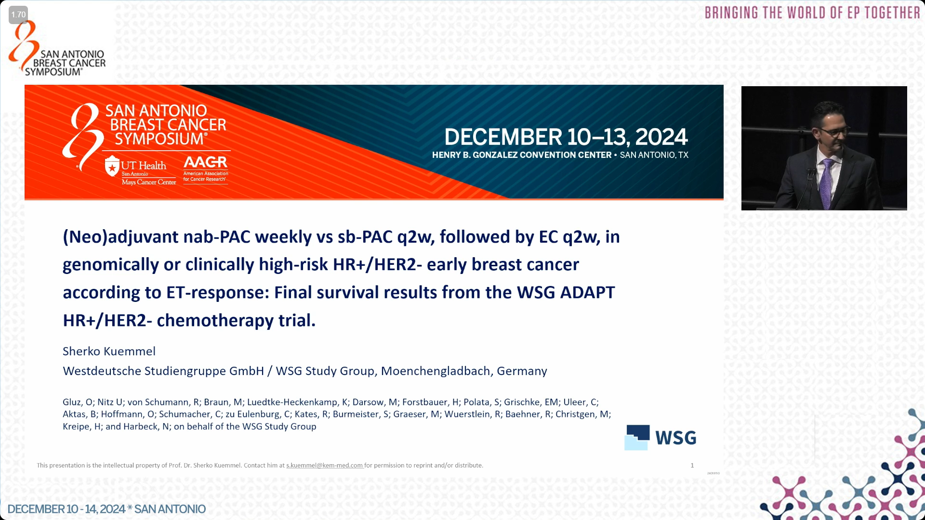

Slide 18
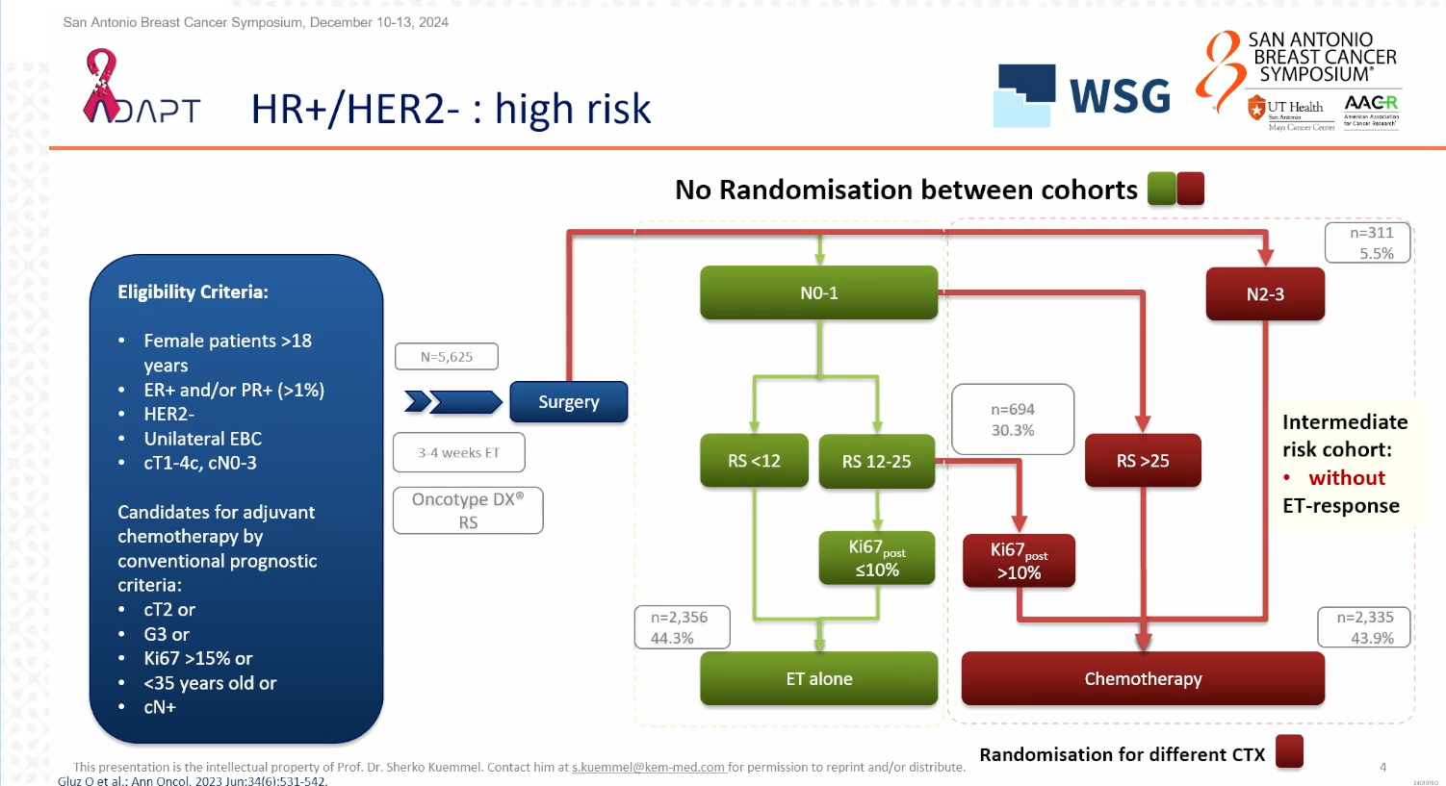
5-year Outcome of Chemotherapy Regimens
Primary objective:
Initially to show non-inferiority of nab-pac on 5 y DFS
Amended in 2021, to demonstrate superiority of nab-pac on 5 y iDFS
dd T x 4 -> dd AC/EC x 4 vs
Nab-pac wkly x 12 -> dd AC/EC x 4

Slide 19
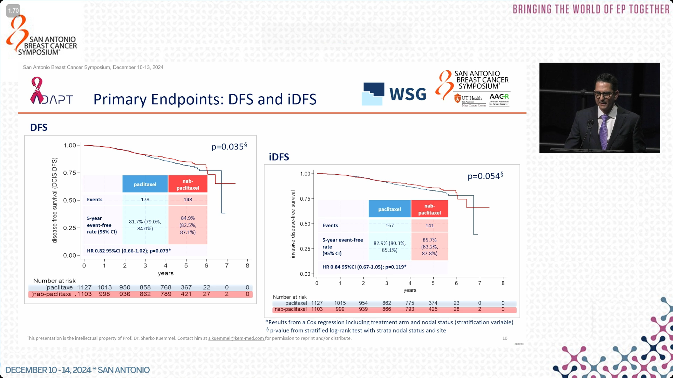
No difference in dDFS or OS
More myelosuppression, fatigue, nausea with nab-pac
More bone pain and bit more neuropathy with pac

Slide 20
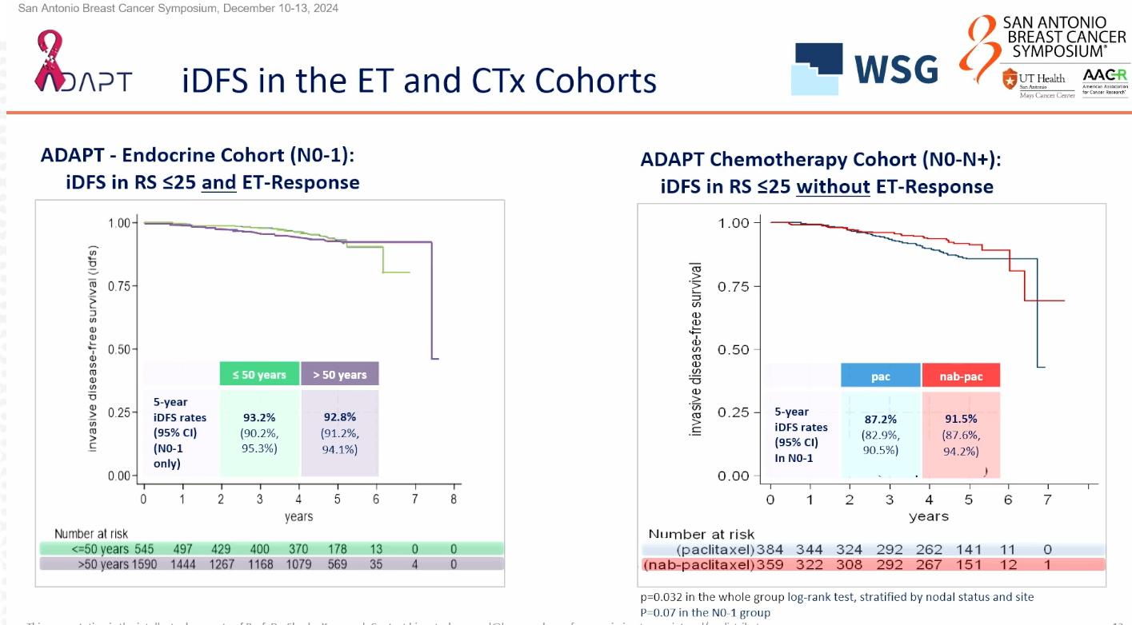
Implications:
Nab-paclitaxel an option (good to have if HSR occurs)
Excellent outcome in endocrine response cohort with RS ≤ 25
5y dDFS > 96% ET alone regardless of age

Slide 21
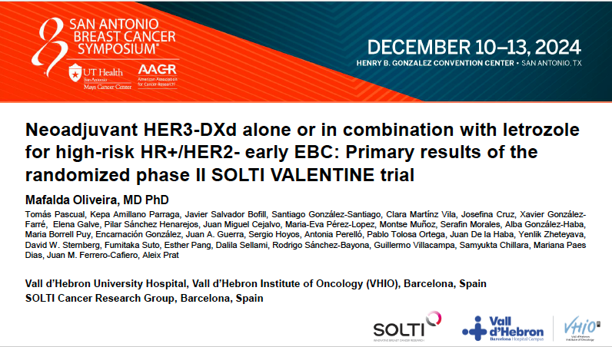

Slide 22
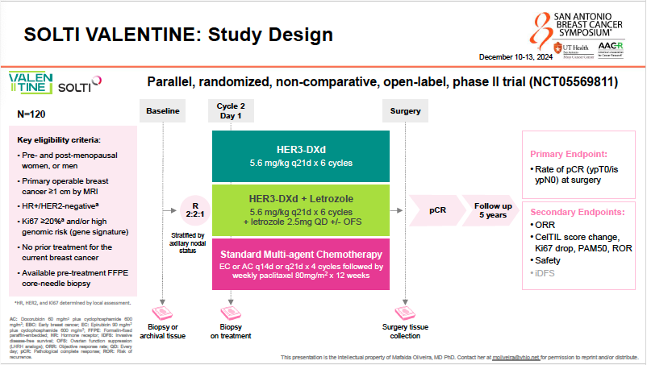
Not designed to formally compare treatment arms in terms of pCR rate
Designed to provide good estimate of pCR in each arm

Slide 23
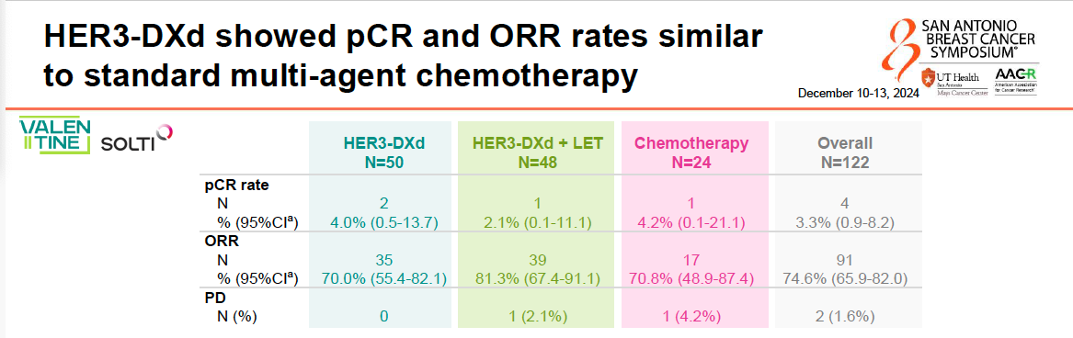
HER3-DXd either alone or with letrozole showed evidence of tumor activity
Drop in Ki67
Switch to less proliferative PAM50 subtypes
Shift in ROR scores from medium/high at baseline to low at surgery (same in chemo arm)
Change in CelTIL score (biomarker of response that combines tumor cellularity and TILs and predicts likelihood of tumor shrinkage)

Slide 24

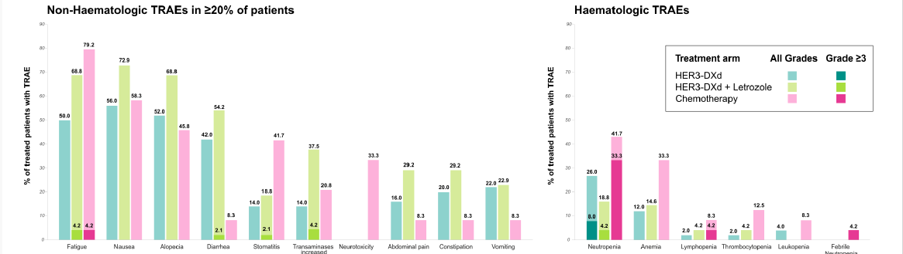
HER3-DXd better tolerated than chemo
- Grade≥3 AEs (14 %vs 46%)
- Less interruptions (~12% vs 38%)
- Less d/c (0-4% vs 8%)
- No cases ILD with HER3-DXd

Slide 25
SOLTI VALENTINE -- Implications
HER3-DXd similar activity to chemo and better tolerated
Potential novel neoadjuvant therapy for higher risk HR+/HER2- breast cancer

Slide 26
METASTATIC BREAST CANCER

Slide 27
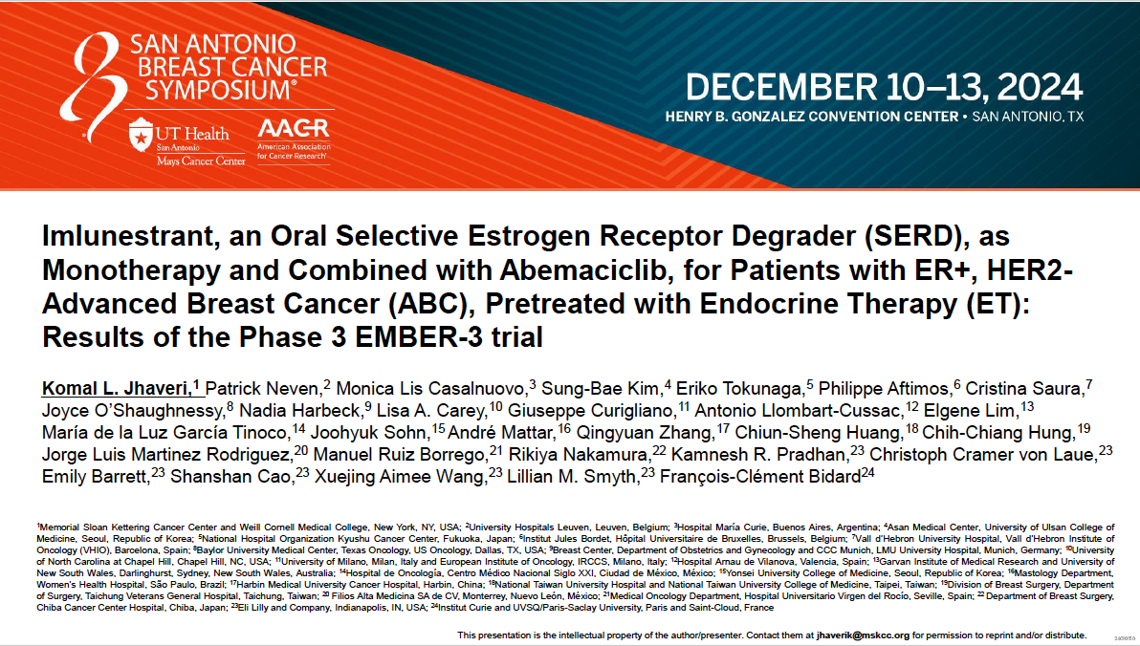

Slide 28
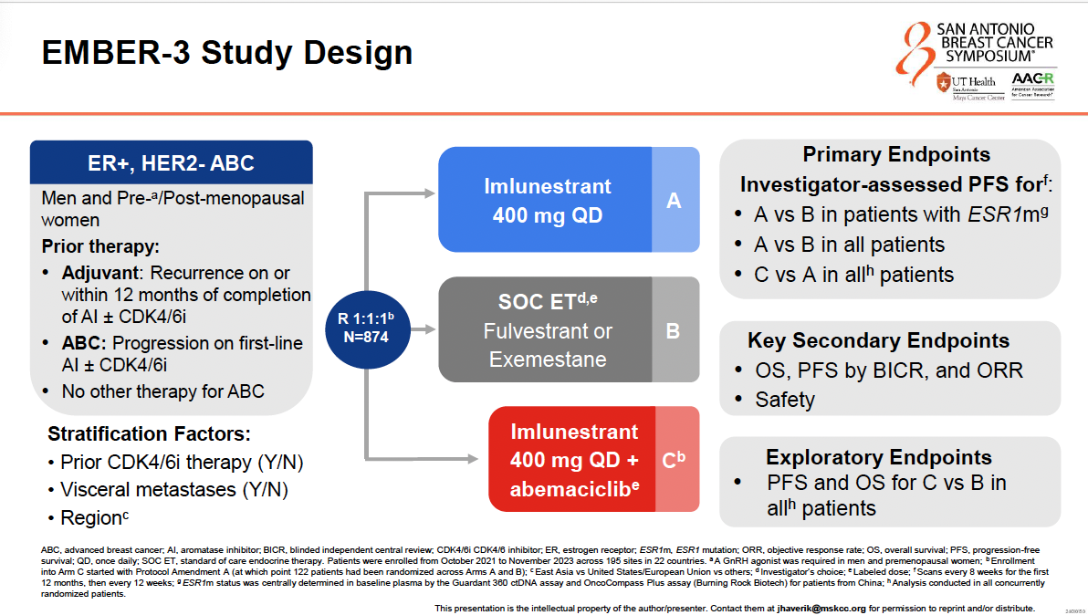
SOC ET: 88% Fulvestrant; 10% Exemestane

Slide 29
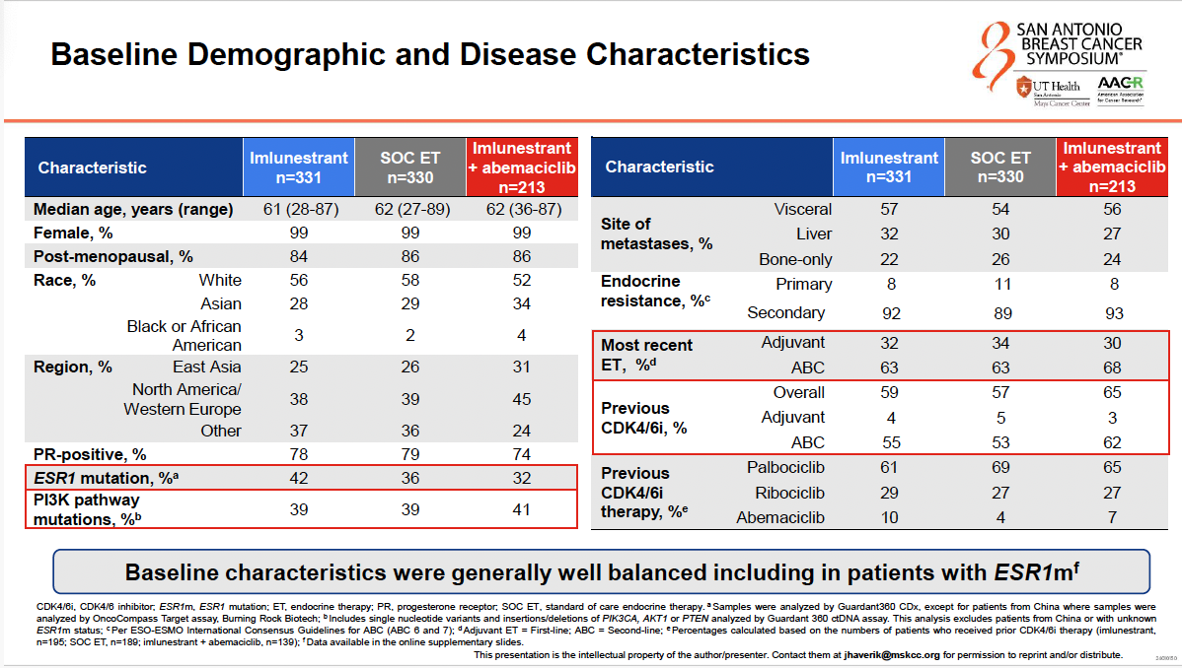

Slide 30
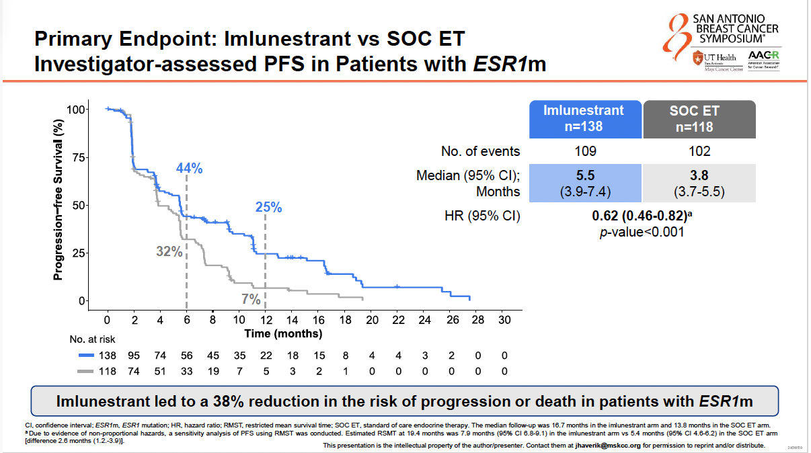
ESR1m
Primary Endpoint:
No significant PFS difference in ALL patients

Slide 31
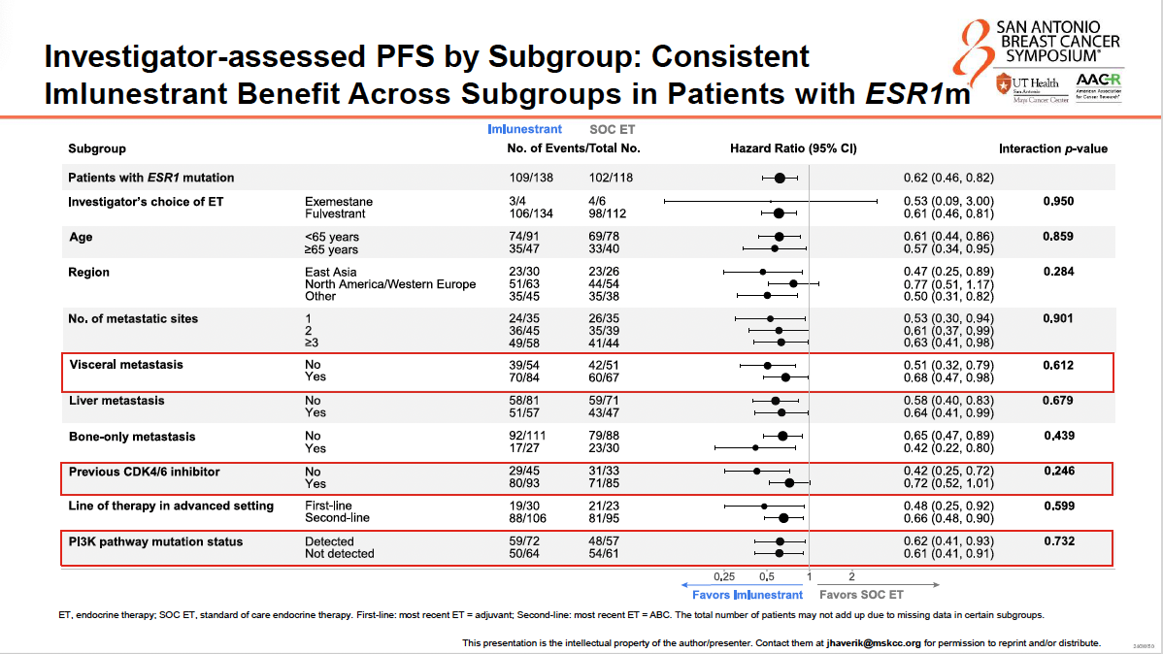
ESR1m

Slide 32
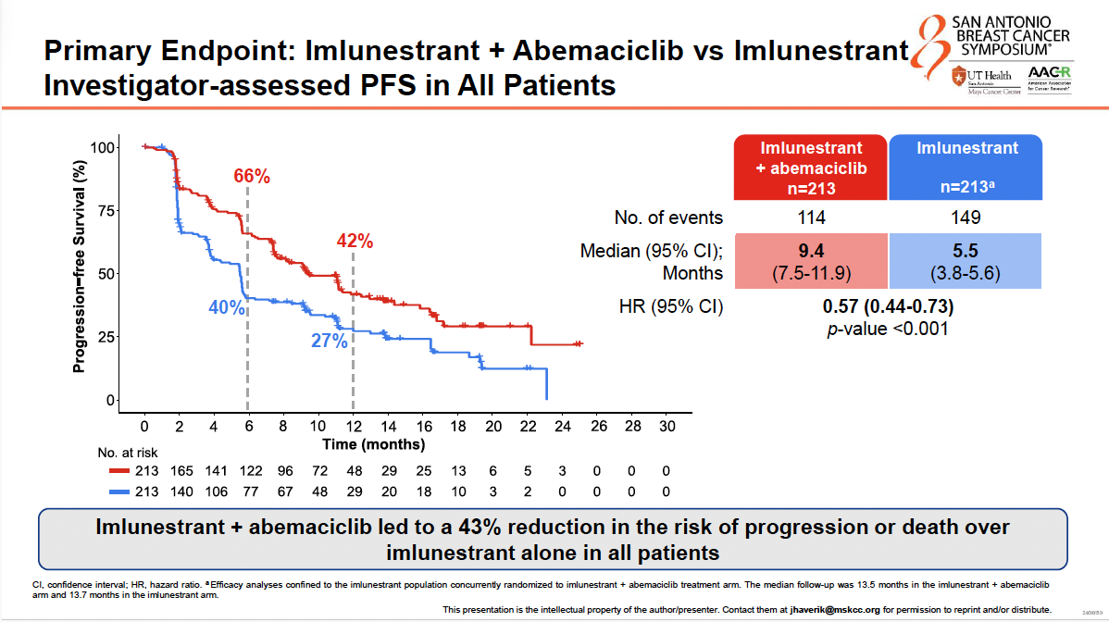

Slide 33
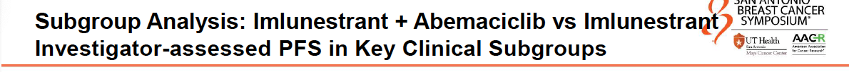
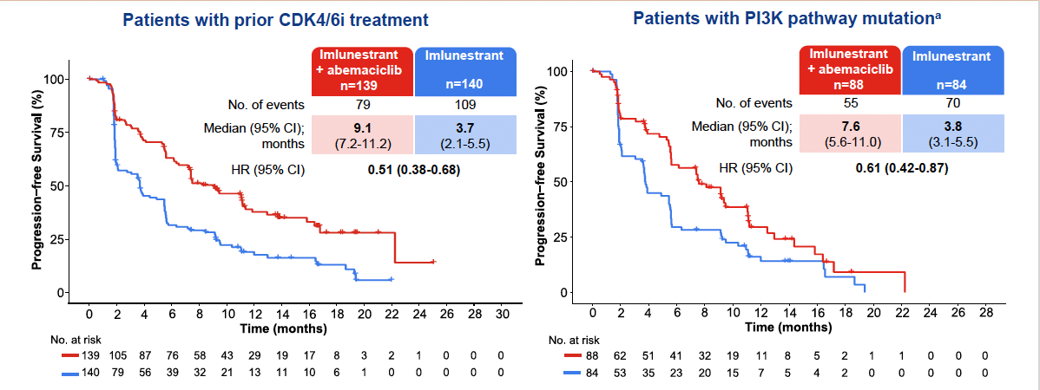
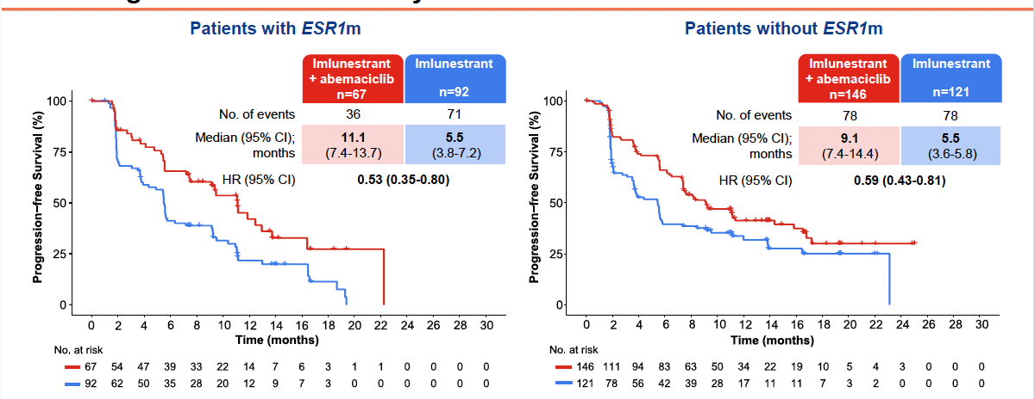

Slide 34
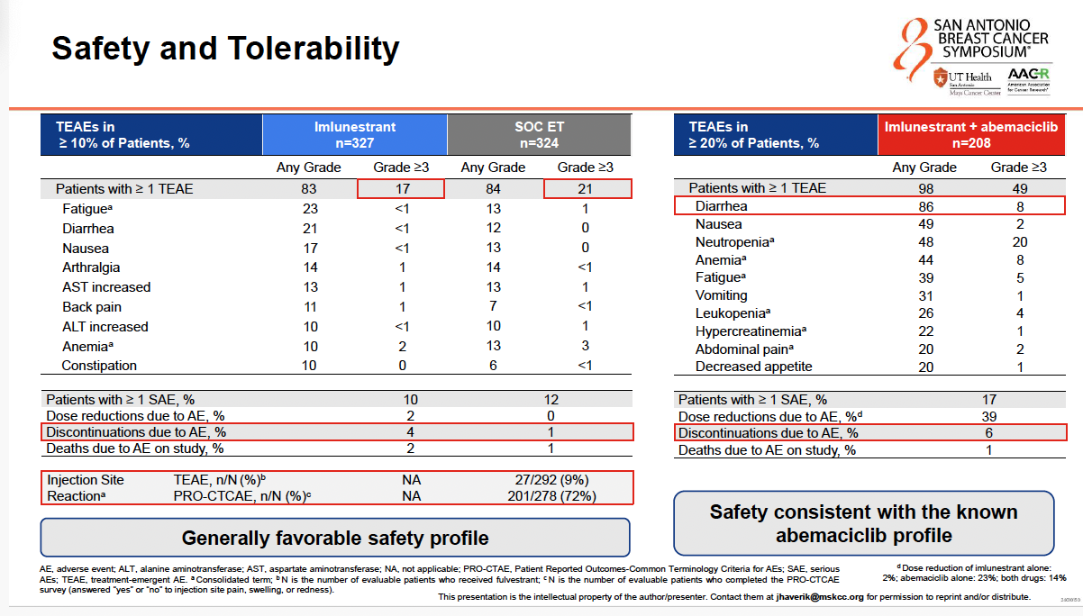

Slide 35
EMBER-3 - Conclusions
Imlunestrant monotherapy vs SOC ET:
Modest PFS benefit in ESR1m (5.5 vs 3.8 mos)
Well tolerated (no ocular, cardiac safety issues)
Similar to that seen with Elacestrant in Emerald study
Imlunestrant + Abema vs Imlunestrant alone:
Clinically meaningful PFS benefit in all pts (9.4 vs 5.5 mos)
Well tolerated
Reassuring to see benefit in those with prior use CDK4/6i (greater than in those without prior CDK4/6i)

Slide 36
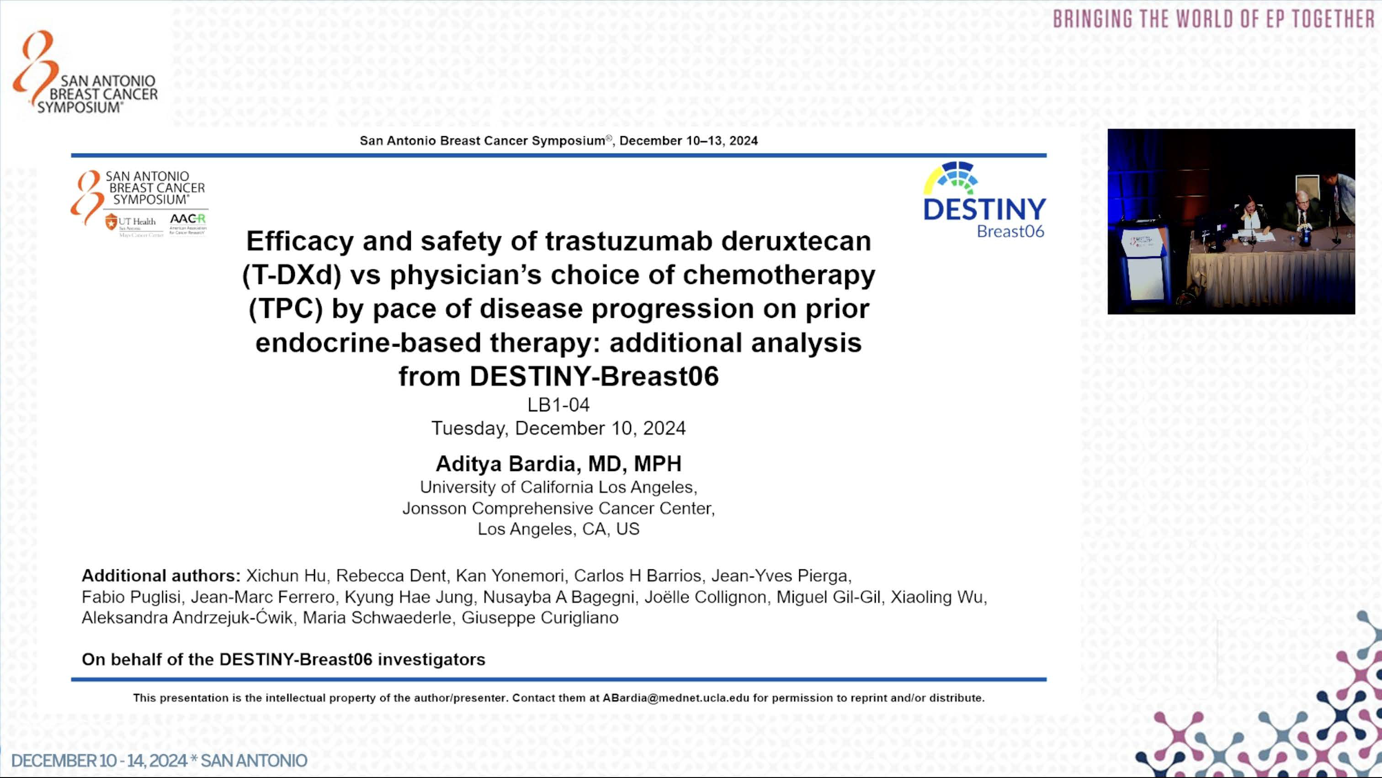

Slide 37
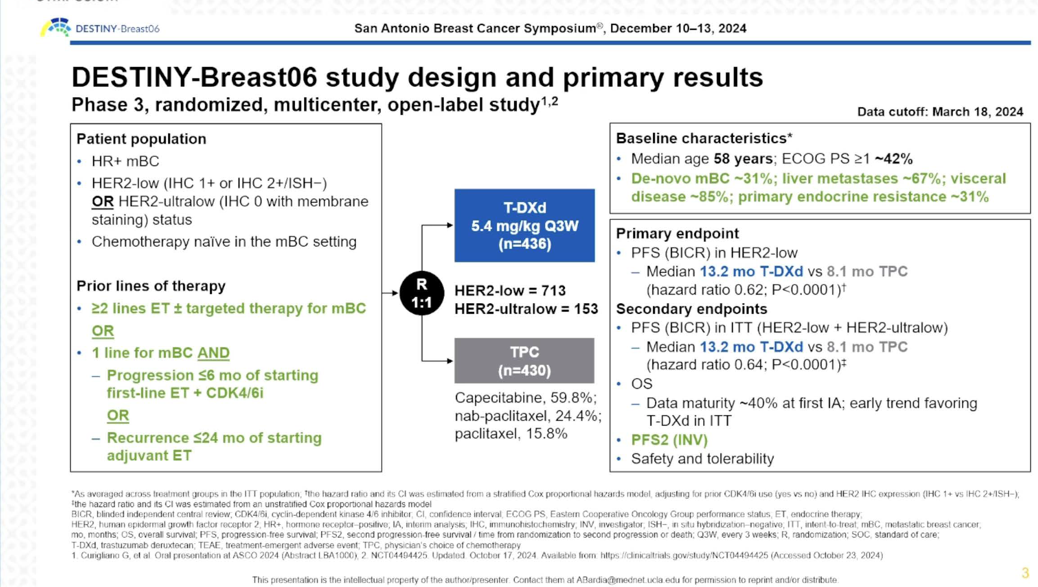

Slide 38
PFS (BICR) in HER2-low: primary endpoint – ASCO 2024
1.0
Hazard ratio 0.62
95% CI 0.51–0.74
P<0.0001*
0.8
T-DXd
mPFS: 13.2 mo
0.6
Probability of PFS
0.4
TPC
mPFS: 8.1 mo
Δ 5.1 mo
0.2
0
0
3
6
9
12
15
18
21
24
27
30
33
36
39
Time from randomization (months)
No. at risk
T-DXd
359
310
265
213
163
131
72
49
28
17
10
6
1
0
354
254
192
118
85
65
37
19
10
6
2
1
1
TPC
0
Similar PFS benefit seen in HER2 ultralow
OS data immature – 12 mos OS in HER2-low 87.6% vs 81.7% (NS)
*P-value of <0.05 required for statistical significance
BICR, blinded independent central review; CI, confidence interval; HER2, human epidermal growth factor receptor 2; mo, months; (m)PFS, (median) progression-free survival; T-DXd, trastuzumab deruxtecan; TPC, chemotherapy treatment of physician’s choice

Slide 39
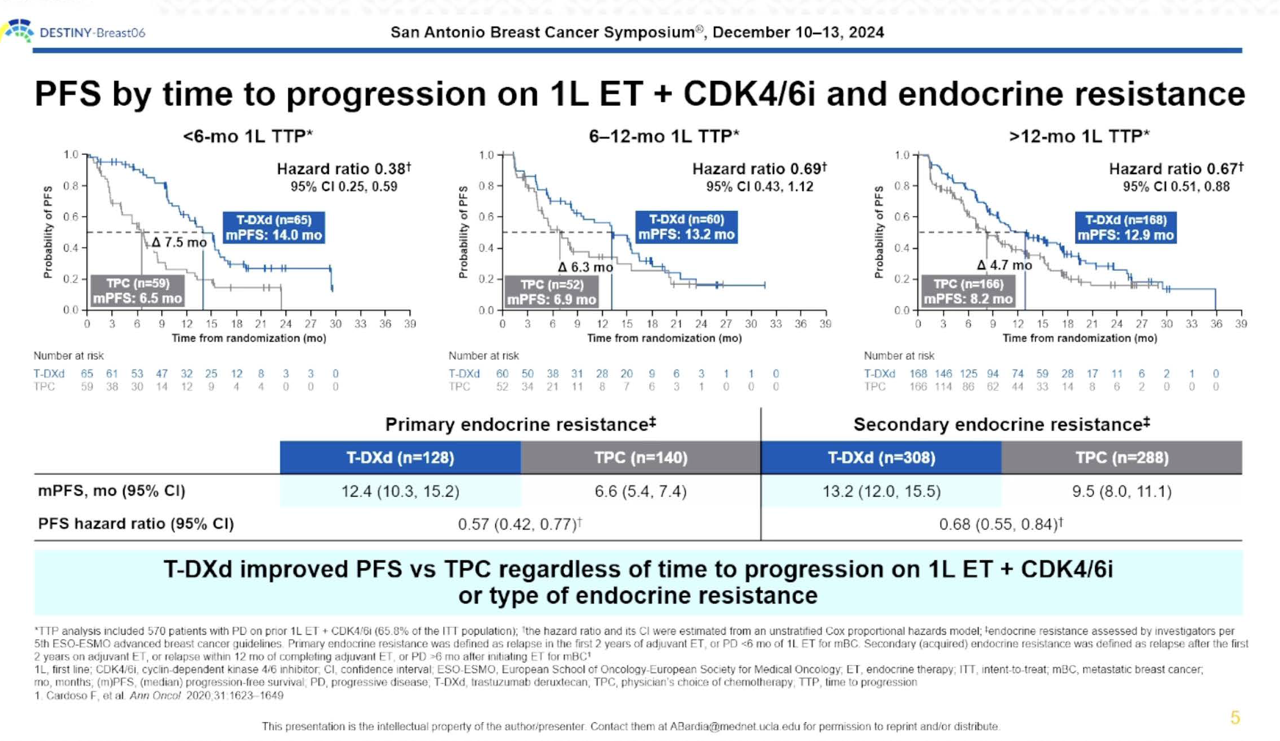

Slide 40
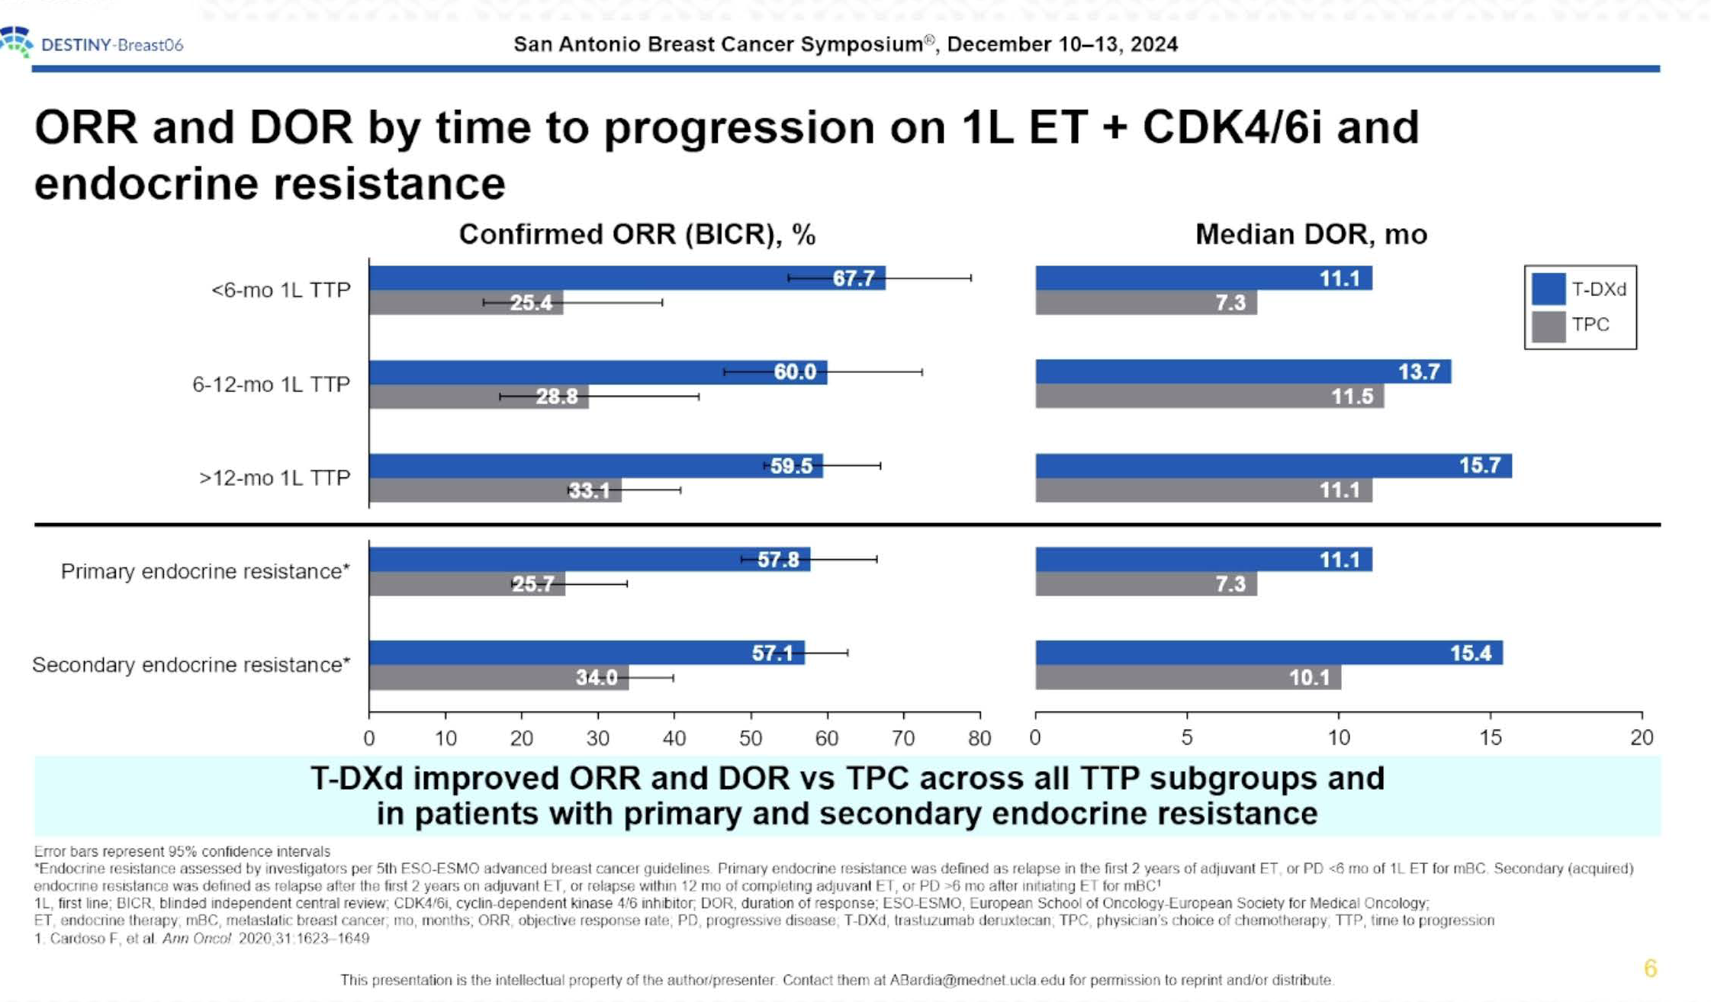

Slide 41
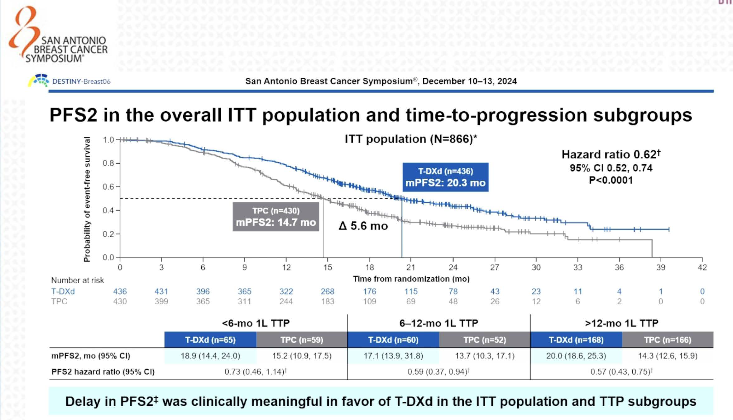

Slide 42
DB-06 Implications
T-DXd is highly effective drug in HR+/HER2 low/ultralow
Reassuring to see benefit persisting across subgroups
BUT, in order to meaningfully assess PFS2 (and OS), need to know % patients who received T-DXd in 2L (or subsequent line)
In US, question is when to use T-DXd not whether to use it
In DB-04 (T-DXd given as 2-3L chemo) PFS▲ 4.7 mos, OS▲ 6.4 mos (vs DB-06 with PFS ▲ 5.1 mos)
Based on data from ASCO 2024, only 20% pts in TPC arm in DB-06 got subsequent T-DXd

Slide 43
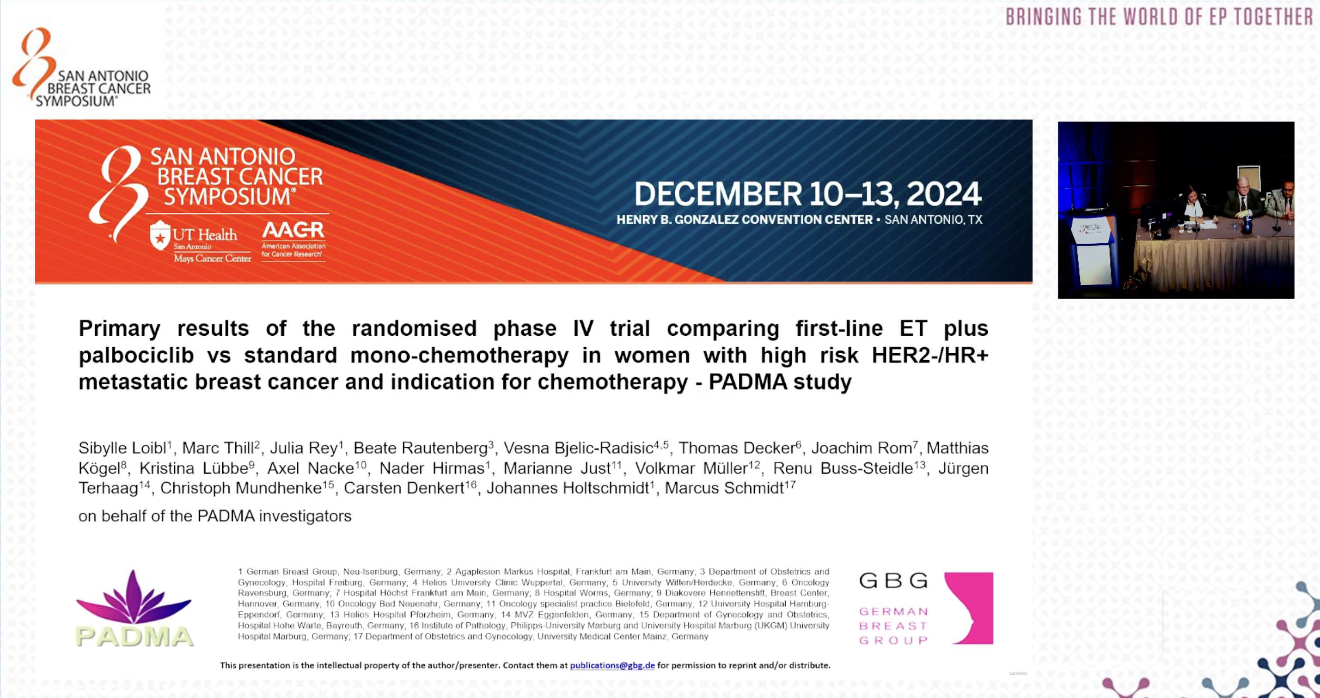

Slide 44
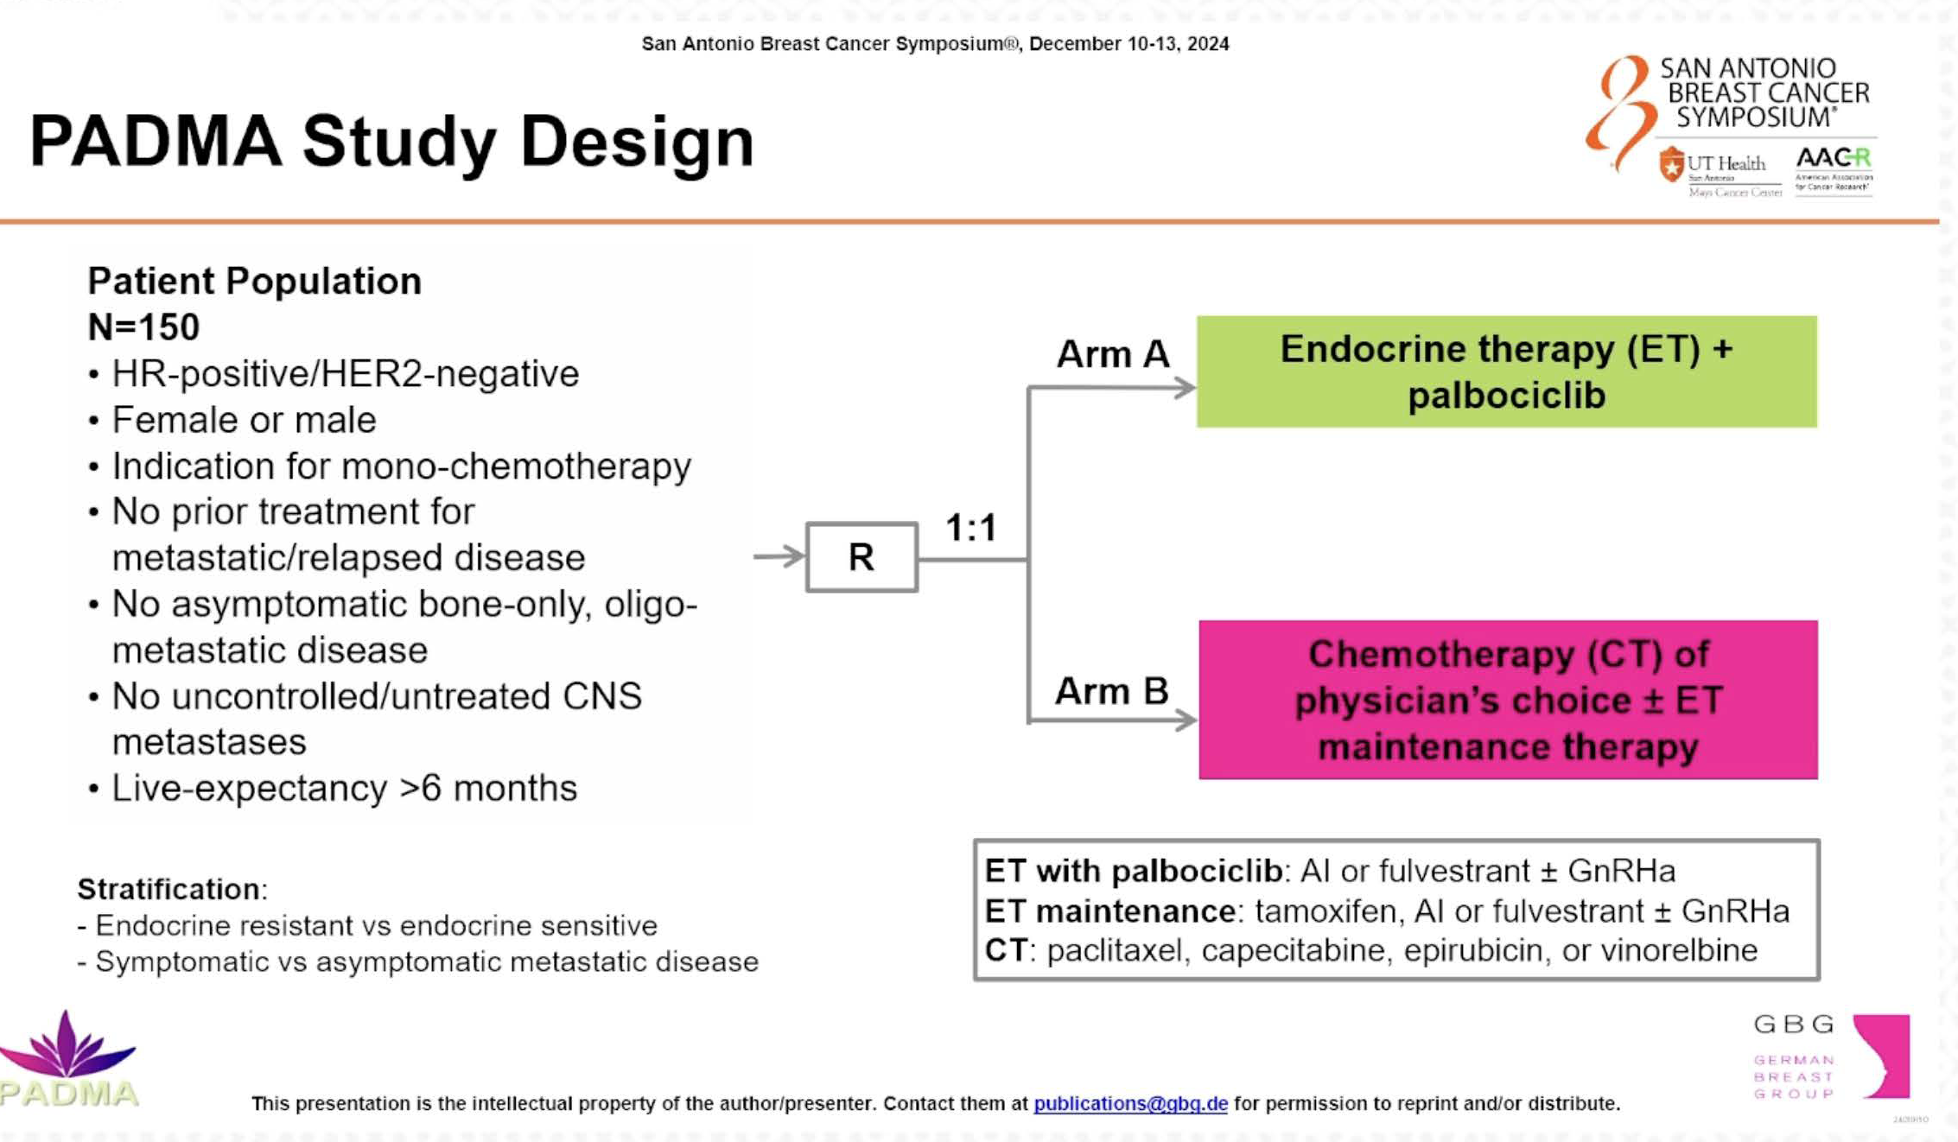
Primary Endpoint: TTF
Secondary Endpoints: PFS; OS; Safety
Cape 69%; Pac 29%; Vinorelbine 2%
Select participant characteristics
Postmenopausal 88%
Liver mets: ET/palbo 46%; chemo 37%
Prior (neo)adj chemo: ET/palbo 47%; chemo 42%
ET resistant: ET/palbo 28%; chemo 36%

Slide 45
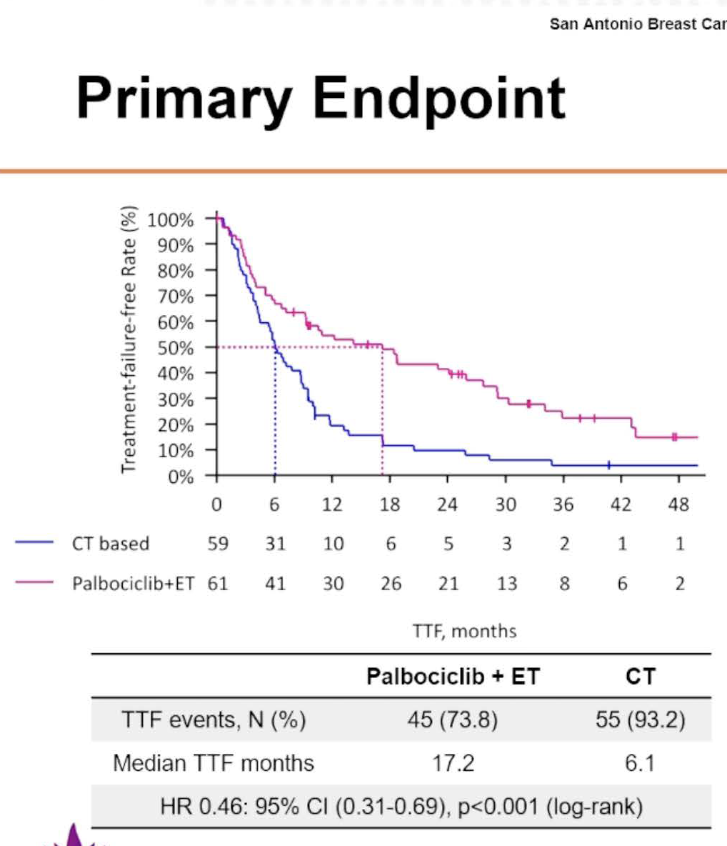
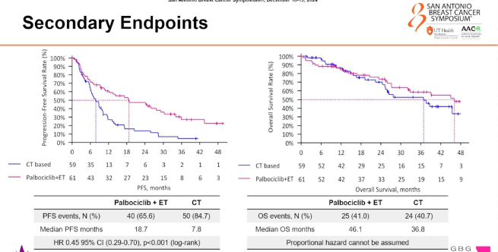
TTF
PFS
OS
Consistent Effect Across Subsets

Slide 46
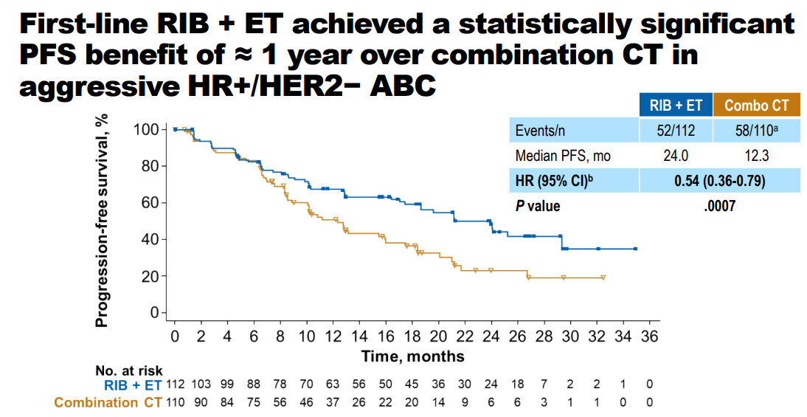
RIGHT CHOICE: RCT 1L Ribo + ET vs Combo Chemo in Aggressive HR+/HER2- mBC
24 vs 12.3 mos
HR=0.54
Lu Y-S et al. SABCS 2022; GS01-10

Slide 47
PADMA - Implications
In first line setting in “high-risk” HR+/HER2-, superior outcome with ET + palbociclib c/w single agent chemotherapy
Improved TTF (17.2 vs 6.1 mos) and mPFS (18.7 vs 7.8 mos)
Numerical trend for improved OS
Findings very much in keeping with RIGHT CHOICE trial
ET + CDK4/6i should be given as 1L therapy in patients with HR+/HER2- mBC except in specific circumstances (eg rapid progression on ET particularly if given with CDK4/6i)

Slide 48
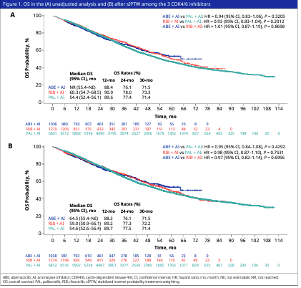
Comparative OS of 1L CDK4/6i + AI in HR+/HER2- mBC in the US RW Setting Flatiron DB (N= 9146 -- Palbo n=6831, Ribo n=1279, and Abema n=1036)
No significant differences in OS between 3 CDK4/6i
Limitations:
Retrospective database analysis so potential for treatment selection biases and issues with data capture
Ribo and Abema groups had smaller sample sizes shorter f/u given uptake patterns so late difference could emerge
Rugo, Lynce et al. SABCS 2024; PS2-03

Slide 49
Thank you!

