Slide 1



Best of San Antonio Breast Cancer
January 25, 2025

Slide 2

Hope S. Rugo, MD, FASCO
Hope S. Rugo, MD, FASCO, is a medical oncologist specializing in breast cancer research and treatment. A Professor of Medicine, Dr. Rugo joined the Breast Care Center in 1999 after a decade of experience at University of California San Francisco (UCSF) in malignant hematology/bone marrow transplantation. She entered the field of breast cancer in order to incorporate novel therapies with excellent quality of care into the treatment of breast cancer. Dr. Rugo graduated from the University of Pennsylvania School of Medicine in 1983. She completed a residency in internal medicine and primary care followed by a fellowship in hematology and oncology at UCSF and was a post-doctoral fellow in immunology at Stanford University. Dr. Rugo joined the faculty at UCSF in 1990. Dr. Rugo is the Director of Breast Oncology and Clinical Trials Education at the UCSF Helen Diller Family Comprehensive Cancer Center. She is a principal investigator of multiple clinical trials focusing on novel targeted therapeutics to improve the treatment of breast cancer, publishing widely in this area. Her research interests include immunotherapy and combinations of targeted agents to treat breast cancer, as well as management of toxicity. She is co-chair of the Safety Committee for the multicenter adaptively randomized phase II I-SPY2 trial, co-chair of the Triple Negative Working Group of the Translational Breast Cancer Research Consortium (TBCRC) and a member of the Alliance breast committee. Dr. Rugo is an active clinician and is committed to education. She has received a number of awards honoring her work.

Slide 3


Best of SABCS 2024:
HER2+ Breast Cancer
Hope S. Rugo, MD
Professor of Medicine
Winterhof Family Distinguished Professor of Breast Oncology
University of California San Francisco Comprehensive Cancer Center
Notes:
45 min

Slide 4
Disclosures
Institutional research support: AstraZeneca, Daiichi Sankyo, Inc., F. Hoffmann-La Roche AG/Genentech, Inc., Gilead Sciences, Inc., Lilly; Merck & Co., Inc., Novartis Pharmaceuticals Corporation; Pfizer; Stemline Therapeutics, OBI Pharma, Ambryx
Consultancy/advisory: Chugai, Sanofi, Napo, Mylan

Slide 5
Disclaimer
Speaker is being compensated for their presentation today by the group purchasing organization affiliated directly or indirectly with AB Specialty Solutions, LLC (the “GPO”) . However, neither the GPO nor any pharmaceutical company has influenced the content of this presentation nor has the GPO independently verified the presentation for accuracy.

Slide 6
Topics
HER2 metastatic disease
  GS02-12 Patina: Maintenance therapy in HR+/HER2+ disease with palbociclib
  PS8-06 Disitimab vedotin: versus lapatinib and capecitabine in patients with liver mets
  PS5-01 ZN-1041: BBB penetrable HER2 inhibitor in patients with CNS metastases
  RF3-04 NRG-BR004: Atezolizumab plus HER2 targeted therapy
HER2+ early-stage disease
  RF3-05 NeoHIP: Atezolizumab as neoadjuvant therapy
  RF1-02 TOUCH: Neoadjuvant therapy with ET/CDK4/6i vs paclitaxel
  LB1-02 MARGOT/TBCRC 052: Margetuximab as neoadjuvant therapy
  GS1-04 FASCINATE-N: A novel HER2 ADC as neoadjuvant therapy

Slide 7
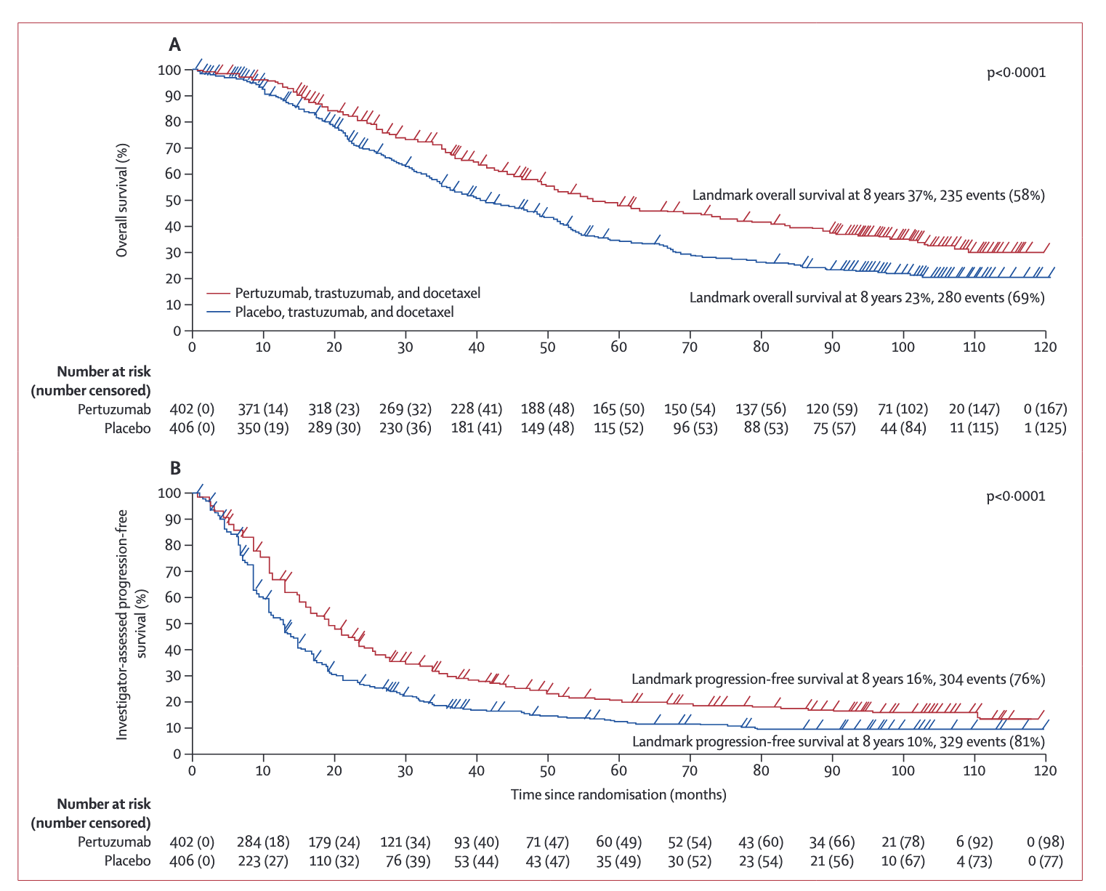
CLEOPATRA End-of-Study Results:
Taxane + Trastuzumab +/- Pertuzumab in 1st line HER2+ MBC
Pertuzumab approved June 2012 based on CLEOPATRA
90% of patients had no prior trastuzumab
Endocrine therapy was not allowed during maintenance setting in CLEOPATRA, however this has become the standard of care
Median OS:
57.1 months
Median PFS:
18.7 months
Swain S, et al. Lancet Oncol. 2020;21:519-530.

Slide 8
Why Combine CDK4/6 inhibitors with HER2 Targeted Therapy?
Approximately 15%-20% of breast cancers overexpress HER2
  Half of HER2+ tumors also co-express estrogen receptors
Anti-HER2 therapies have significantly improved survival outcomes
  Resistance to therapy remains inevitable in advanced HER2+ breast cancer
Rationale for blocking CDK4/6 in HER2+ disease
  The cyclin D1-CDK4 axis is essential for the initiation and maintenance of growth of ErbB2-driven mammary carcinomas¹⁻³
  Persistent cyclin D1-CDK4 activity drives resistance to the HER2 pathway blockade⁴
  Combined CDK4/6 and HER2 inhibition shows synergistic anti-tumor activity in preclinical models of HER2+ breast cancer⁴
Palbociclib is an approved CDK4/6 inhibitor associated with a clinically meaningful improvement in progression-free survival in HR+,HER2- breast cancer
1. Yu Q, et al. Nature. 2001;411(6841):1017-1021.
2. Yu Q, et al. Cancer Cell. 2006;9(1):23-32.
3. Choi YJ, et al. Cancer Cell. 2012;22(4):438-451.
4. Goel S, et al. Cancer Cell. 2016;29(3):255-269.

Slide 9
Primary Results From AFT-38 PATINA Phase 3 Trial of Palbociclib + Anti-HER2 Therapy + ET in HR+/HER2+ MBC: Study Design and Patients
Primary endpoint: INV-assessed PFS
Key secondary endpoint: OS
Palbo + Anti-HER2 + ET
Palbociclib (125 mg PO qd D1-D21) + trastuzumab ± pertuzumab + ETª
N=518
Stratification factors
Pertuzumab use (yes vs no)
  The non-pertuzumab option is limited to up to 20% of the population
Prior anti-HER2 therapy in the (neo)adjuvant setting (yes vs no, including de novo)†
Response to induction therapy (CR or PR vs SD) by investigator assessment†
Type of endocrine therapy (fulvestrant vs aromatase inhibitor)
R
1:1
Until PD or toxicity
Anti-HER2 + ET
Trastuzumab ± pertuzumab + ETª
Patient Characteristics, (%) N=518 |  | Palbo + Anti-HER2 + ET (n=261) | Anti-HER2 + ET (n=257)
Median age (IQR), years |  | 53.5 (43.6-60.4) | 53.0 (45.1-62.8)
Median cycles of induction therapy (range), n |  | 6 (4-8) | 6 (4-8)
Pertuzumab use |  | 253 (96.9) | 251 (97.7)
Type of ET | AI | 237 (90.8) | 234 (91.1)
 | Fulvestrant | 24 (9.2) | 23 (8.9)
Prior (neo)adjuvant anti-HER2 therapy | Yes | 190 (72.8) | 182 (70.8)
 | No | 71 (27.2) | 75 (29.2)
Best response to induction therapy | CR or PR | 179 (68.6) | 176 (68.5)
 | SD | 82 (31.4) | 81 (31.5)
Key Eligibility Criteria
HR+/HER2+ MBC
No prior treatment in ABC setting beyond induction therapy
  6-8 cycles of treatment, including trastuzumab ± pertuzumab and taxane/vinorelbine
Completion of induction chemotherapy and no evidence of disease progression
ª Trastuzumab and pertuzumab were administered per SOC. ET options include an AI or fulvestrant.
Metzger O, et al. SABCS 2024. Abstract GS2-12.

Slide 10
Primary Results From PATINA Phase 3 Trial of Palbociclib + Anti-HER2 Therapy + ET in HR+/HER2+ MBC: PFS
PFS | Palbo + Anti-HER2 + ET (n=261) | Anti-HER2 + ET (n=257)
Events | 126 | 136
mPFS, months (95% CI) | 44.3 (32.4-60.9) | 29.1 (23.3-38.6)
HR (95% CI) Nominal 1-sided P-value | 0.74 (0.58-0.94) 0.0074
PFS (Investigator Assessed)
Median follow-up on patients who are alive and disease-free, 52.6 months
PFS Subgroup Analysis
Metzger O, et al. SABCS 2024. Abstract GS2-12.

Slide 11
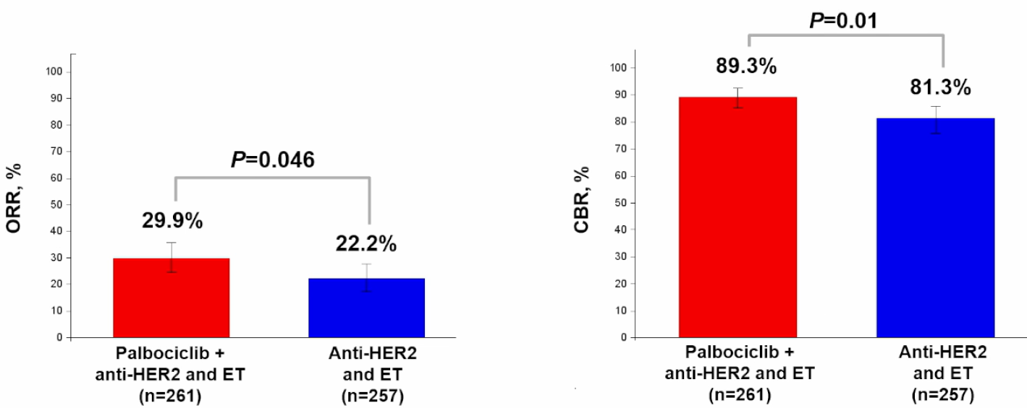
Primary Results From PATINA Phase 3 Trial of Palbociclib + Anti-HER2 Therapy + ET in HR+/HER2+ MBC: ORR, CBR, and OS
Secondary Endpoint: Overall Survival
Confirmed ORRª
CBR^{b}
ª Patients with a CR or PR on ≥2 consecutive reporting periods according to RECIST v1.1 ^{b} Patients with a CR, PR, and/or SD for ≥24 weeks per RECIST v1.1.
Metzger O, et al. SABCS 2024. Abstract GS2-12.

Slide 12
Adverse Events
(Grade ≥2 in ≥10% of Patients)
Metzger O, et al. SABCS 2024. Abstract GS2-12.

Slide 13
Implications
Adding CDK4/6i to ET + HER2 targeted therapy based on robust preclinical data
Remarkable increase in median PFS from 29.1 to 44.3 months
  Δ15.2 months!
Interestingly mPFS across receptor subsets for Cleopatra was 18.7 months
  Hazard ratios similar across ER status
Expected toxicity profile, low discontinuation rate
In my opinion, represents a new standard of care for HR+/HER2+ MBC following response to THP

Slide 14
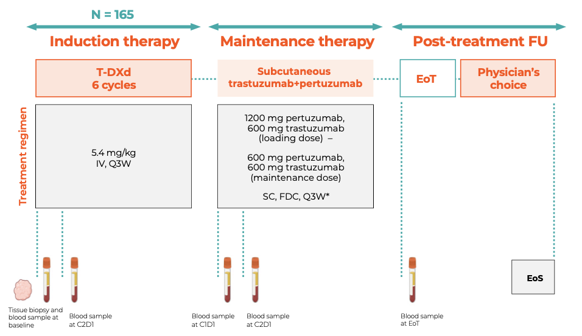
Estimated primary completion July 2025
The DEMETHER Study will evaluate maintenance HP+/-ET post T-DXd
  Role of palbociclib?
Cortex et al, SABCS 2024

Slide 15
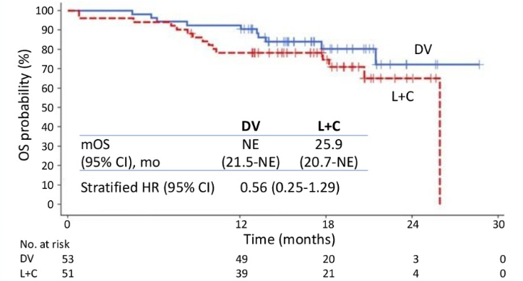
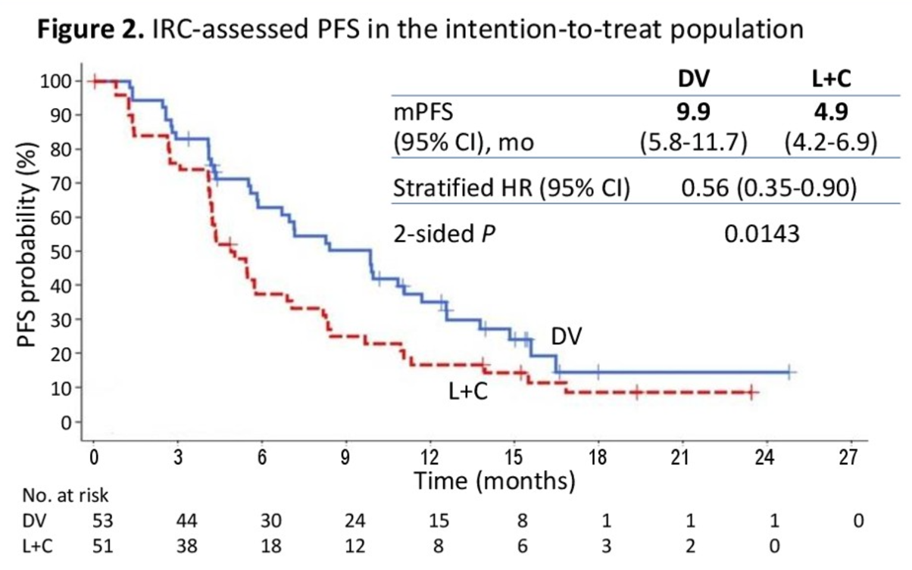
Disitamab vedotin vs Lapatinib + Capecitabine in Patients with HER2+ MBC with Liver Metastasis: Final Results of a Phase III Trial
Primary Endpoint:
IRC-assessed PFS in ITT
Most received 1 line prior chemo
38% lung mets, ~55% HR+
29% prior pertuzumab
Median FU 17-18 mo
Toxicity: higher neutropenia, neuropathy not reported
41% crossed over
OS immature
Investigations ongoing in US
  DV plus tucatinib
IRS PFS in the ITT population
Small phase III!
Wang J, et al. SABCS 2024

Slide 16
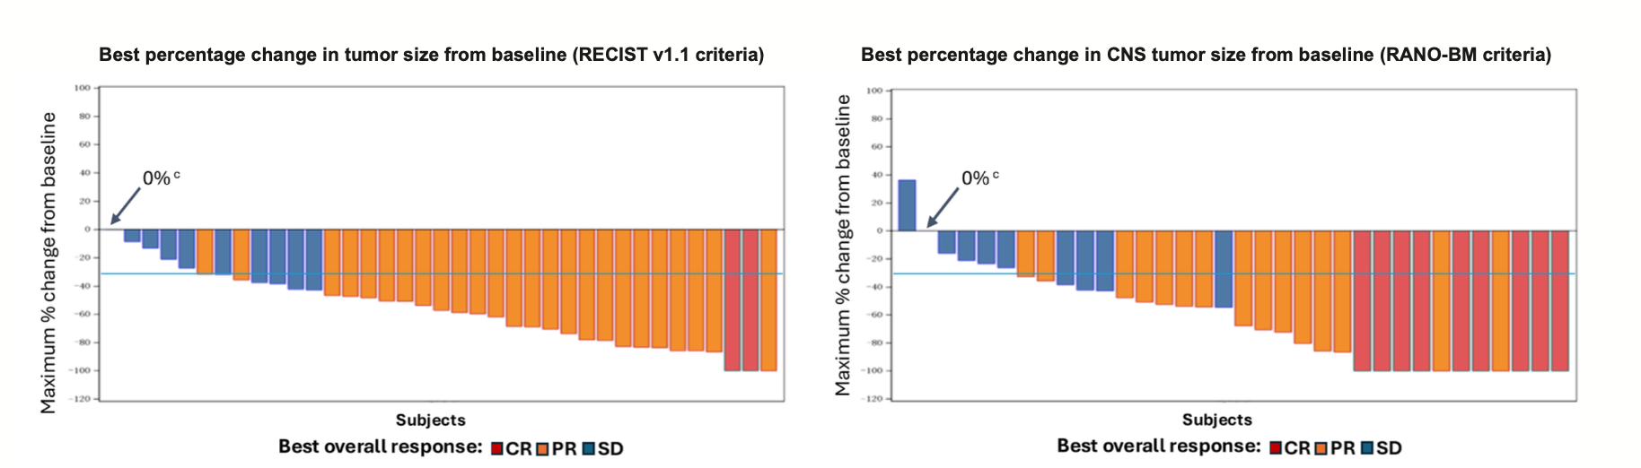
ZN-1041: BBB Penetrable HER2 Inhibitor
Phase I dose escalation study then expansion in 40 patients
  Trastuzumab only prior HER2 directed Rx, median 1 line prior Rx, 32 with active brain mets
ZN-1041/capecitabine/trastuzumab
  ORR 73%, IC-ORR 64.9%, median DOR in brain 14.7 mo.
  Median PFS 14 mo, IC PFS (RANO-BM) 17.4 mo
Low rate of diarrhea (37.5%, no grade 3); elevated bilirubin (20%), liver enzyme elevation in 15-17%
Ma F, et al. SABCS 2024

Slide 17
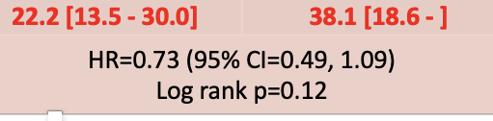
NRG-BR004: Adding Atezolizumab to Cleopatra in a Phase III Trial
Designed to enroll 600 patients; closed early due to excess in deaths in the atezolizumab arm
190 total randomized
Median follow-up for PFS is 31.9 months and for OS is 35.9 months.
Demographics
93 Pla, 97 Atezo
81% no prior trastuzumab
~75% PD-L1 negative
~34% ER negative
Atezolizumab arm
  6 deaths on treatment
    5/6 likely related to Rx
Efficacy
  Median PFS (mo), 95% CI
  PFS in Patina 29 months (all HR+)
  No difference in OS (17 vs 14 deaths)
Placebo
Atezo
Valero et al, SABCS 2024

Slide 18
Implications
BR004 closed early due to both slow accrual and an imbalance in deaths
  The final analysis showed no difference in Grade 3/4 events or delivery of THP
PFS numerically longer but underpowered for efficacy and NS
Further study could be in combination with ADCs although this remains to be seen.
Additional data with immunotherapy and HER2 targeted therapy
  Neoadjuvant IMpassion 050
    Randomized 454 patients to receive dose dense AC followed by paclitaxel/HP with atezolizumab or placebo, then atezo or placebo with HP to complete one year of Rx.
      Identical pCR rates (62-63%); 73 vs 64% in PD-L1+
      More serious AEs and grade 3/4 Aes with atezo
      5 grade 5 AEs, all with atezo. (Covid 19 (2), sepsis (2), alveolitis (1))
  Perhaps IO cannot add to the efficacy of AC/THP
    Could IO be anthracycline/pertuzumab sparing? Is it worth the toxicity for HER2+ disease?
Huober et al, JCO 2022

Slide 19
neoHIP: Phase 2 Neoadjuvant HER2 Targeted Therapy +/- Pembrolizumab
Demographics
82-85% T1/2
60-68% N0
63% HR+
Paclitaxel (T) 80mg/m2 weekly for 12 weeks (all arms)
Enrollment to Arm C was terminated after 22 patients underwent surgery due to a prespecified interim efficacy analysis
Additional chemotherapy was permitted before surgery if residual disease was biopsy proven after the intervention
McArthur et al, SABCS 2024

Slide 20
Immune related adverse events

Slide 21
Implications
The addition of pembrolizumab improved pCR
  Non-anthracycline regimen still required pertuzumab
  pCR similar to IMpassion 050 regardless of atezo – but without anthracycline
  Immune adverse events ~19%
Differences in receptor status, intrinsic subtype impact pCR
Compass pCR results will help understand the true pCR rate from THP
How will this compare to T-DXd plus pembrolizumab?
  No long-term toxicity with T-DXd
EFS data to follow, although underpowered for longer term outcome

Slide 22
Phase II TOUCH Trial: Neoadjuvant ET/Palbo/HP vs Paclitaxel/HP for HR+/HER2-
Investigators prior data showed that high levels of RBsig, a gene-expression signature of functional loss of RB1, composed of E2F-1 and 2 associated genes, is associated with:
  Resistance to CDK4/6i in ER+/HER2neg BC models/clinical samples
  Sensitivity to chemo+ anti-HER2 in pts with ER+/HER2+ eBC
The study was designed to look for differential response in RBsig HIGH vs LOW
Primary Objective:
Explore the interaction between treatment activity (pCR: ypT0/ypTis ypN0) and RBsig status (HIGH or LOW) measured on pre-treatment biopsies by RNA-sequencing
Paclitaxel: 80 mg/m2 iv; day 1,8,15 q28d x 4 cycles
Malorni et al, SABCS 2024

Slide 23
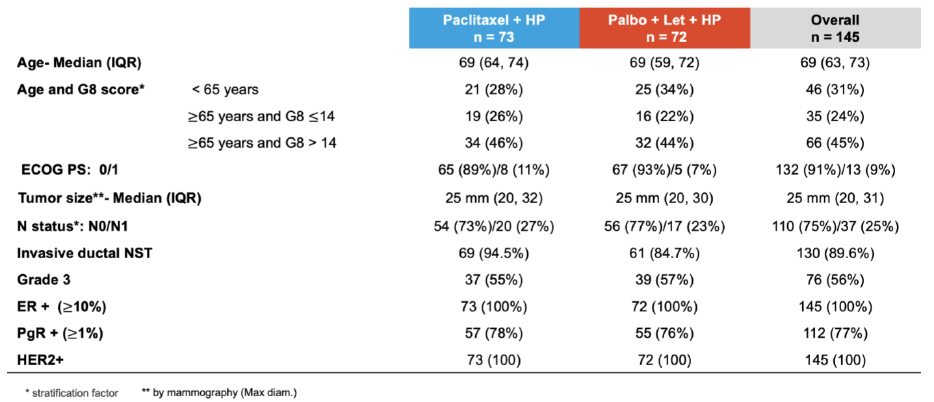
Results
Implications
Although Rbsig did not predict differential benefit:
  P/L/HP was less toxic with higher completion rate
  Similar pCR rates between the two arms
    Clearly effective regimen that merits further exploration
      Older patients, MMP low risk?
    Lower than neoHIP demonstrating importance of ER
Completed 4 cycles of Rx 79.5% 94.4%
Early d/c due to AE 16.4% 2.8%

Slide 24
MARGOT/TBCRC052:
Phase II Neoadjuvant Margetuximab
Margetuximab
  Anti-HER2 antibody with modified FC receptor to increase ADCC
    Higher receptor binding to the low affinity FcγRIIIa (CD16A) F polymorphism where trastuzumab may have less efficacy
  Sophia phase III trial in HER2+ MBC: Margetuximab improved PFS but not OS compared to trastuzumab (both with chemotherapy) in heavily pre-treated disease
    Trend toward improved efficacy in patients with CD16A F polymorphism
Enrollment from
10/2020 – 5/2024 at 9 national TBCRC sites
PRIMARY OBJECTIVE: To compare rate of pathologic complete response (pCR; ypT0/TisN0) in patients with HER2+ early-stage breast cancer treated with neoadjuvant TMP vs THP.
Waks et al, SABCS 2024
Rugo HS et al JAMA Oncol 2021; Rugo HS et al J Clin Oncol 2023

Slide 25
Primary endpoint: pCR
Demographics
81% T2, 65% node negative
85% clinical stage II
65% HR+, 77% HER2 3+
CD16A genotype
  FF: 47%
  FB: 53%

Slide 26
>90% in both arms received all 4 intended treatment cycles
Safety similar between the two arms
  Only exception was increased infusion related reactions in the TMP arm
    27 vs 15%

Slide 27
Implications
Phase II signal finding trial
Numeric non-statistically significant improvement in pCR with TMP vs THP in patients with CD16A FF and FV polymorphisms
  High rate of polymorphisms relative to SOPHIA trial
  Correlative studies are ongoing in blood and tissue including immune biomarkers
Patients will be followed for EFS
Margetuximab approved in combination with chemotherapy as late line therapy for metastatic HER2+ disease
  Unknown advantage over trastuzumab post T-DXd and HER2Climb

Slide 28
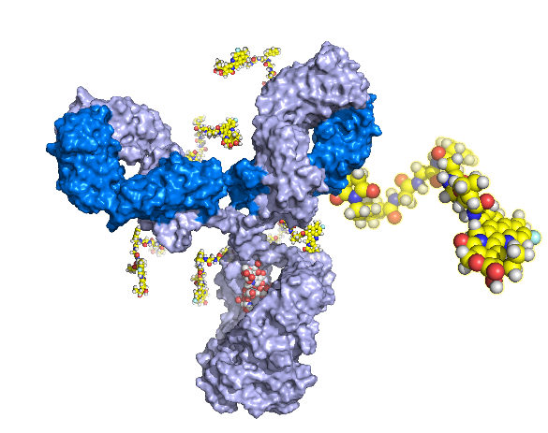
FASCINATE-N: Phase II Trial of Neoadjuvant Therapy with a Novel HER2 ADC SHR-A1811
SHR-A1811
  Trastuzumab, a cleavable and stable linker, and the topoisomerase I inhibitor payload SHR169265
  SHR169265: high membrane permeability and potent cell-killing effect
  DAR: 6
Phase I trial
  ORR 59.9% for all tumors
    76.3% for HER2+ BC
    60.4% for HER2 low-expressing BC;
  ILD: 2.6%
Li, JJ et al, SABCS 2024

Slide 29
HER2+ Subtype Study Design
265 patients

Slide 30
55% HR-
90% node positive
70% Stage III
Toxicity highest in the pyrotinib arm
55% grade 3/4 neutropenia
95.5% diarrhea, ~10% grade ¾
Most common toxicity with ADC
~40% grade 3/4 neutropenia
Moderate liver enzyme elevation

Slide 31
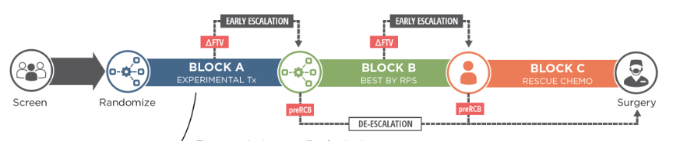
Implications
Promising HER2 ADC with differential safety profile
  High pCR rates with single agent
  Should not be given with pyrotinib due to significant toxicity
Ongoing trials
  Destiny Breast11
  ISPY2
    Modifying treatment based on response

Slide 32
Summary
Practice changing studies
  Patina relevant to todays clinical practice
  Little downside
Application of this data to the neoadjuvant setting
  Merits further exploration in carefully selected subgroups
Several interesting novel agents
  Oral TKI
  ADCs
Future path for IO unclear although interesting data
  Toxicity is a concern

Slide 33

Thank you!

