Slide 1


Best of ASCO
Part 1
June 15, 2024
Notes:
Welcome everyone to our Best of ASCO (Part 1) Virtual CME event.

Slide 2

Deb Armstrong, MD
Dr. Armstrong works primarily in the area of women's malignancies, with a particular emphasis on breast cancer, ovarian cancer and other gynecologic malignancies, and the genetics of breast and ovarian cancer. She directs the medical gynecologic oncology clinical service and oversees therapeutic clinical trials in gynecologic cancers. Dr. Armstrong's clinical focus is on the development of new therapeutic approaches to the treatment of breast cancer and gynecologic malignancies. Particular areas of interest are intraperitoneal therapy in ovarian cancer and targeted biologic therapies. Dr. Armstrong also directs the Kimmel Cancer Center's Breast and Ovarian Cancer Screening Service, a genetic counseling service that focuses on identifying patients at risk for cancer and examination of new strategies for cancer screening and prevention.
Dr. Armstrong has lectured locally, nationally and internationally. She is active in the Gynecologic Oncology Group, serving on the Medical Oncology, Developmental Therapeutics and Phase I GOG committees and as chair of several clinical trials through this group. She is a representative of the Southwest Oncology Group to the Gynecologic Cancer Steering Committee of the National Cancer Institute. Dr. Armstrong also serves as a representative of Johns Hopkins to the National Cooperative Cancer Network serving on the ovarian cancer and breast cancer risk reduction panels. She has participated as a member of the Cancer Working Group for the Office of Research on Women's Health for the National Institutes of Health, as a scientific reviewer for the breast and ovarian cancer research programs of the Department of Defense and the National Cancer Institute, as a reviewer for the NCI Special Emphasis Panel for Insight Awards to Stamp Out Breast Cancer and as a member of the NCI SPORE Program parent committee.
Dr. Armstrong also is co-principal investigator for the NCI National Clinical Trials Network (NCTN) Lead Academic Participating Site (LAPS) at Johns Hopkins, now the major avenue for adult oncology clinical trials in the country. Recent work includes immune checkpoint inhibitor therapy in endometrial cancers with microsatellite instability and PARP inhibition in ovarian cancer.

Slide 3
ASCO 2024 Presentations in Gynecologic Cancers
Deborah K. Armstrong, MD
Professor of Oncology
Professor of Gynecology and Obstetrics
Johns Hopkins Kimmel Cancer Center
Baltimore, MD

Slide 4
Outline
Ovarian cancer
  Immunotherapy in clear cell
  Oral cyclophosphamide and bevacizumab
  PARP inhibitor treatment
  FOLR1 expression
Endometrial cancer
  Hormonal therapy
  Immunotherapy
Cervical cancer
General Gyn

Slide 5
Ovarian Cancer

Slide 6
Ovarian Cancer:
Immunotherapy in Clear Cell Carcinoma

Slide 7
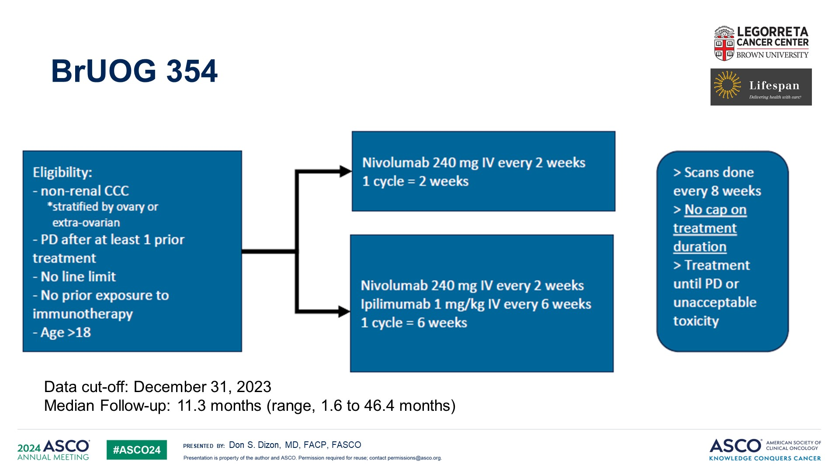
BrUOG 354
Content of this presentation is the property of the author, licensed by ASCO. Permission required for reuse.

Slide 8
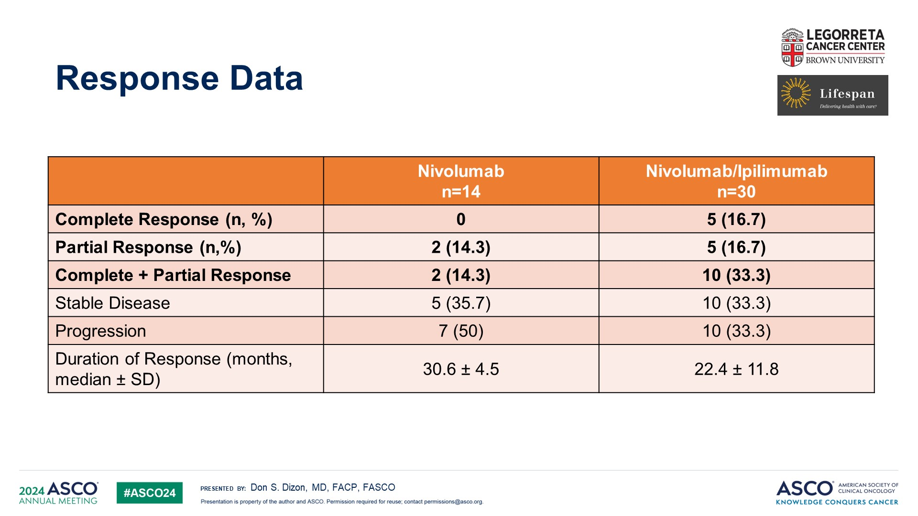
Response Data
Content of this presentation is the property of the author, licensed by ASCO. Permission required for reuse.

Slide 9
NRG GY003: Response* by Imaging
Response Within 6 months** | Nivo→Nivo N (%) | Nivo-Ipi→Nivo N (%) | Odds ratio (85% CI) | p-value
Yes | 6 (12.2) | 16 (31.4) | 3.28 (1.90 - ∞) | 0.034
No | 43 (87.8) | 35 (68.6)
Response Total | Nivo→Nivo N (%) | Nivo-Ipi→Nivo N (%)
Overall | 6 (12.2) | 17 (33.3)
Complete | 3 (6.1) | 3 (5.9)
Partial | 3 (6.1) | 14 (27.4)
* RESIST 1.1, pre-treatment imaging as reference
** Primary analysis

Slide 10
NRG GY003: Subgroup Analyses of Outcome
 | Statistic (95% CI)
Characteristic | Response* | PFS** | OS**
Age: > vs ≤ median | 0.653 (0.244-1.748) | 1.002 (0.638-1.574) | 1.499 (0.818-2.747)
PS: > 0 vs 0 | 1.210 (0.422-3.471) | 0.843 (0.519-1.368) | 1.295 (0.681-2.465)
Prior cytotoxic regimens: >1 vs 1 | 0.676 (0.220-2.079) | 1.021 (0.602-1.730) | 1.150 (NA***)
PFI: ≥ 6 vs < 6 months | 1.900 (0.709-5.091) | 0.662 (0.418-1.047) | 0.518 (0.273-0.984)
Cell type: clear cell vs other | 5.205 (1.370-19.774) | 0.562 (NA) | 1.674 (NA)
* Logistic regression, odds ratio, adjusted for treatment group
** Cox proportional hazards model, hazard ratio, adjusted for treatment group and PFI
*** Not available, insufficient number of events

Slide 11
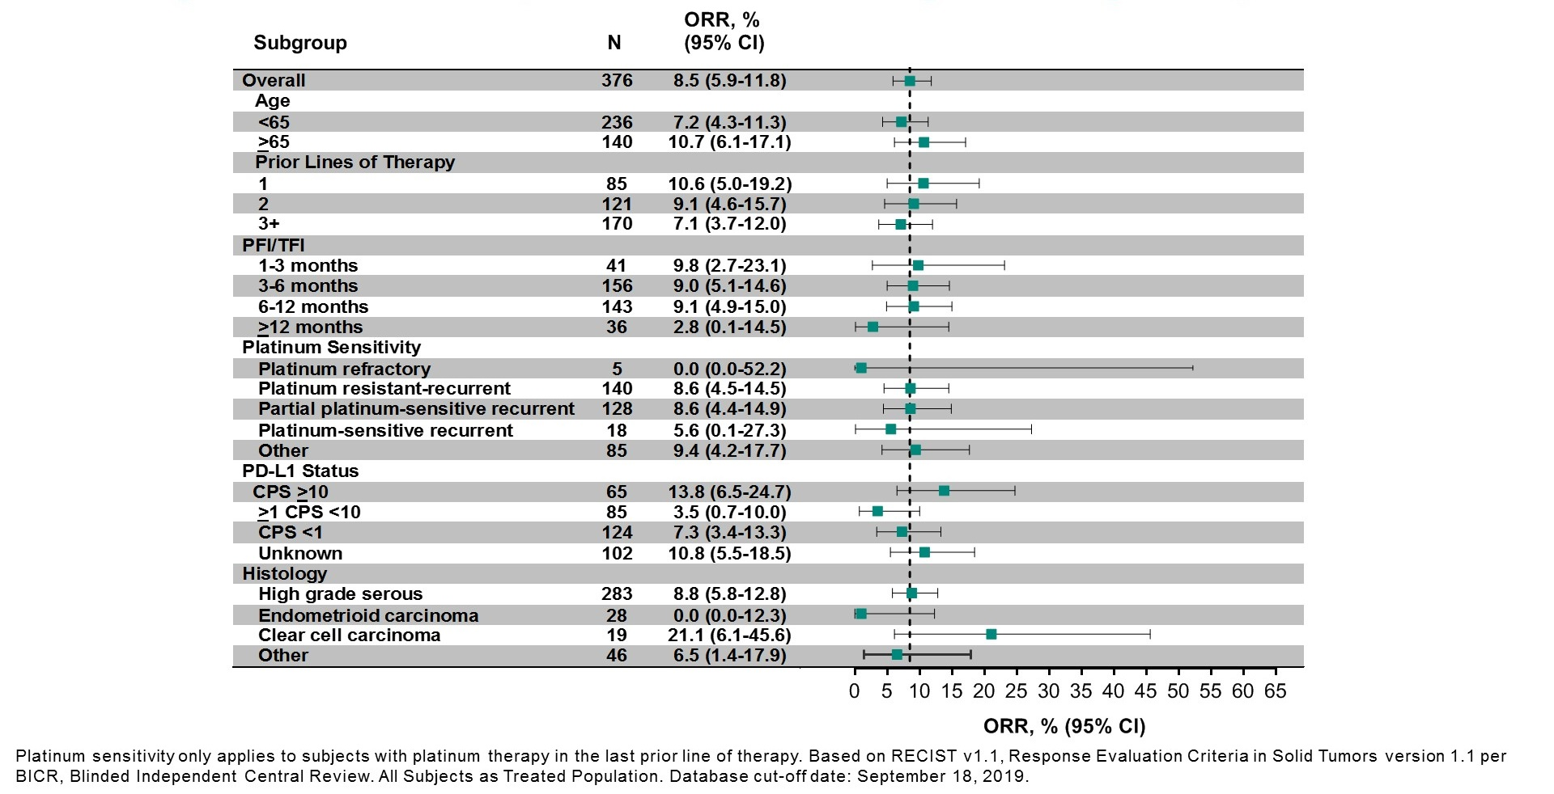
Objective Response Rate by Subgroup<br /><br />
KEYNOTE-100: Phase II pembrolizumab in ovarian cancer

Slide 12
NINJA Trial
Key inclusion criteria
Platinum-resistant advanced or recurrent ovarian cancer
≥20 years of age
Received ≤1 regimen after diagnosis of platinum resistance
ECOG PS ≤1
Key exclusion criteria
Current or previous severe hypersensitivity reactions to antibody products
Current, recurrent, or chronic autoimmune disease
Multiple primary cancers and/or CNS metastases
Pregnant or breastfeeding
Nivolumabª (N=157)
Nivolumab 240 mg IV every 2 weeks
Primary efficacy endpoint:
OS
Secondary efficacy endpoints^{b}:
PFS
ORR
BOR
DoR (RECIST v1.1), etc.
Safety
TEAEs
Treatment-related AEs, etc.
Randomization
(1:1)
Chemotherapyª (N=159)
GEM 1000 mg/m² IV for 30 minutes on Days 1, 8, and 15, then every 28 days, OR
PLD 50 mg/m² IV every 4 weeks
Stratification factors
CCC vs other
0 vs 1 regimen after platinum resistance diagnosis
Planned sample size
316 patients
(158 per group)
Tumor was assessed every 8 weeks through Week 48, then every 12 weeks thereafter
Patients were followed up for 28 days after end of treatment administration
22% Clear Cell Carcinoma
ªTreatment continued until disease progression or unacceptable toxicity.
^{b}Investigator assessed.
AE, adverse event; BOR, best overall response; CCC, clear cell carcinoma; CNS, central nervous system; DoR, duration of response; ECOG PS, Eastern Cooperative Oncology Group performance status; GEM, gemcitabine; IV, intravenous;
ORR, overall response rate; OS, overall survival; PFS, progression-free survival; PLD, pegylated liposomal doxorubicin; RECIST v1.1, Response Evaluation Criteria in Solid Tumors version 1.1; TEAE, treatment-emergent adverse event.

Slide 13
OVERALL RESPONSE
Outcome | Nivolumab (N=119) | GEM/PLD (N=114)
Best overall response, n (%)ª
Complete response | 2 (2) | 2 (2)
Partial response | 7 (6) | 13 (11)
Stable disease | 33 (28) | 53 (47)
Progressive disease | 76 (64) | 45 (40)
Overall response rate (CR + PR), n (%) [95% CI]^{b} | 9 (8) [3.5–13.9] | 15 (13) [7.6–20.8]
Duration of overall response, months, n (%)^{c} | 9 (8) | 15 (13)
Events, n (%) | 5 (56) | 11 (73)
Median [95% CI]^{d} | 18.7 [2.5–NE] | 7.4 [3.0–10.3]

Slide 14
OS SUBGROUP ANALYSIS
n
HR (95% CI)
n
HR (95% CI)
For patients with CCC, OS was numerically longer with nivolumab than with GEM/PLD (HR 0.8; 95% CI: 0.5–1.3)
Total
Age (years)
<65
≥65
ECOG PS
0
1
Duration of disease (years)
<2
≥2
Primary tumor site
Ovary
Fallopian tube
Peritoneum
Classification
FIGO
I
II
III
IV
NA
TNM classification (tumor)
TX/unknown
T0
T1
T2
T3
TNM classification (node)
NX/unknown
N0
N1
TNM classification (metastatic)
MX/unknown
M0
M1
Histological type
CCC
Serous carcinoma
Mucinous carcinoma
Endometrioid carcinoma
Others
Histological grade
Grade 1
Grade 2
Grade 3
Unknown
316
1.08 (0.84–1.38)
Presence of ascites
Yes
No
Site of metastasis (peritoneum)
No
Yes
Site of metastasis (lymph node)
No
Yes
Site of metastasis (lung, bone, liver,
brain, bone marrow, peritoneum, skin)
No
Yes
Completion of first surgery
Complete removal
Residual tumor (<1 cm)
Residual tumor (1–2 cm or >2 cm)
Unknown
Time from last administration of platinum
drug to diagnosis of resistance (months)
<1
≥1
History of radiation therapy
No
Yes
Number of regimens
1
2
3
≥4
Number of regimens
after diagnosis of resistance
0
1
Histological type (IWRS)
CCC
Others
PD-L1
Positive (≥1%)
Negative (<1%)
Others
BRCA1/2 genetic test
Positive
Negative
Unknown
187
0.91 (0.65–1.27)
216
1.11 (0.83–1.50)
129
1.65 (1.14–2.40)
100
1.07 (0.69–1.66)
125
1.36 (0.90–2.06)
266
1.10 (0.84–1.45)
191
1.02 (0.74–1.39)
45
1.05 (0.56–1.95)
150
1.01 (0.71–1.45)
150
1.14 (0.80–1.63)
166
1.41 (0.81–1.61)
166
1.03 (0.74–1.45)
259
1.08 (0.82–1.41)
191
1.20 (0.87–1.65)
n
HR (95% CI)
14
–
125
0.86 (0.59–1.26)
Histological type
40
1.08 (0.54–2.19)
3
–
137
1.06 (0.73–1.53)
CCC
67
0.78 (0.46–1.32)
30
1.15 (0.54–2.47)
59
1.31 (0.71–2.42)
Serous carcinoma
196
1.11 (0.81–1.52)
21
–
95
0.92 (0.58–1.45)
193
1.02 (0.74–1.41)
23
–
Mucinous carcinoma
7
–
68
1.20 (0.70–2.06)
4
–
97
1.14 (0.74–1.77)
Endometrioid carcinoma
24
–
10
–
219
1.05 (0.78–1.42)
0
–
289
1.08 (0.83–1.39)
Others
22
–
44
1.28 (0.67–2.45)
27
1.10 (0.47–2.56)
39
0.93 (0.47–1.84)
0.0
0.5
1.0
1.5
2.0
223
1.10 (0.82–1.48)
70
1.18 (0.69–2.02)
Favors nivolumab
Favors GEM/PLD
84
1.59 (0.98–2.58)
131
1.04 (0.71–1.53)
127
1.09 (0.74–1.59)
65
0.97 (0.56–1.66)
105
0.82 (0.53–1.26)
50
1.08 (0.58–2.00)
7
–
217
1.32 (0.97–1.78)
n
241
1.04 (0.78–1.38)
99
0.74 (0.48–1.14)
HR (95% CI)
68
1.20 (0.70–2.06)
67
0.80 (0.47–1.36)
PD-L1
67
0.78 (0.46–1.32)
249
1.12 (0.85–1.49)
Positive (≥1%)
123
1.09 (0.73–1.64)
196
1.11 (0.81–1.52)
7
–
123
1.09 (0.73–1.64)
Negative (<1%)
189
1.07 (0.78–1.46)
24
–
189
1.07 (0.78–1.46)
22
–
4
–
Others
4
–
9
–
26
–
36
1.71 (0.81–3.62)
159
1.16 (0.82–1.65)
0.0
0.5
1.0
1.5
2.0
125
0.95 (0.63–1.41)
16
–
Favors nivolumab
Favors GEM/PLD
146
0.96 (0.67–1.37)
0
1
2
3
4
0
1
2
3
4
Favors nivolumab
Favors GEM/PLD
Favors nivolumab
Favors GEM/PLD
BRCA1/2, breast cancer susceptibility gene I/II; CCC, clear cell carcinoma; CI, confidence interval; ECOG PS, Eastern Cooperative Oncology Group performance status; FIGO, International Federation of Gynecology and Obstetrics; GEM, gemcitabine; HR, hazard ratio; IWRS, Interactive Web Response System; NA, not applicable; OS, overall survival; PD-L1, programmed death-ligand1; PLD, pegylated liposomal doxorubicin; TNM, TNM Classification of Malignant Tumors.

Slide 15
Ovarian Cancer:
Oral Cyclophosphamide and Bevacizumab

Slide 16
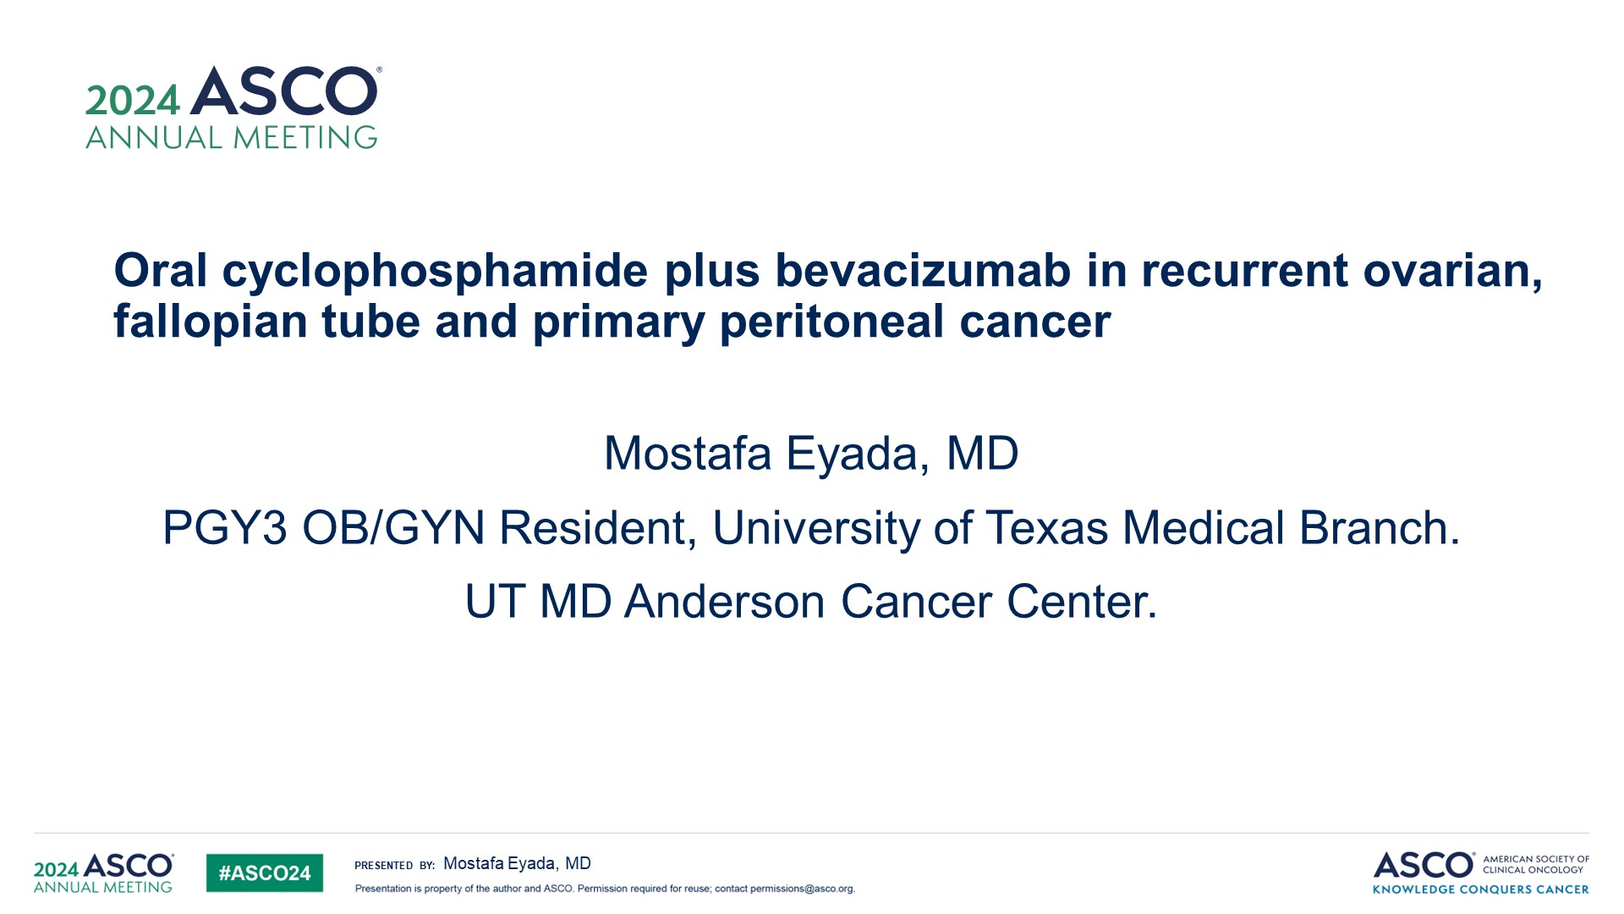
Oral cyclophosphamide plus bevacizumab in recurrent ovarian, fallopian tube and primary peritoneal cancer
Content of this presentation is the property of the author, licensed by ASCO. Permission required for reuse.

Slide 17
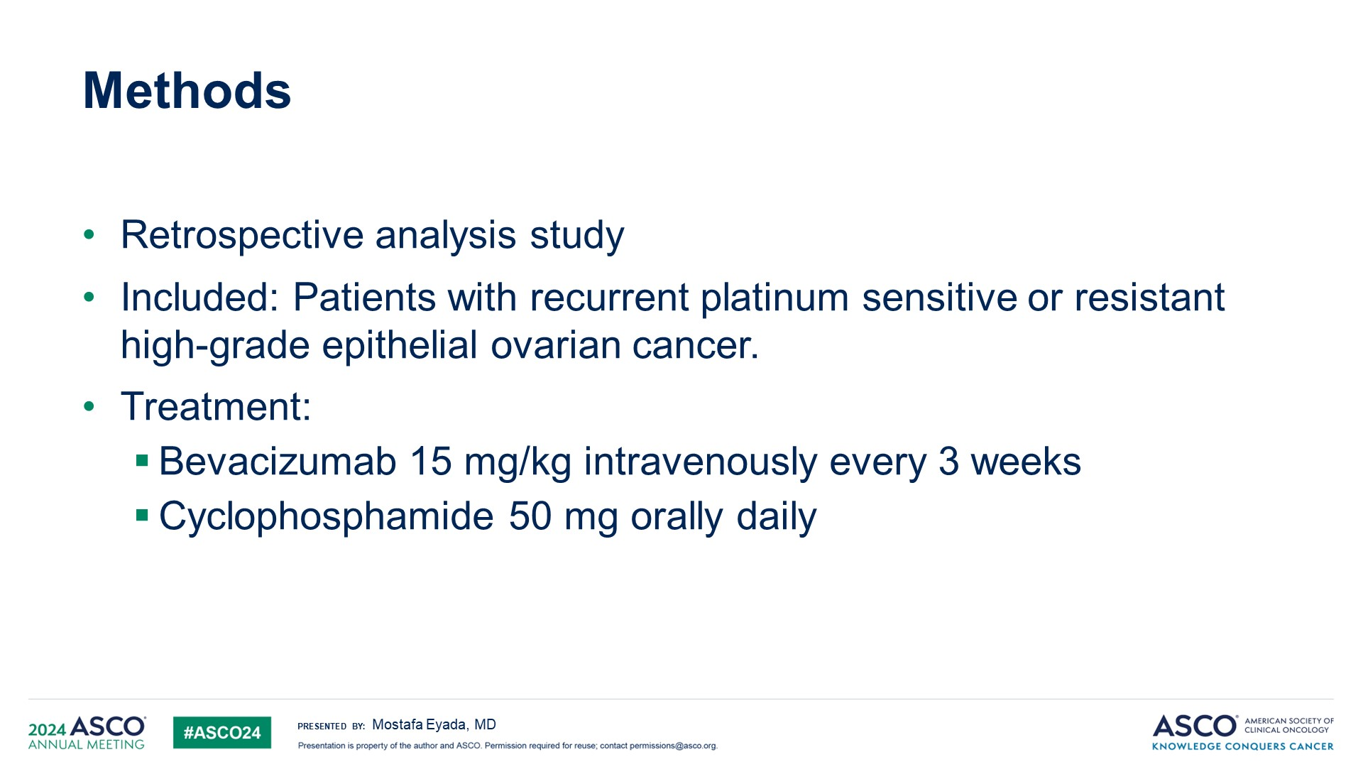
Methods
Content of this presentation is the property of the author, licensed by ASCO. Permission required for reuse.

Slide 18
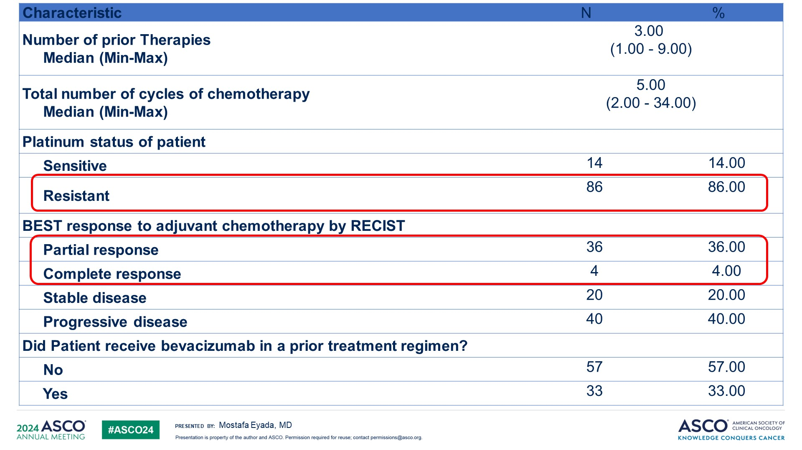
Slide 7
N=100
40%

Slide 19
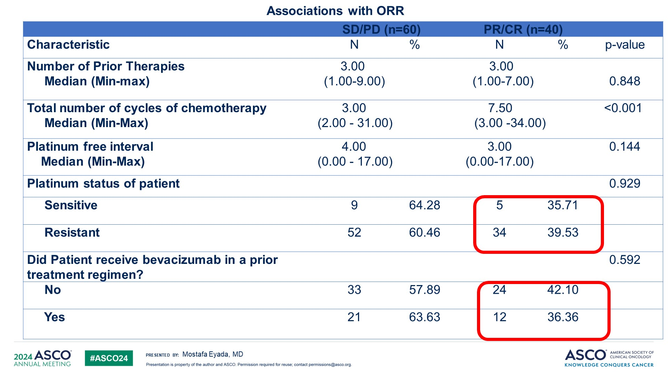
Slide 9
N=100

Slide 20
Bevacizumab in
Relapsed Ovarian Cancer
 | GOG 170-D* (N = 62) | NCI 5789** (N = 70) | Genentech Study*** (N = 44)
Study Treatment | Single agent BV 15 mg/kg q 3 wk | BV 10 mg/kg q 2 wks + low dose oral cyclophos. | Single agent BV 15 mg/kg q 3 wk
Prior Regimens | 1 – 21/62 (34%) 2 - 41/62 (62%) | Median = 2 Range 1-3 | 2 - 23/44 (52%) 3 - 21/44 (48%)
Platinum Resistant | 42% | 40% | 100%
Efficacy ORR 6-mo PFS | 21% 39% | 24% 56% | 16% 27%
GIP or fistula | 0 | 4 (6%) | 5 (11%)
*Burger RA, et al. J Clin Oncol 2007; 25: 5165–5171; **Garcia AA, et al. J Clin Oncol 2008; 26: 76–82, ***Cannistra SA, et al. J Clin Oncol 2007; 25: 5180–5186

Slide 21
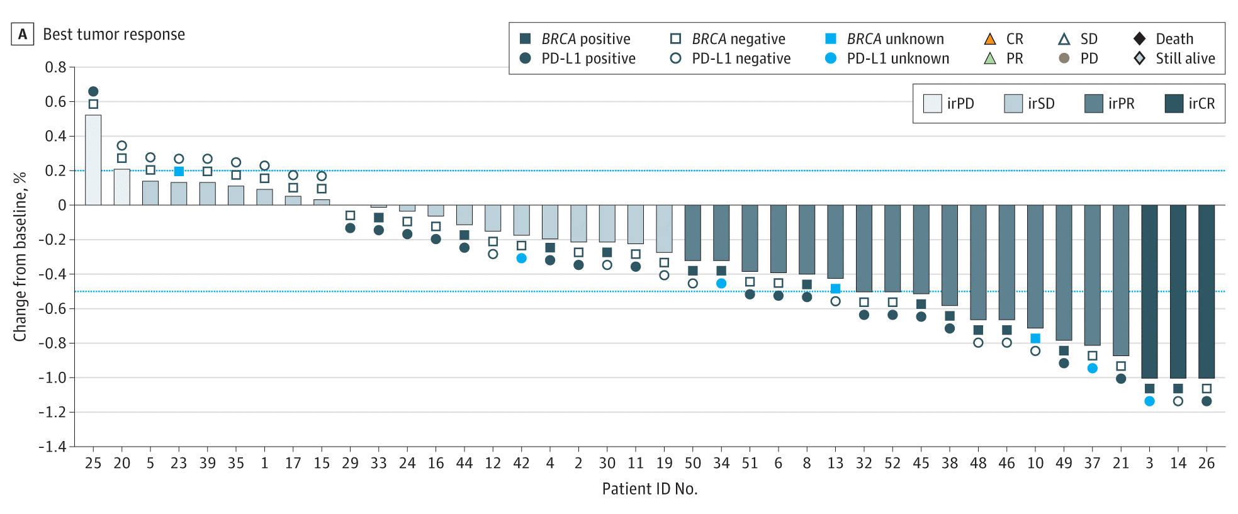
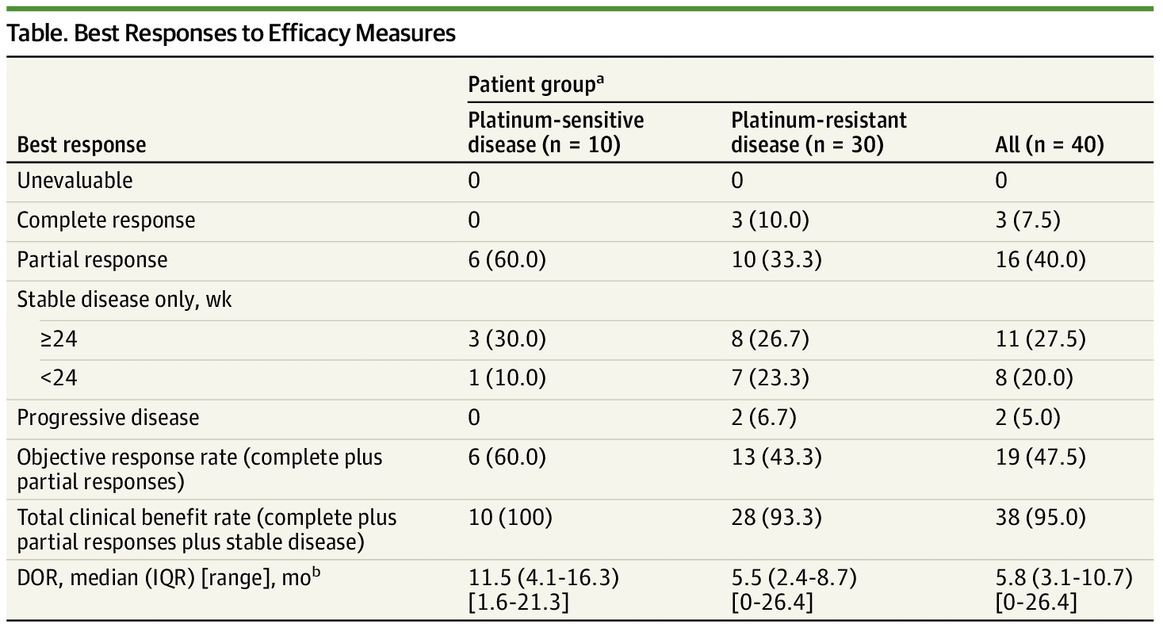
Pembrolizumab With Bevacizumab and Oral Metronomic Cyclophosphamide in Recurrent Ovarian Cancer
Zsiros E et al. JAMA Oncol. 2021;7(1):78-85
30/40 (75.0%) platinum-resistant
10/40 (25.0%) platinum-sensitive
ORR 19/40 (47.5%)
3/40 (7.5%) CR
16/40 (40.0%) PR
19/40 (47.5%) SD 47.5%
38/40 (95.0%) clinical benefit

Slide 22
Ovarian Cancer:
PARP Inhibitor Therapy

Slide 23
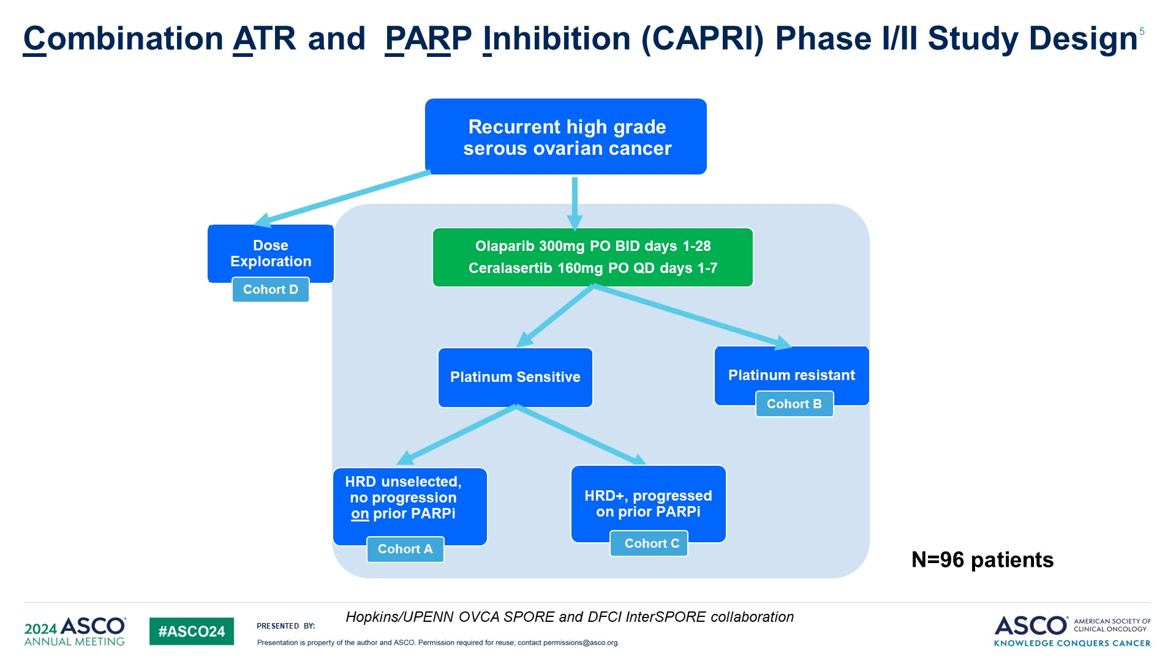
Combination ATR ​and PARP Inhibition (CAPRI) Phase I/II Study Design

Slide 24
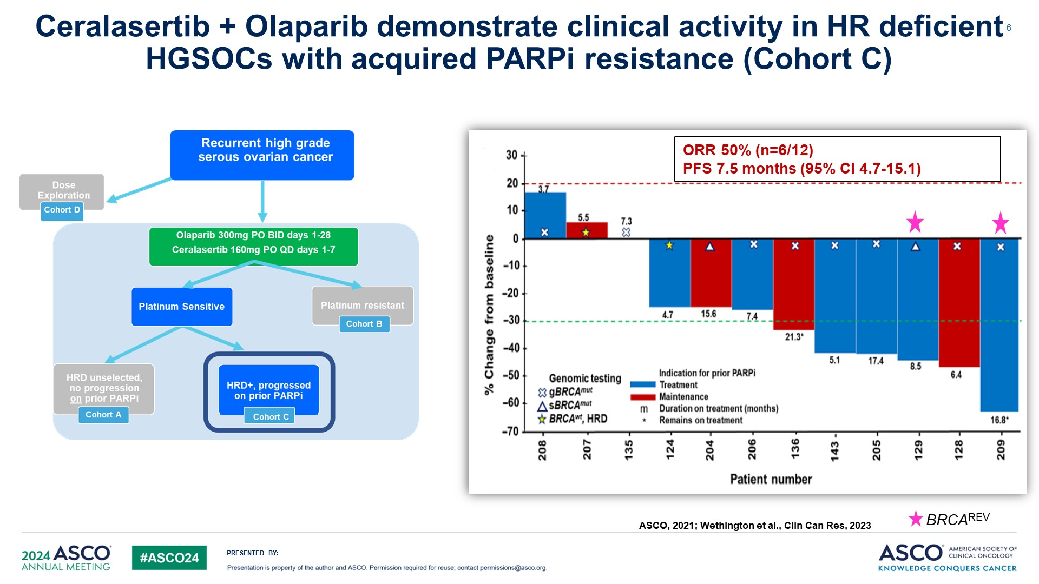
Ceralasertib + Olaparib demonstrate clinical activity in HR deficient HGSOCs with acquired PARPi resistance (Cohort C)

Slide 25
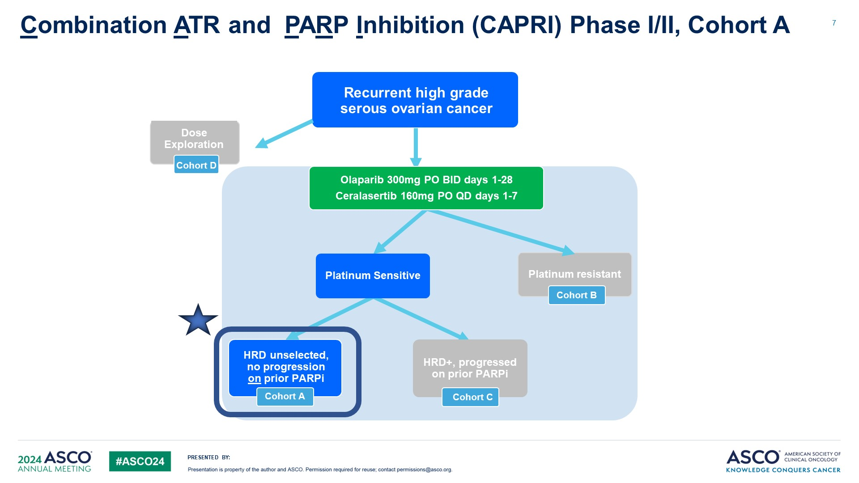
Combination ATR ​and PARP Inhibition (CAPRI) Phase I/II, Cohort A

Slide 26
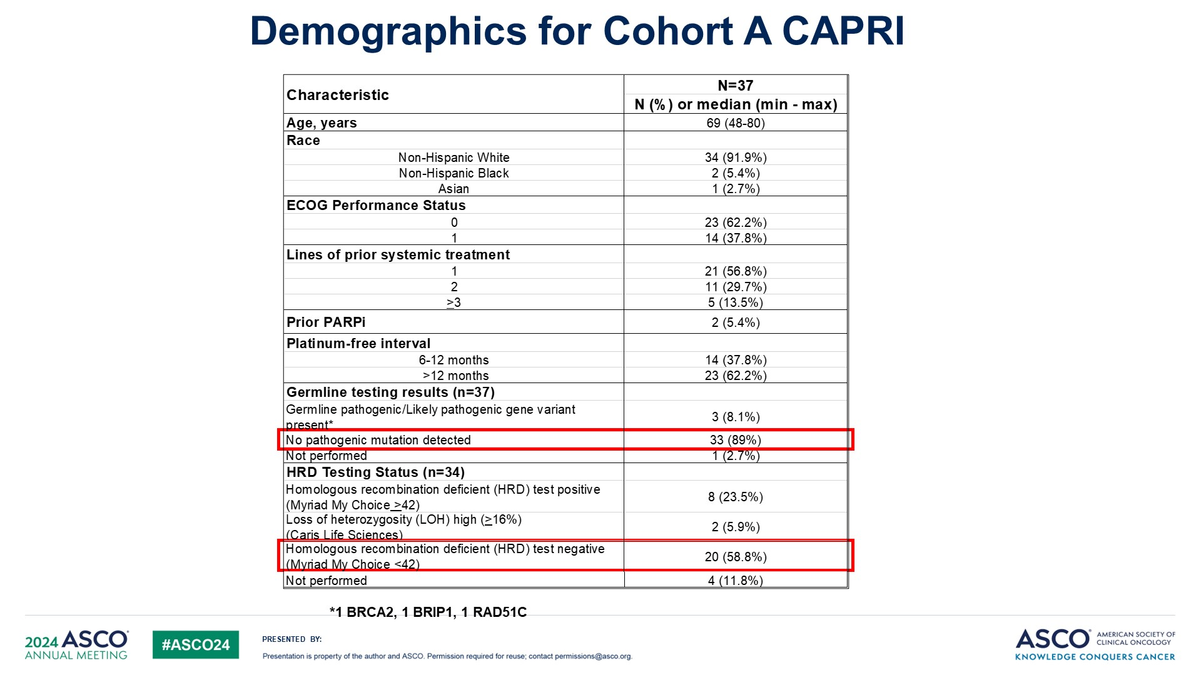
Slide 9

Slide 27
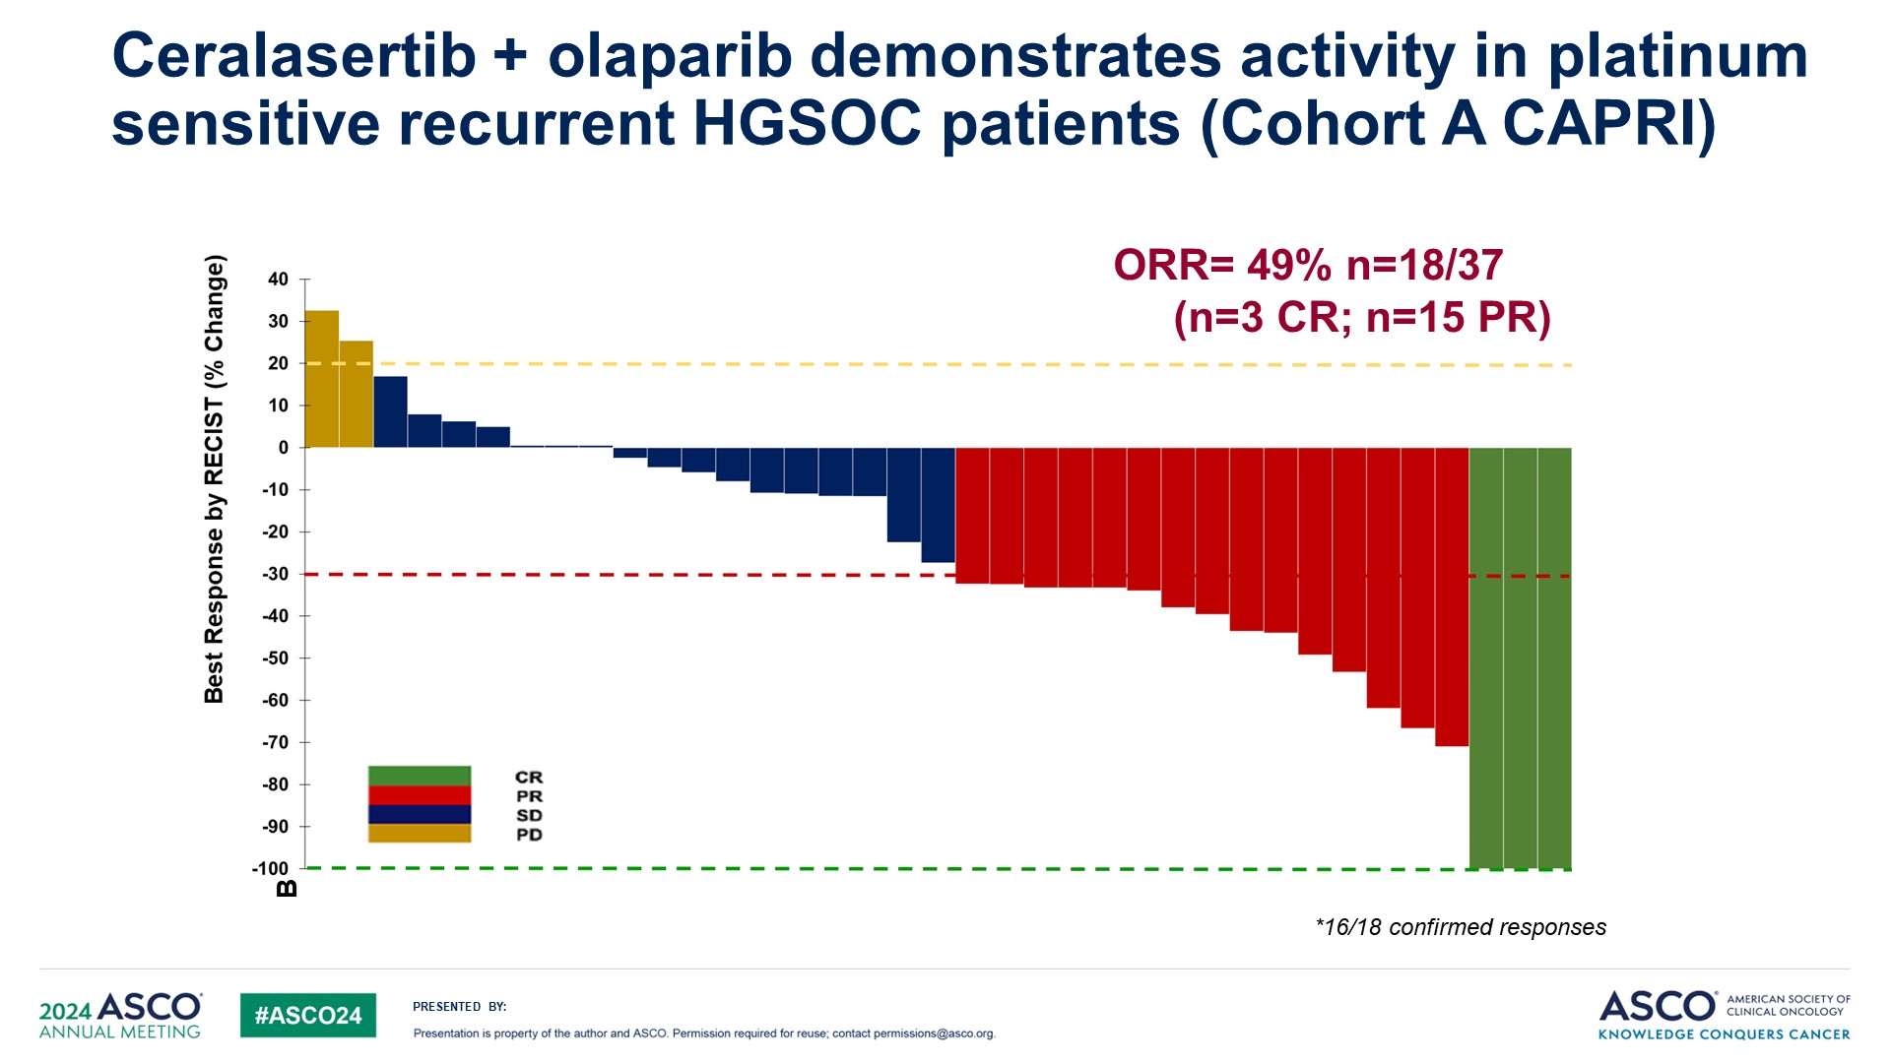
Ceralasertib + olaparib demonstrates activity in platinum sensitive recurrent HGSOC patients (Cohort A CAPRI)

Slide 28
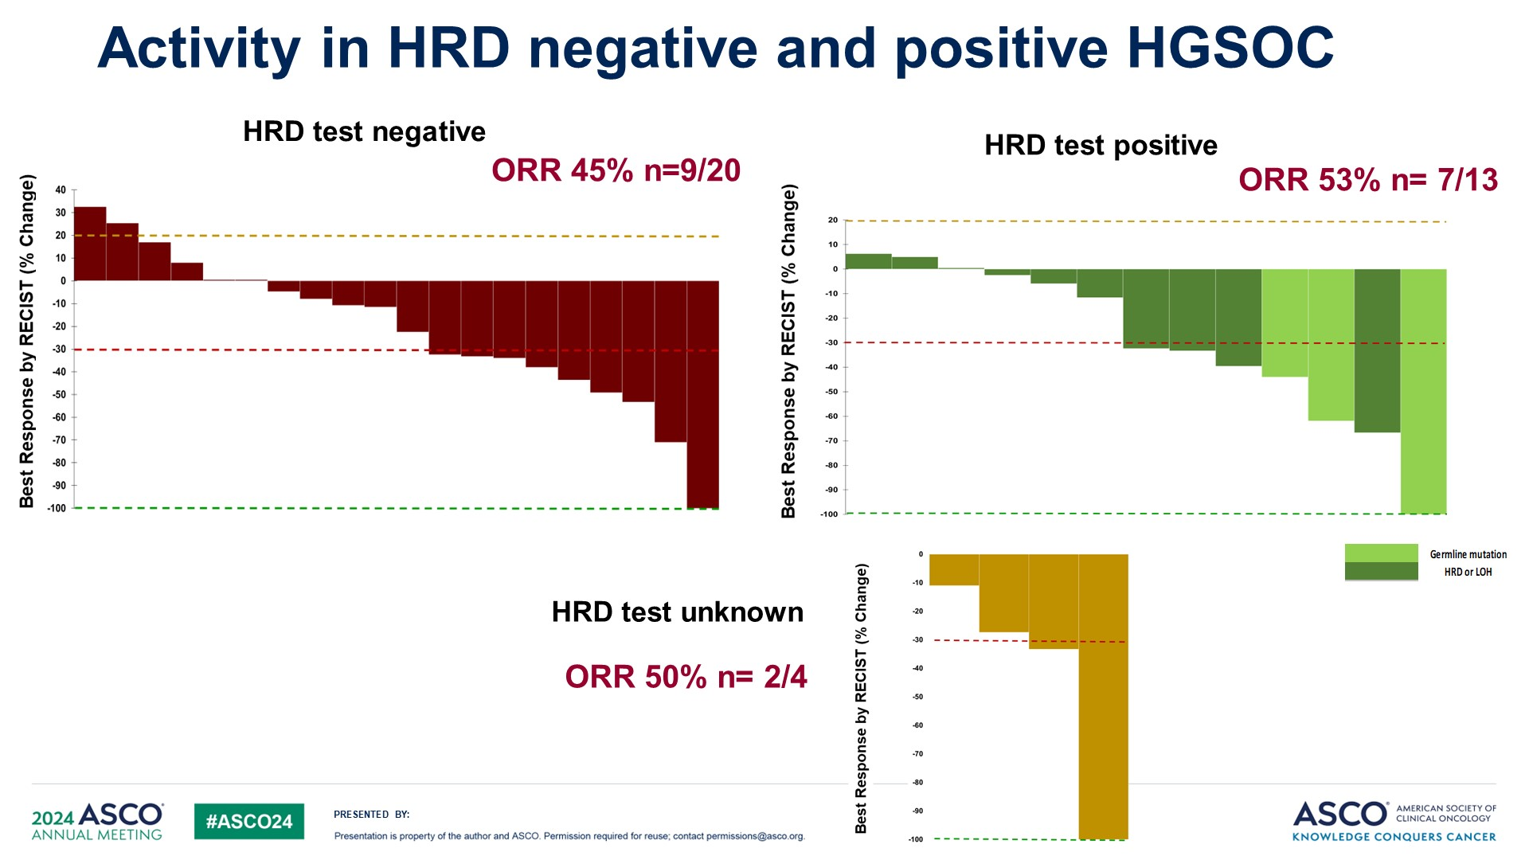
Activity in HRD negative and positive HGSOC

Slide 29
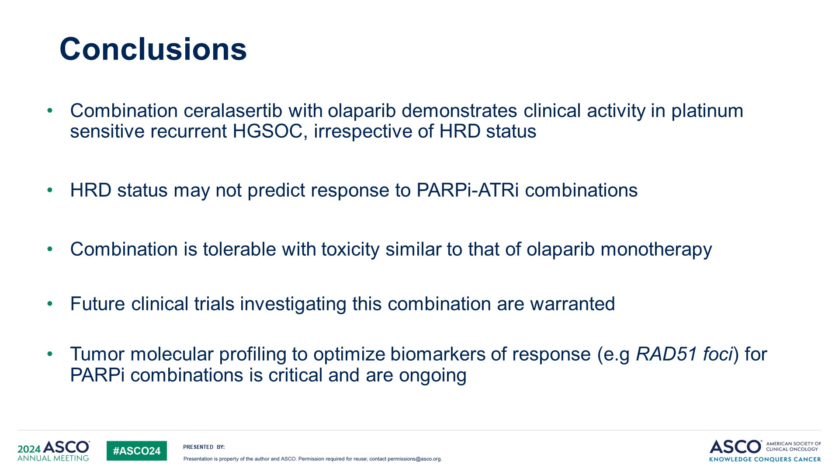
Conclusions

Slide 30
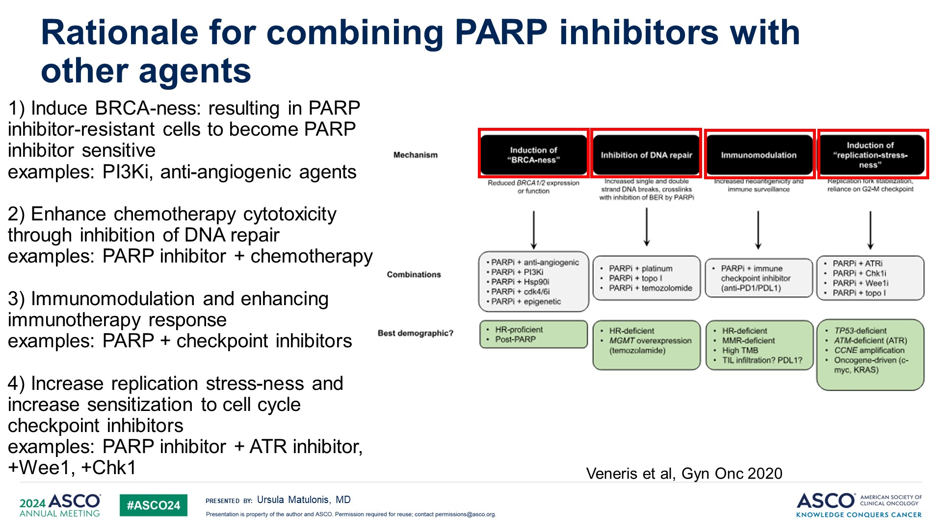
Rationale for combining PARP inhibitors with other agents
Alpelisib
Bevacizumab
Cediranib
Pembro
Ceralasertib

Slide 31
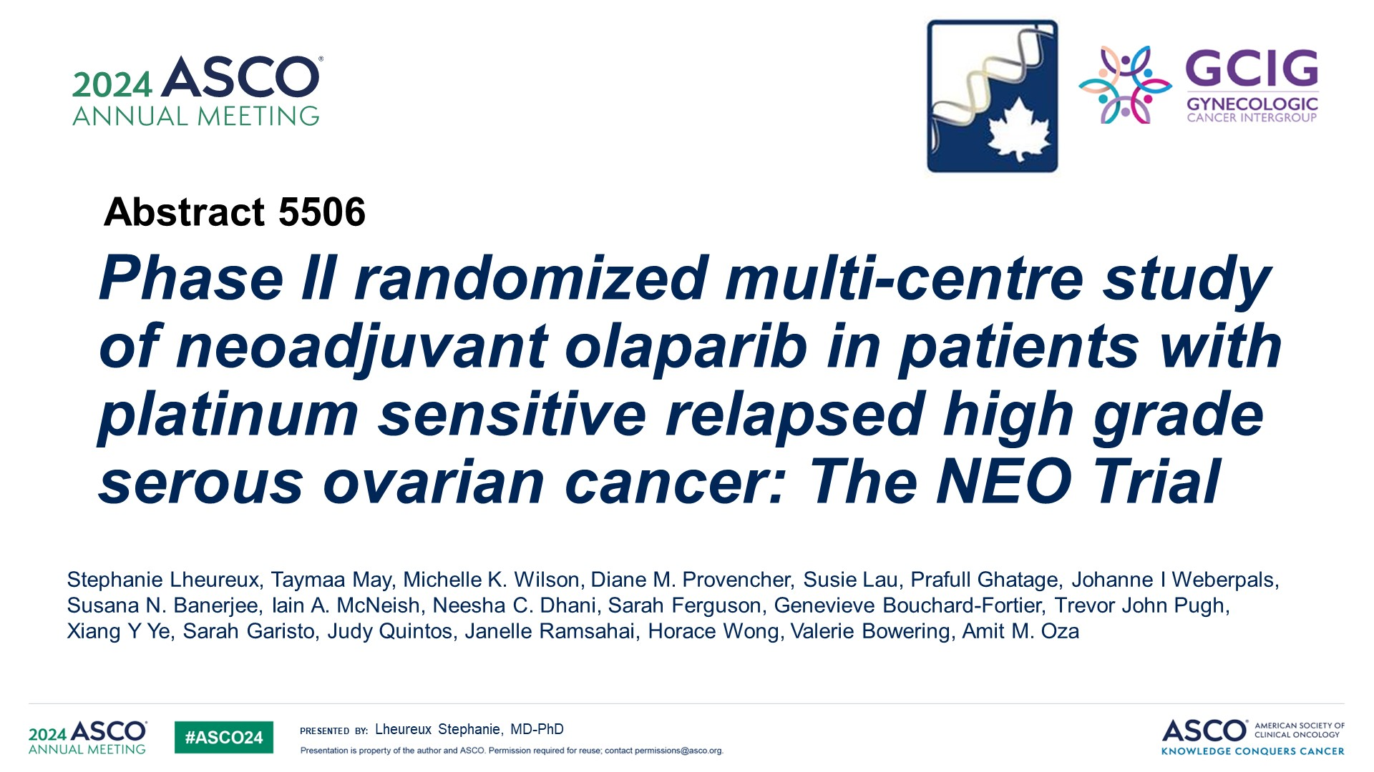
Phase II randomized multi-centre study of neoadjuvant olaparib in patients with platinum sensitive relapsed high grade serous ovarian cancer: The NEO Trial

Slide 32
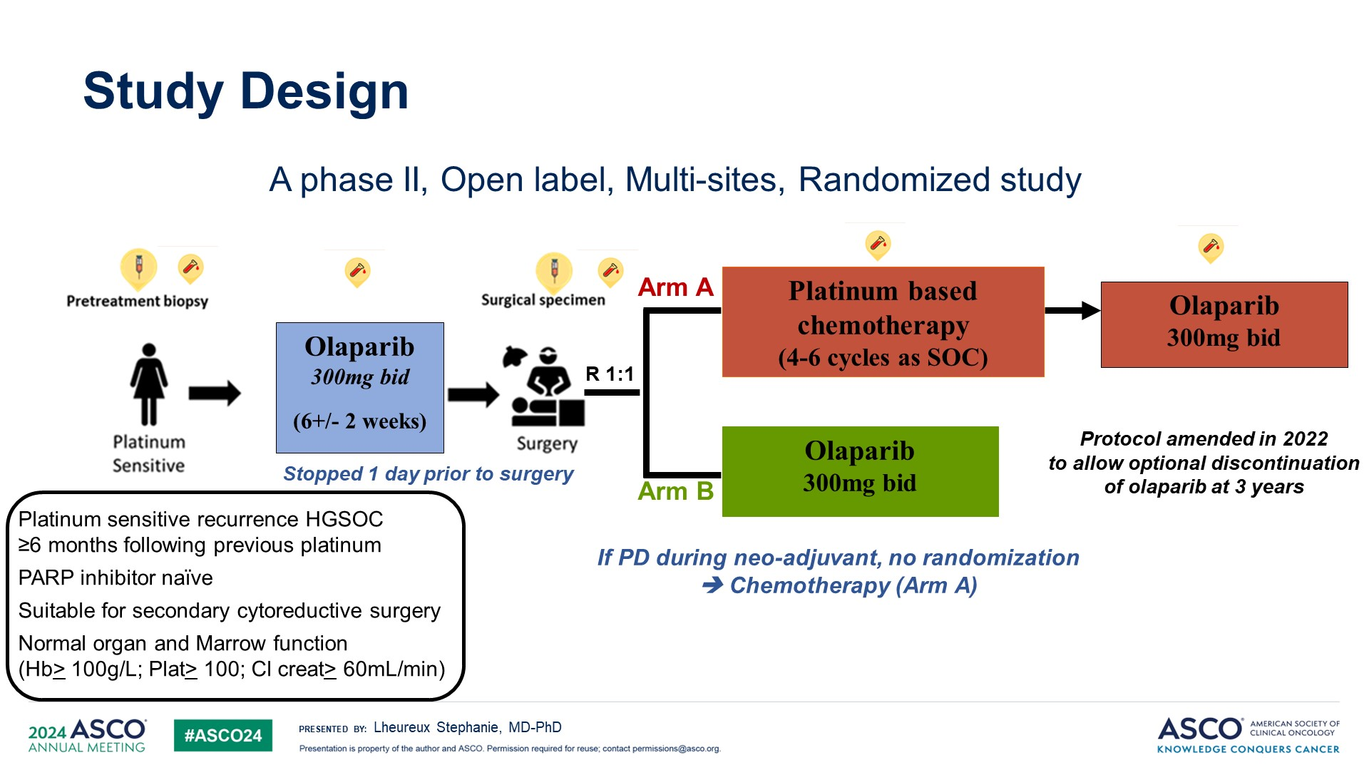
Study Design

Slide 33
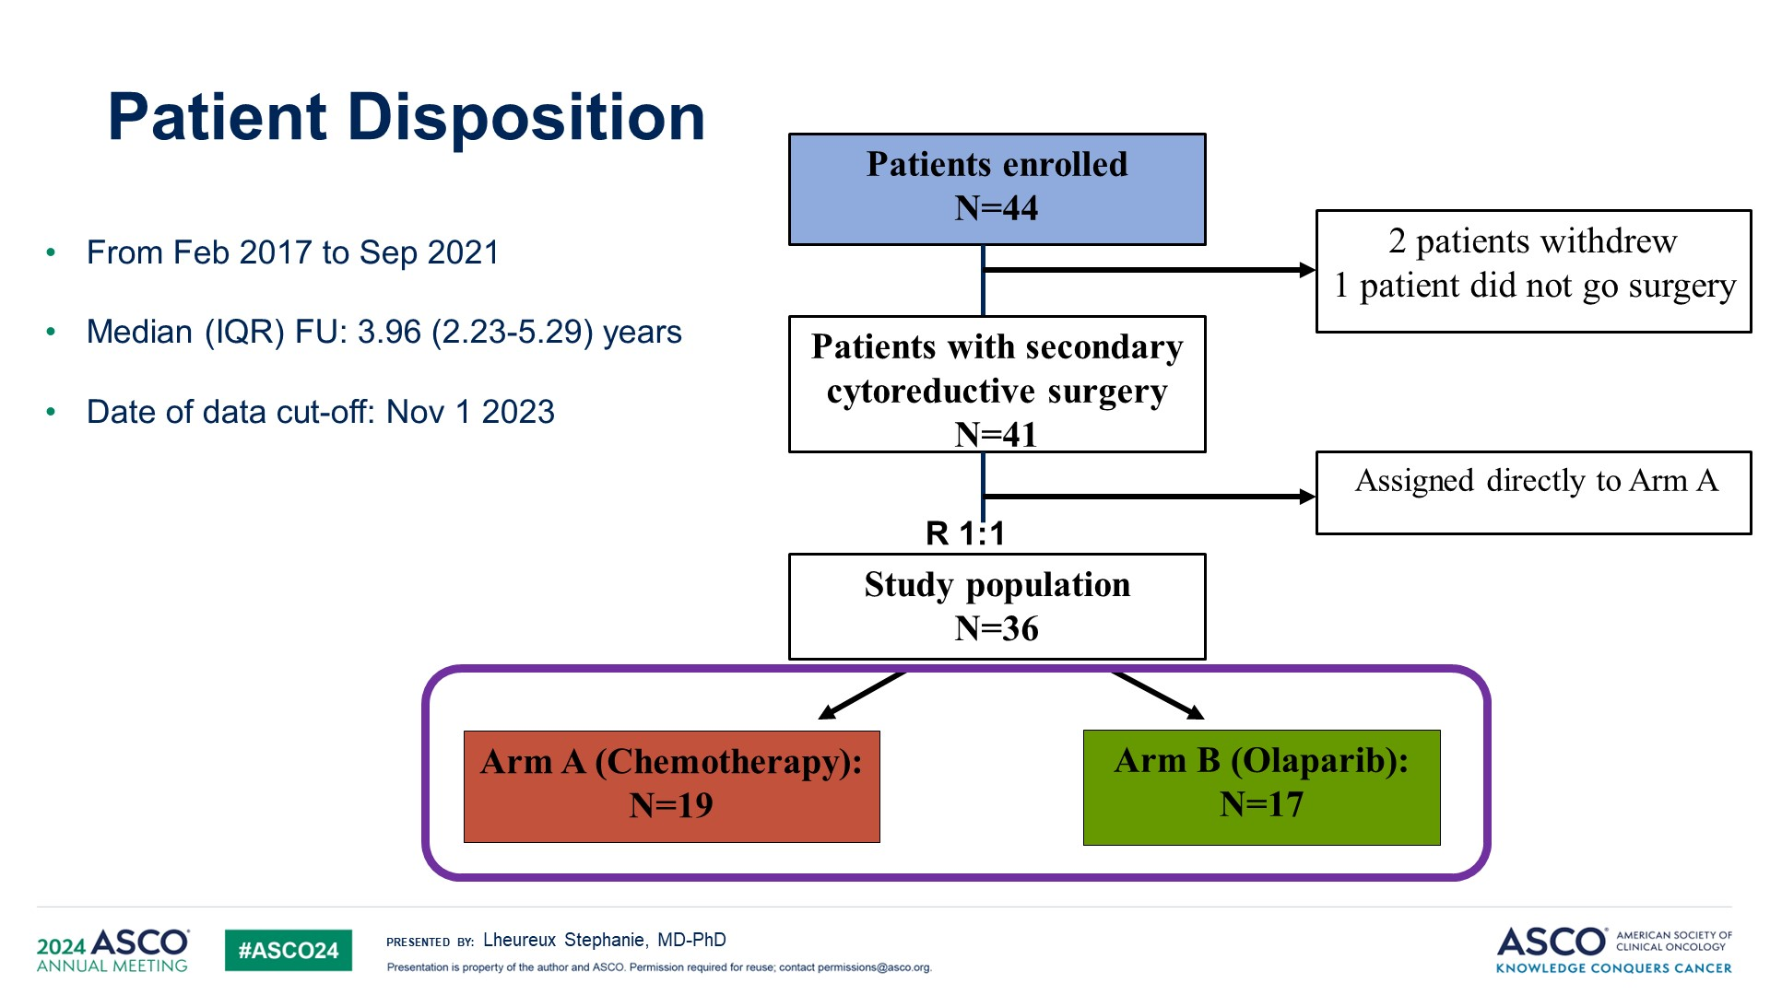
Patient Disposition

Slide 34
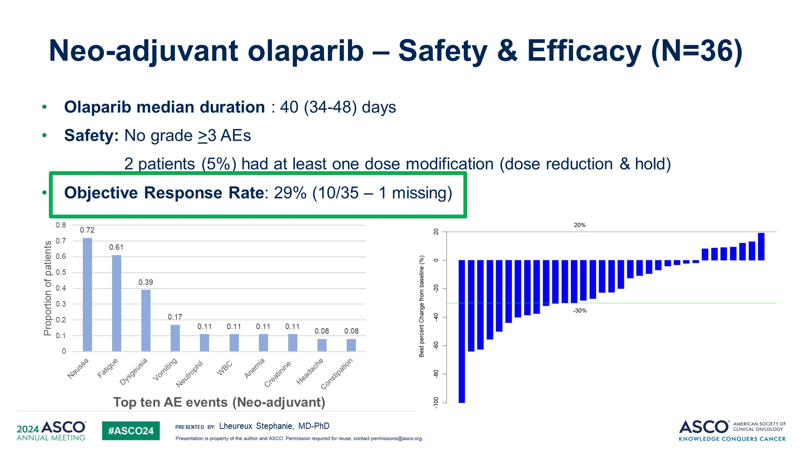
Neo-adjuvant olaparib – Safety & Efficacy (N=36)

Slide 35
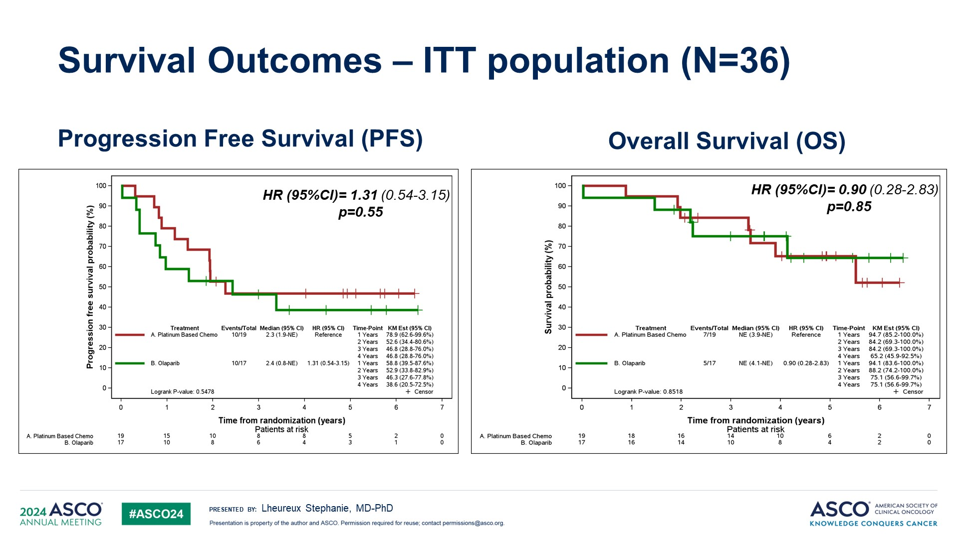
Survival Outcomes – ITT population (N=36)

Slide 36
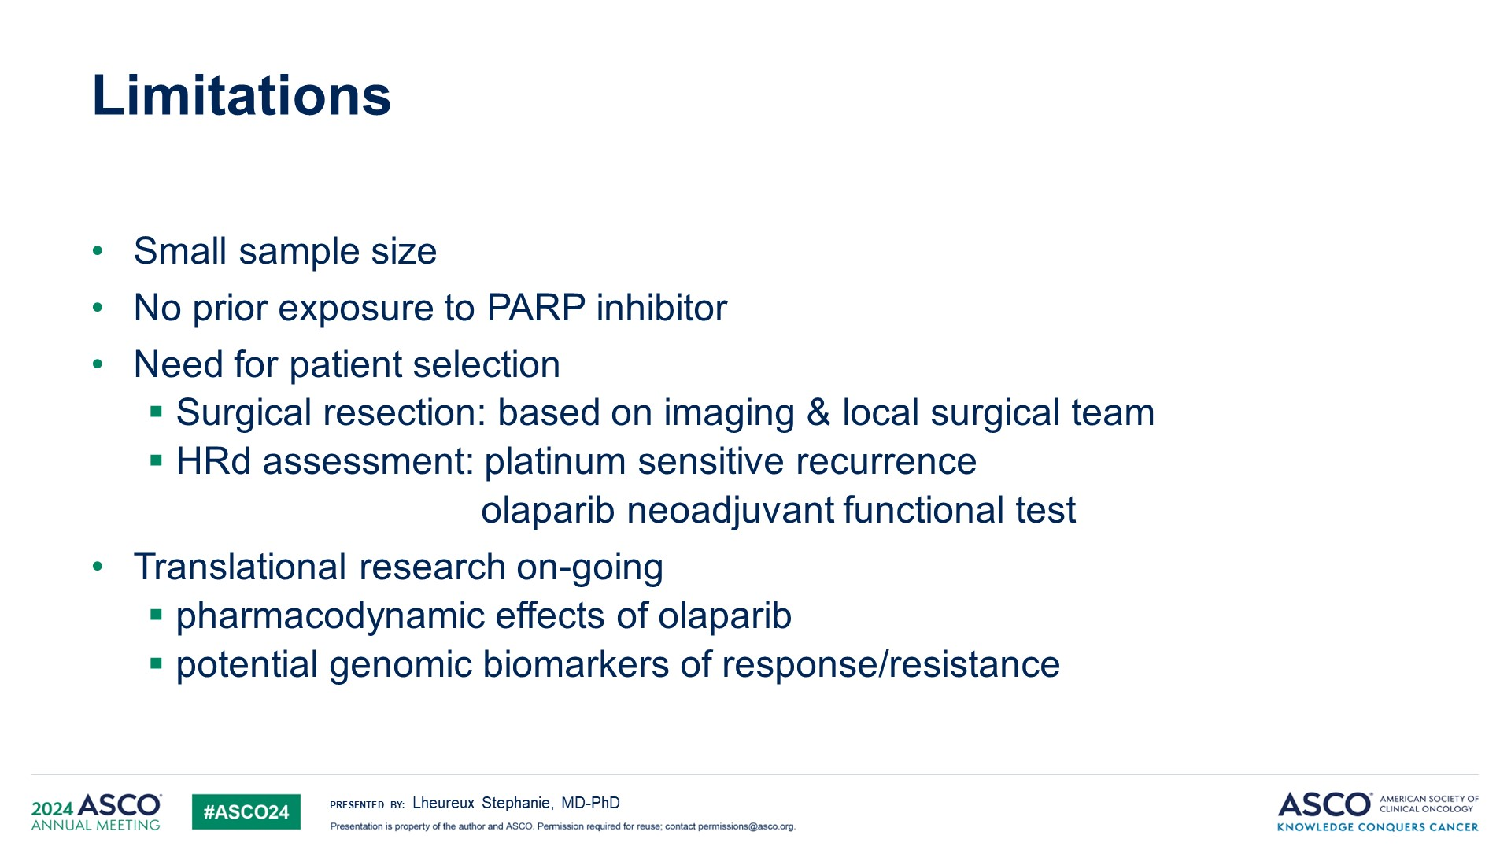
Limitations

Slide 37
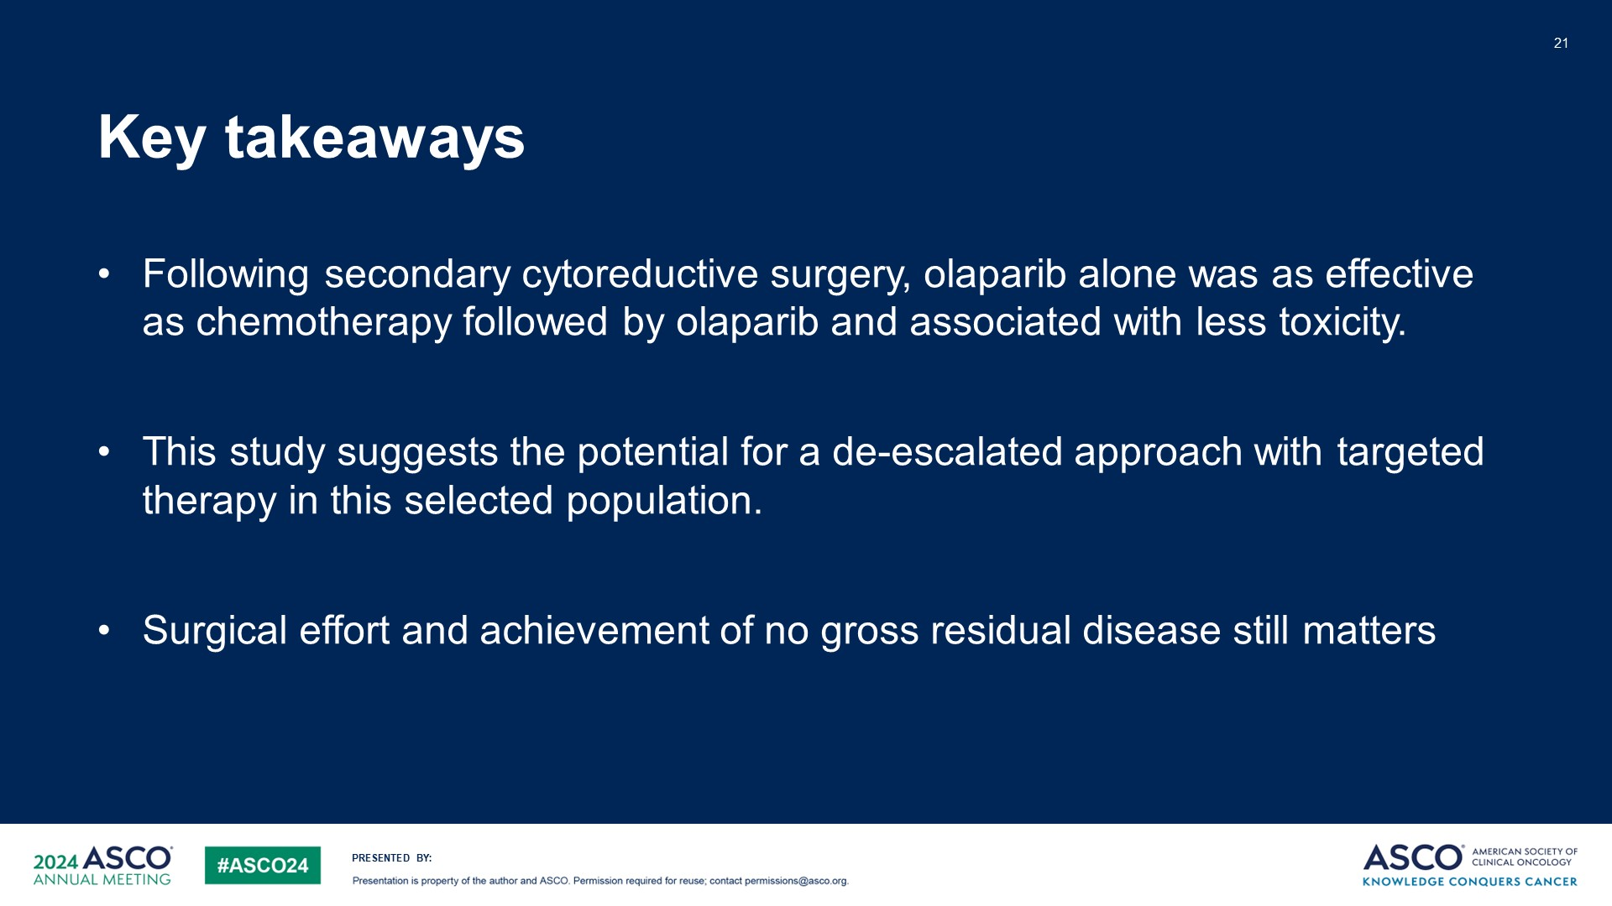
Key takeaways

Slide 38
Ovarian Cancer:
FOLR1 Expression

Slide 39
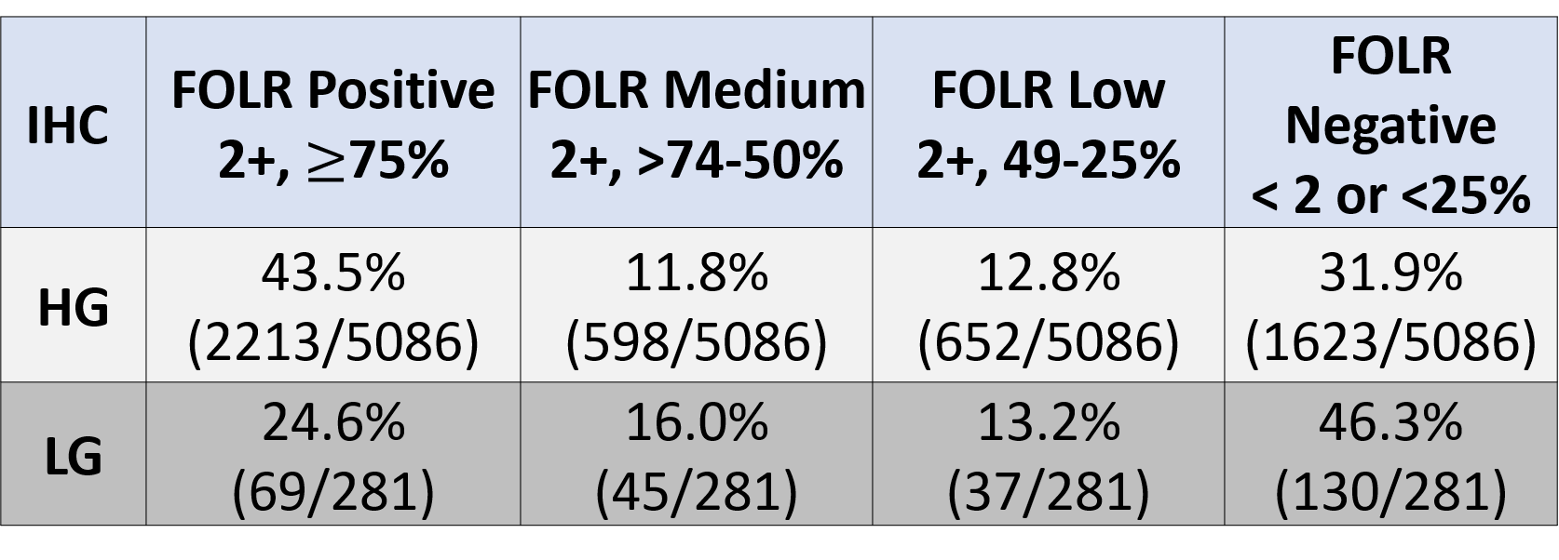
FOLR1 in LGSOC
Rushton T, et al. ASCO 2024

Slide 40
Endometrial Cancer

Slide 41
Endometrial Cancer:
Fulvestrant and Abemaciclib
(Hormonal Therapy)

Slide 42
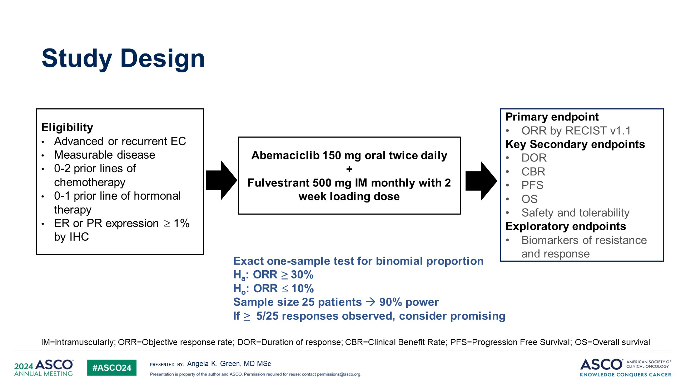
Study Design

Slide 43
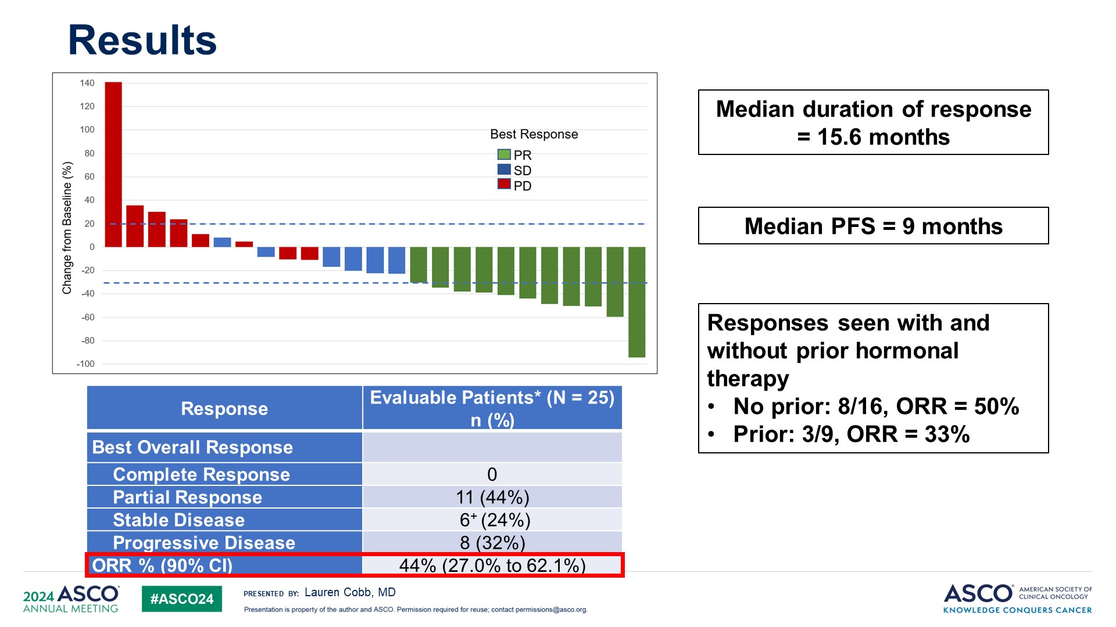
Results

Slide 44
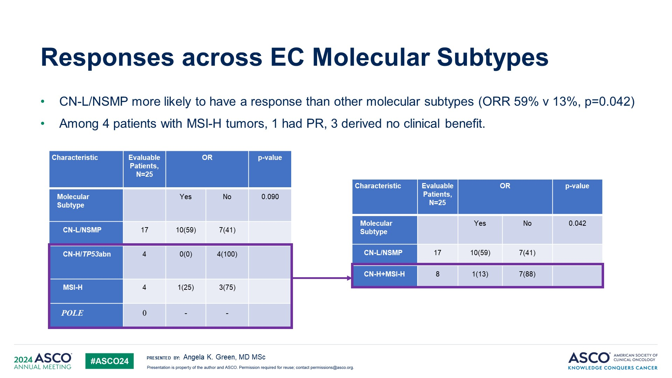
Responses across EC Molecular Subtypes
Content of this presentation is the property of the author, licensed by ASCO. Permission required for reuse.

Slide 45
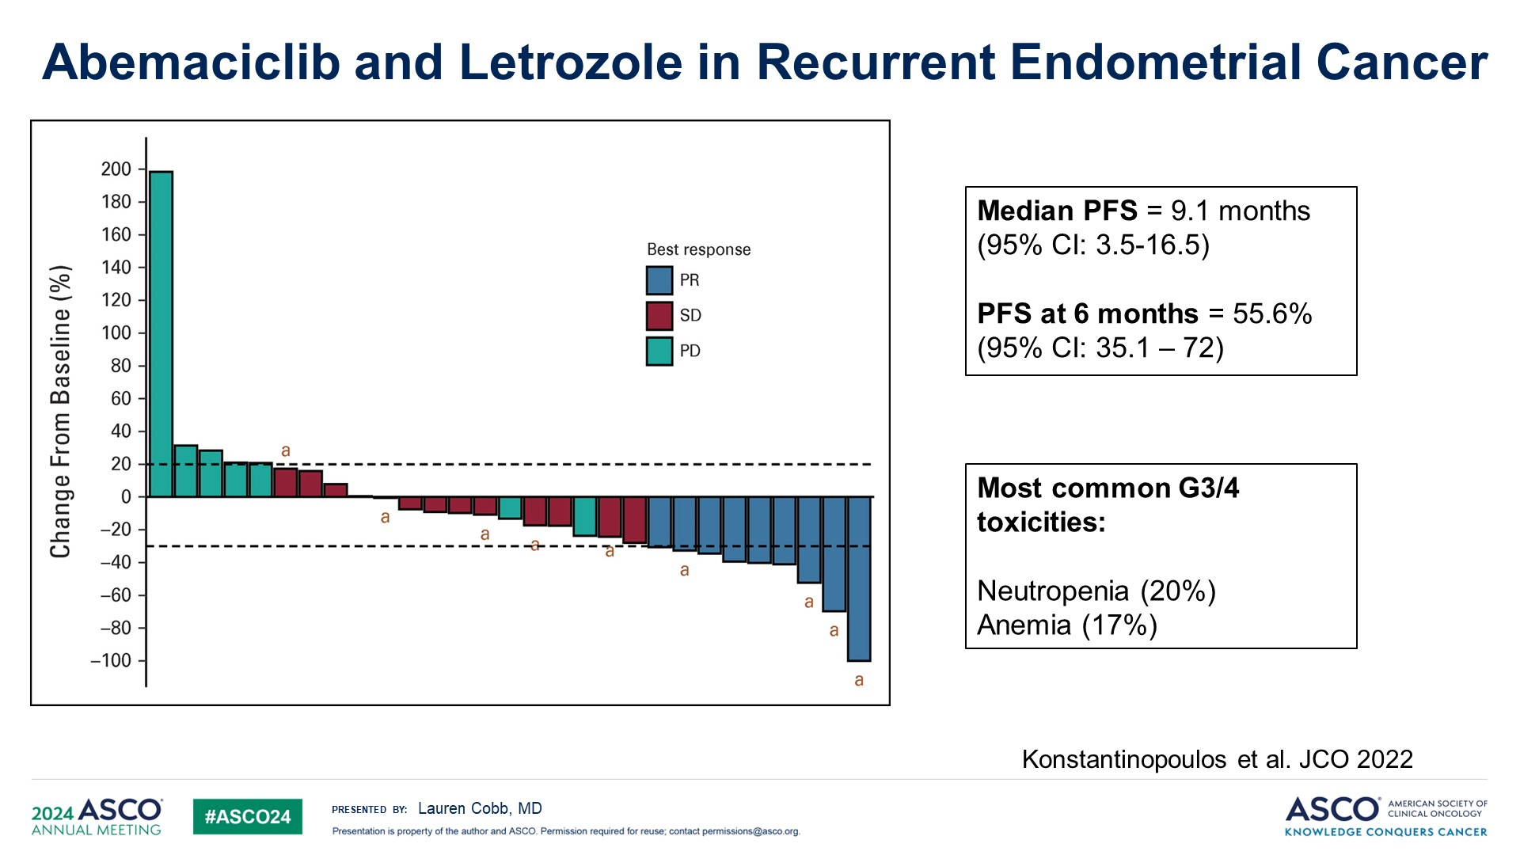
Abemaciclib and Letrozole in Recurrent Endometrial Cancer
ORR 30%
Abema/Letrozole included in NCCN Guidelines

Slide 46
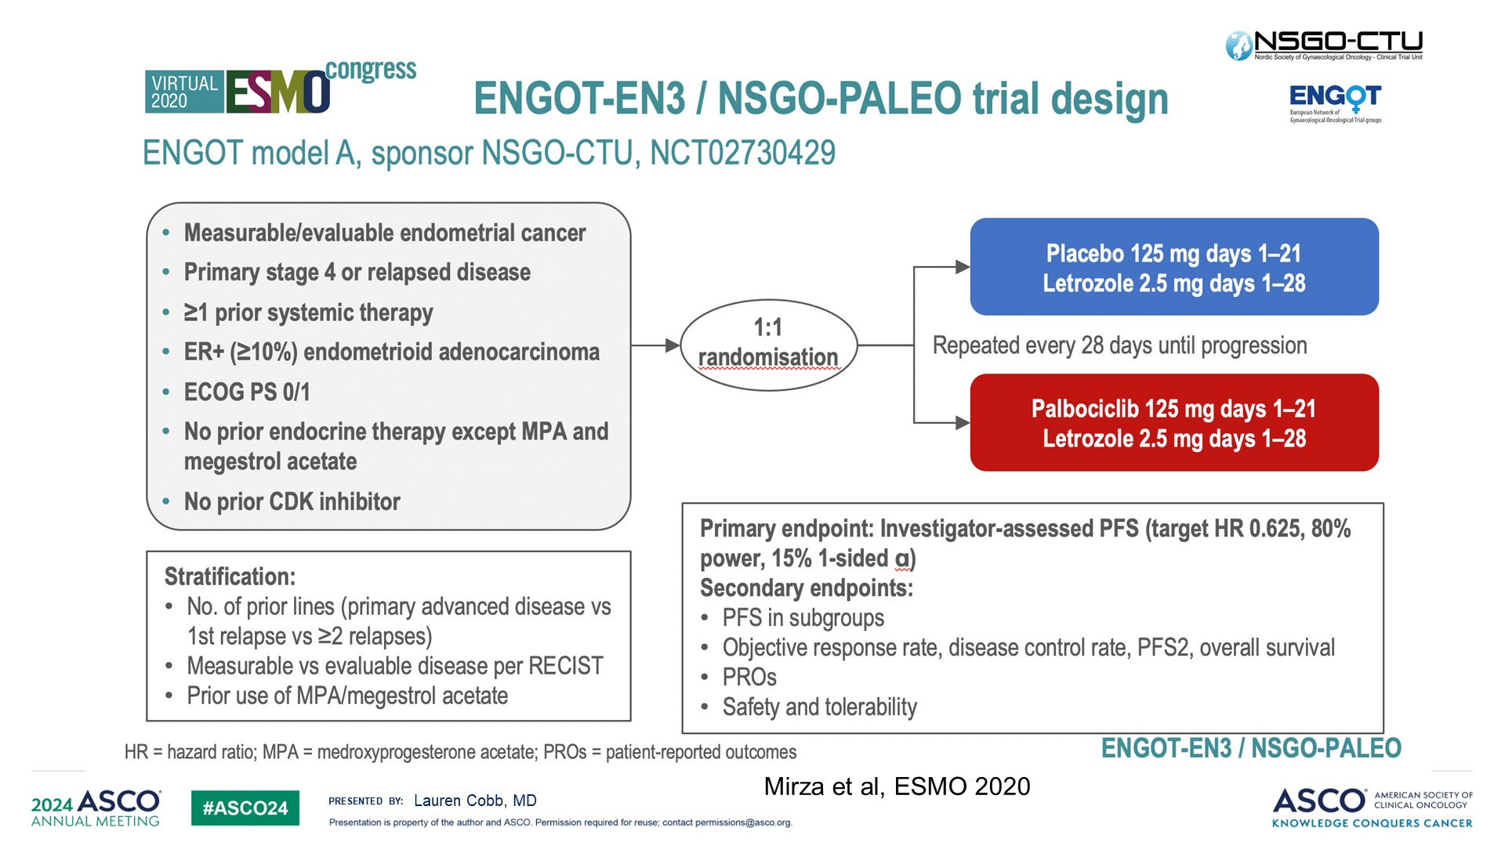
Slide 10

Slide 47
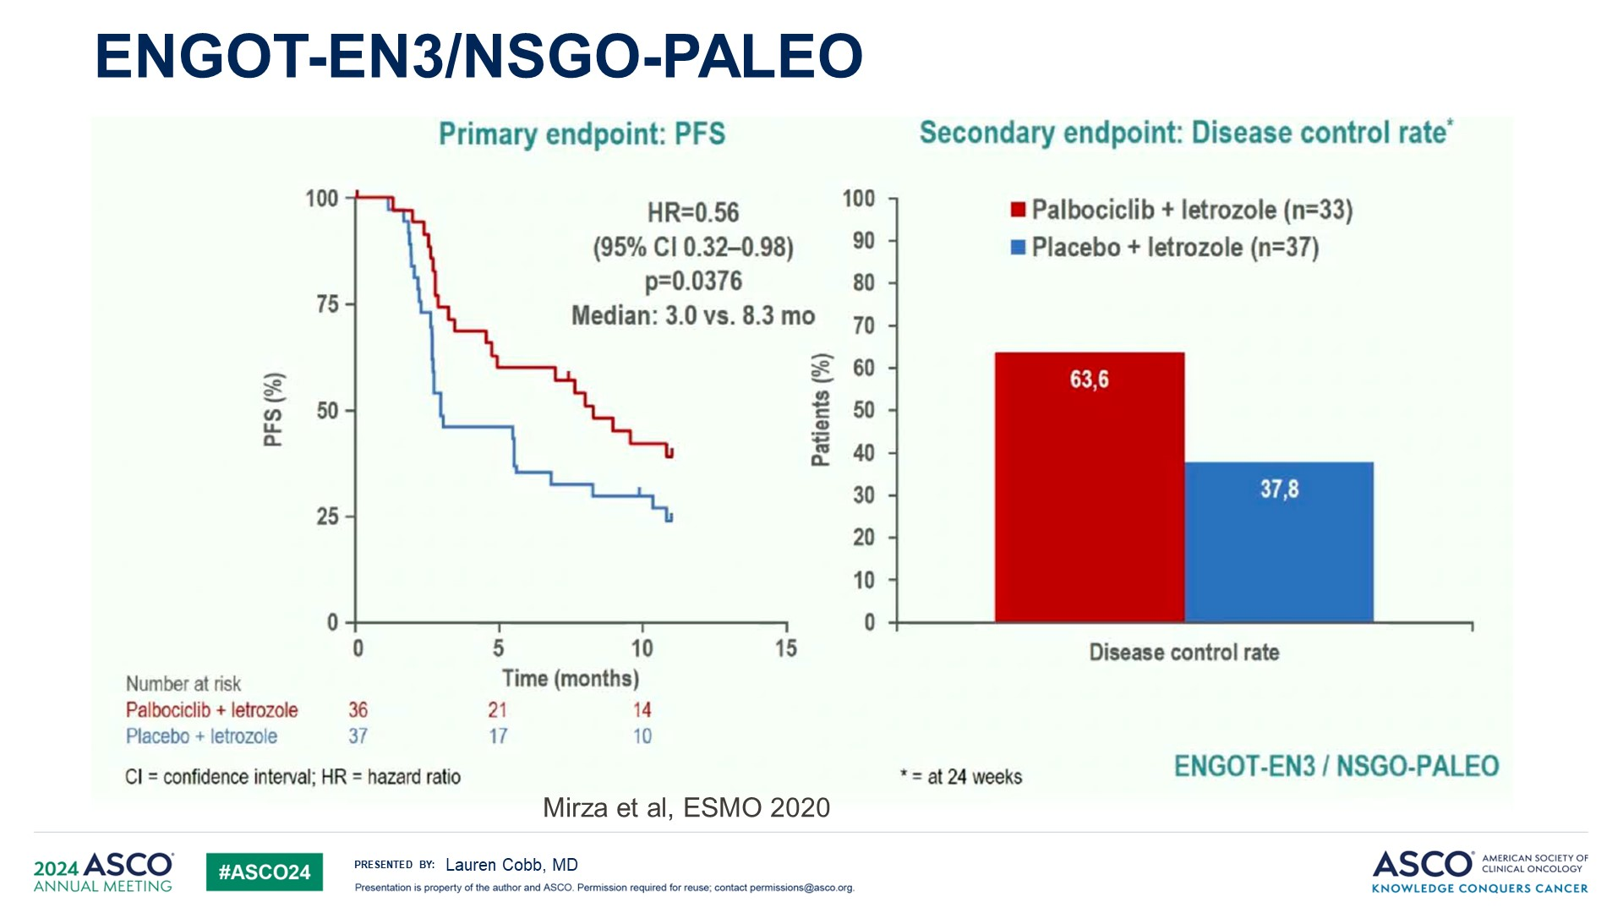
ENGOT-EN3/NSGO-PALEO
Palbo/Letrozole currently NOT included in NCCN Guidelines

Slide 48
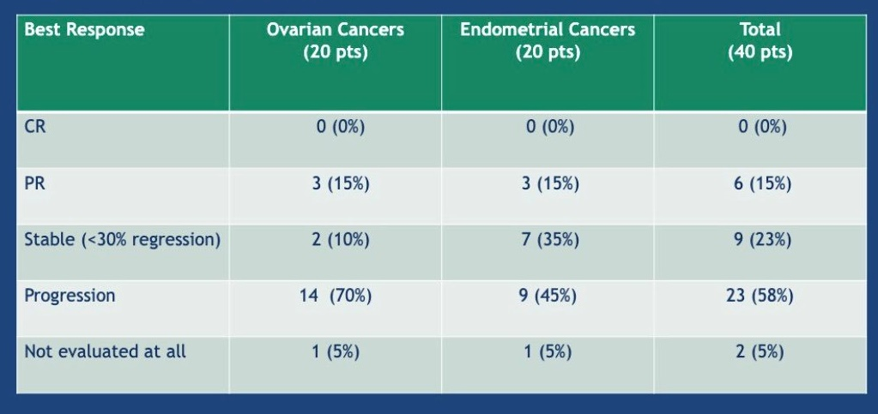
Phase II trial of ribociclib and letrozole in ER+ ovarian or endometrial cancer
Otero-Colon G. et al. 2020
Ribo/Letrozole included in NCCN Guidelines
Three of 20 OC patients had LGSOC
All three patients with LGSOC responded for > 2 years
  1 CR, 2 PR > 2 years, 2/3 remained on treatment for >30 months

Slide 49
Endometrial Cancer:
Immunotherapy

Slide 50
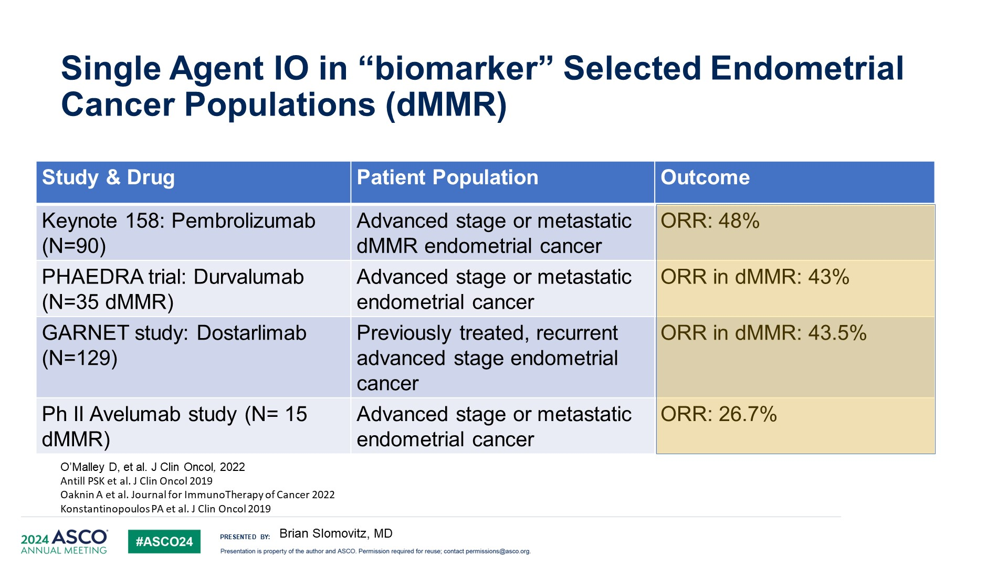
Single Agent IO in “biomarker” Selected Endometrial Cancer Populations (dMMR)

Slide 51
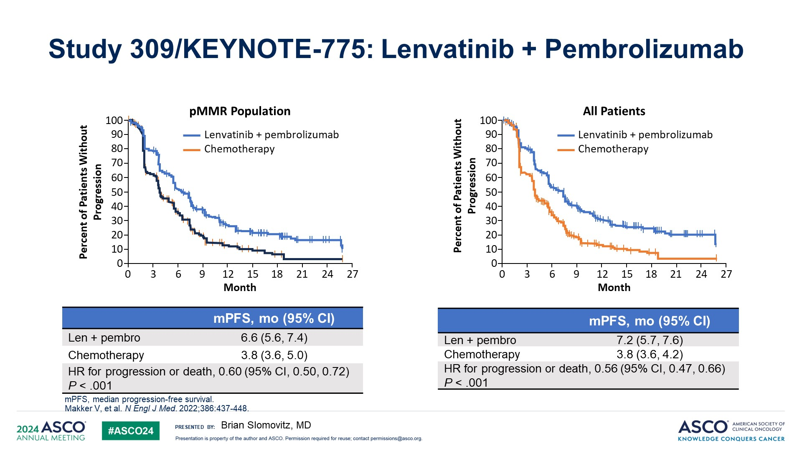
Study 309/KEYNOTE-775: Lenvatinib + Pembrolizumab

Slide 52
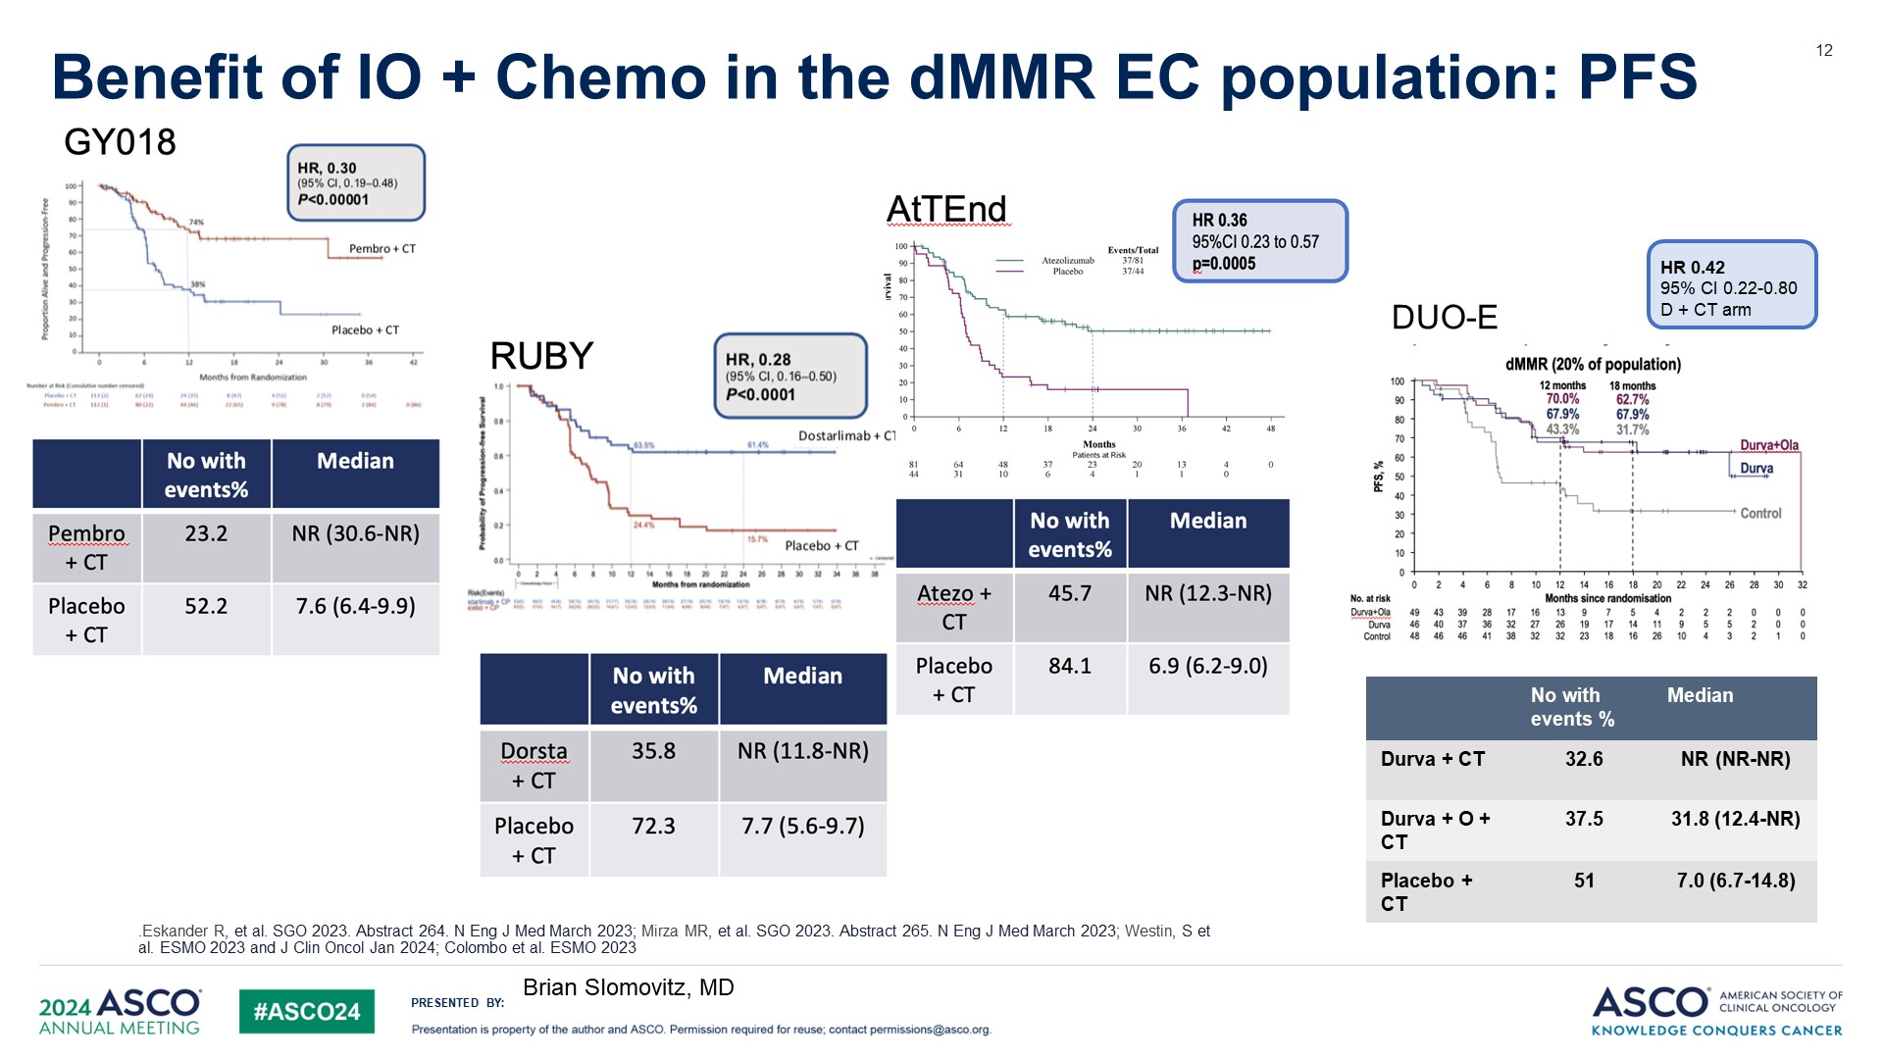
Benefit of IO + Chemo in the dMMR EC population: PFS
Dostarlamib plus CT FDA
Approved for dMMR
Priority review for all
PDUFA 8/23/24
2/2024 FDA Priority Review
PDUFA date 6/21/24

Slide 53
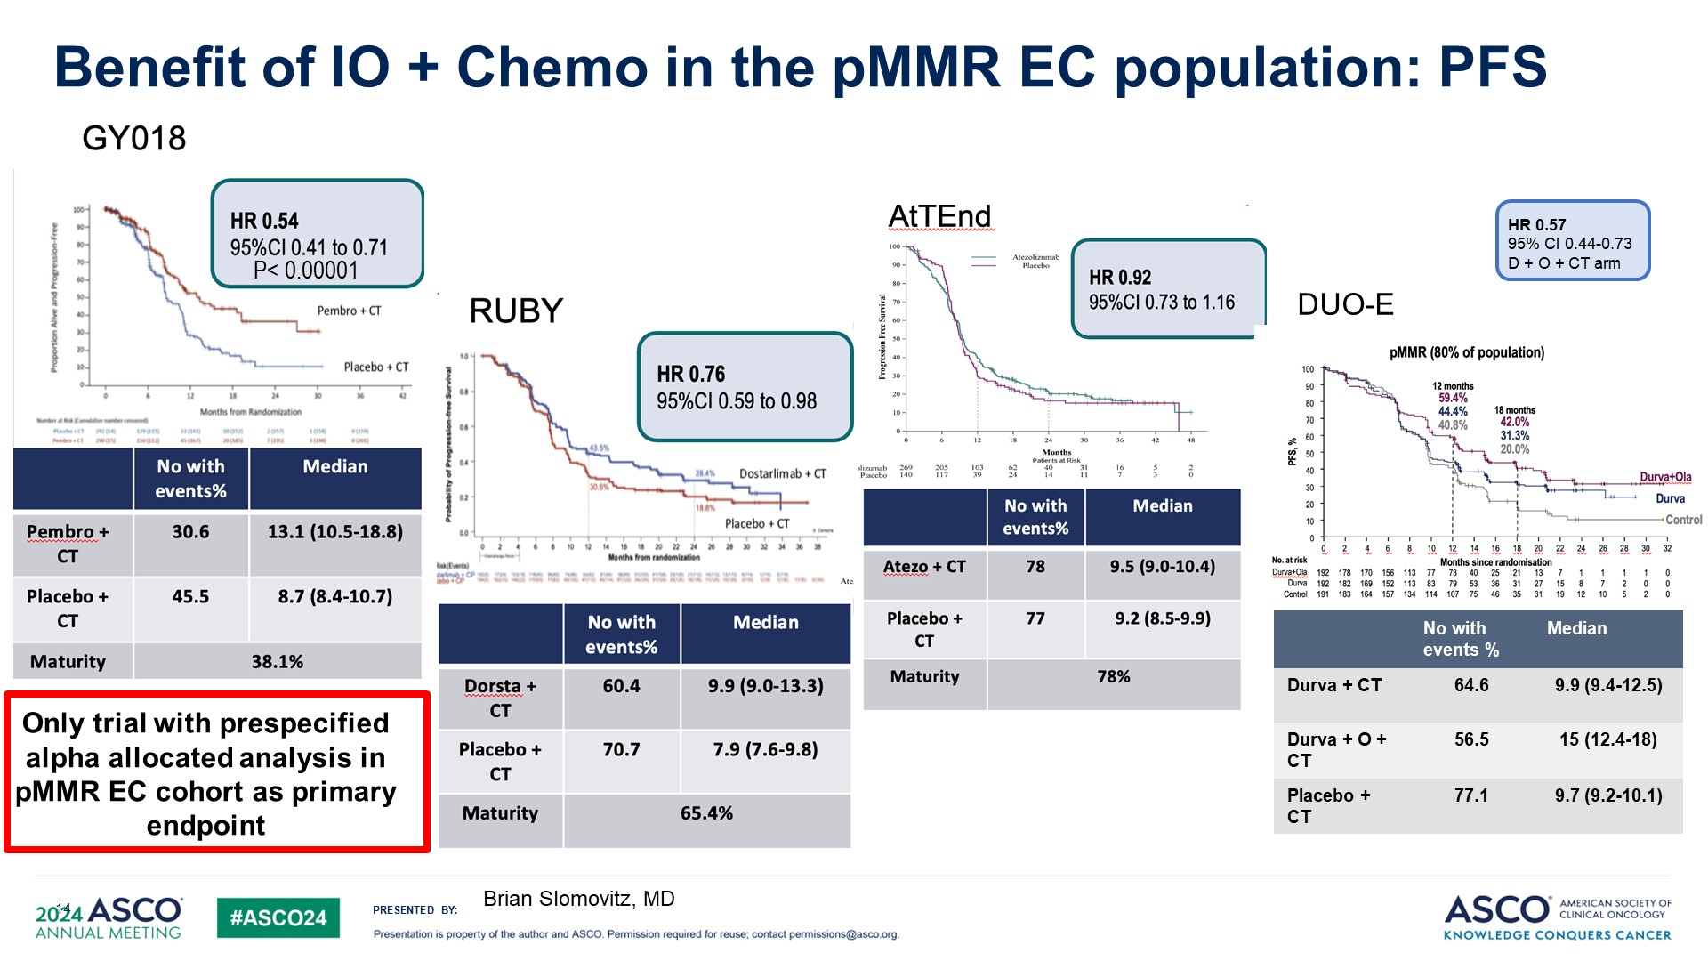
Benefit of IO + Chemo in the pMMR EC population: PFS

Slide 54
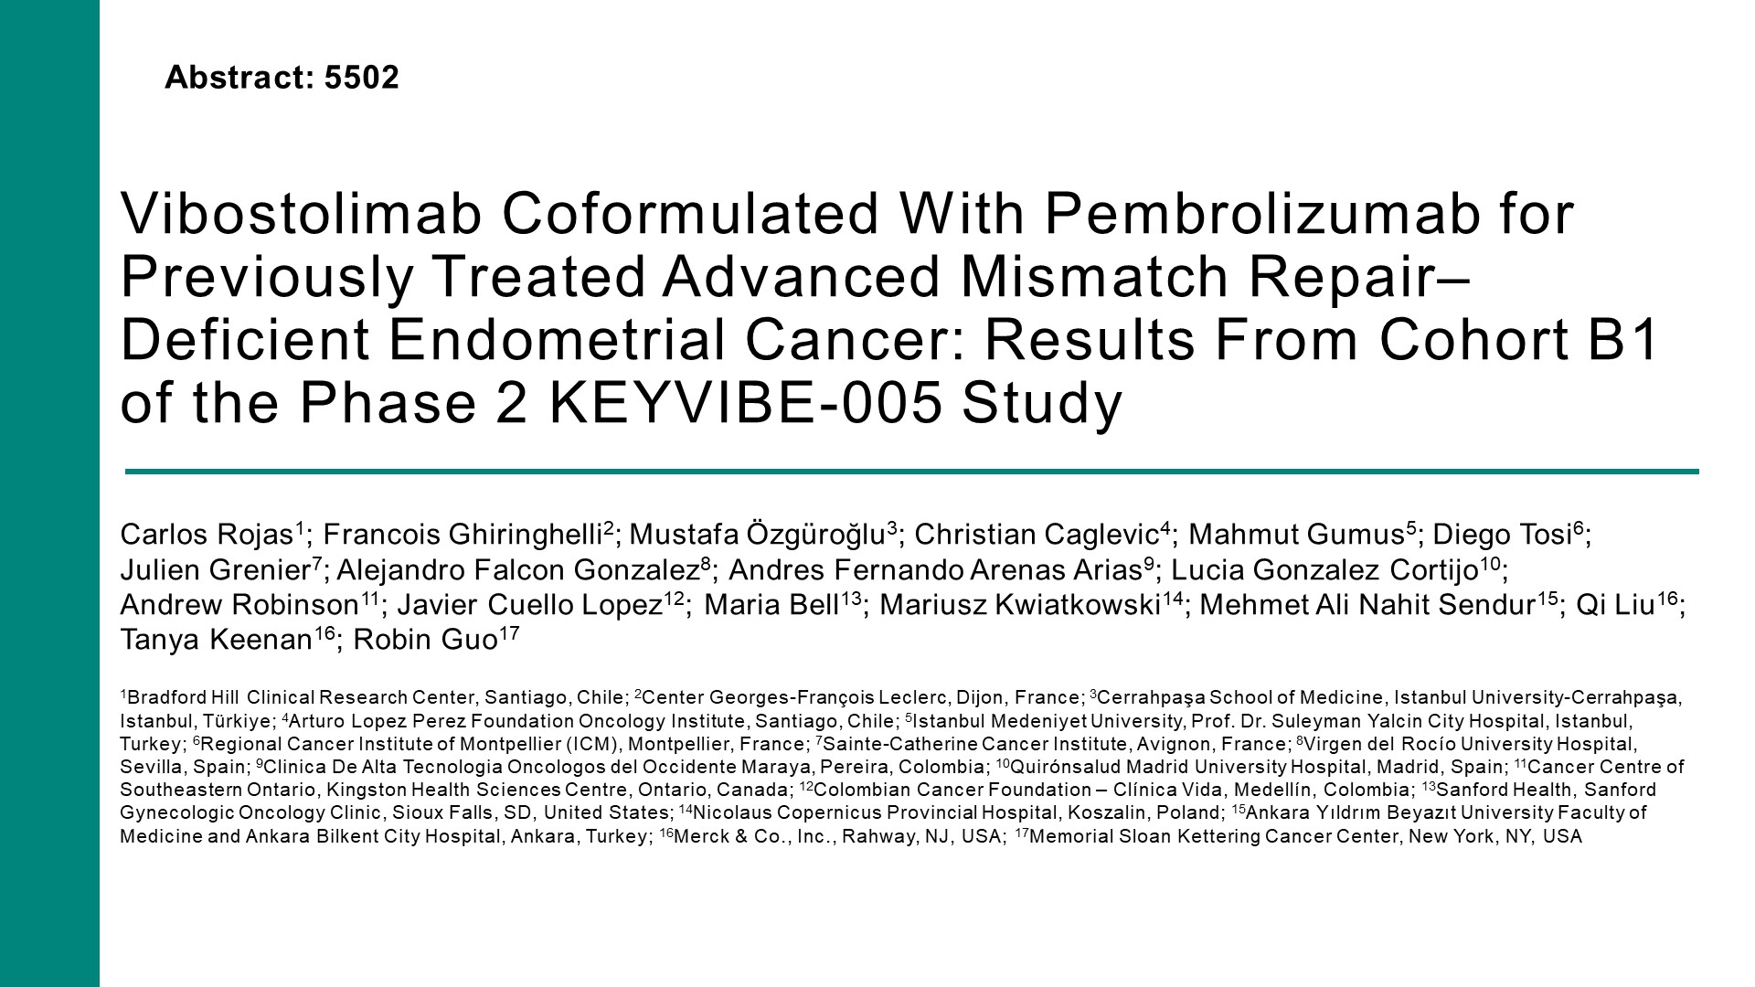
Vibostolimab Coformulated With Pembrolizumab for Previously Treated Advanced Mismatch Repair–Deficient Endometrial Cancer: Results From Cohort B1 of the Phase 2 KEYVIBE-005 Study

Slide 55
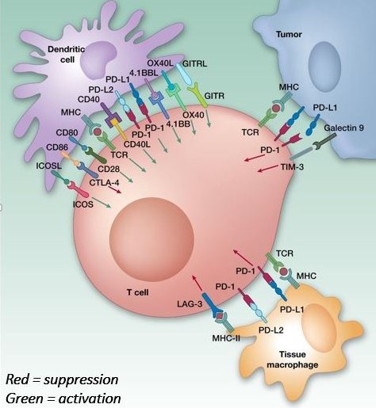
Immune Checkpoint Inhibiting mAbs
Anti-PD-1 (T-cell)
Nivolumab (Opdivo®)
Pembrolizumab (Keytruda®)
Cemiplimab (Libtayo®)
Dostarlimab (Jemperli®)
Toripalimab (Loqtorzi®)
Anti-PD-L1 (Tumor, TM, Dendritic cell)
Durvalumab (Imfinzi®)
Avelumab (Bavencio®)
Atezolizumab (Tecentriq®)
Anti-CTLA-4 (T-cell)
Ipilimumab (Yervoy®)
Tremelimumab (Imjudo®)
LAG-3 (T-cell) Relatinib (Opdualag®) + Nivolumab
TIGIT (T-cell) Tiragolumab, Vibostolimab, others
B7-H3 (Tumor cell) Enoblituzumab
TIM-3 (T-cell)
Others
B7-H3
TIGIT

Slide 56
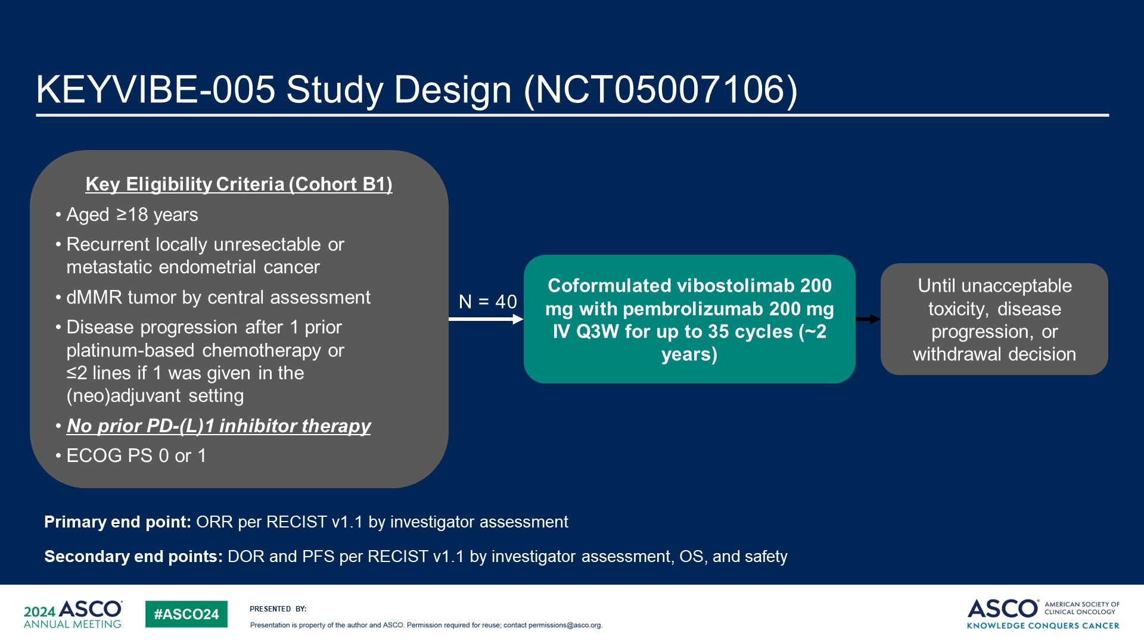
KEYVIBE-005 Study Design (NCT05007106)
Content of this presentation is the property of the author, licensed by ASCO. Permission required for reuse.

Slide 57
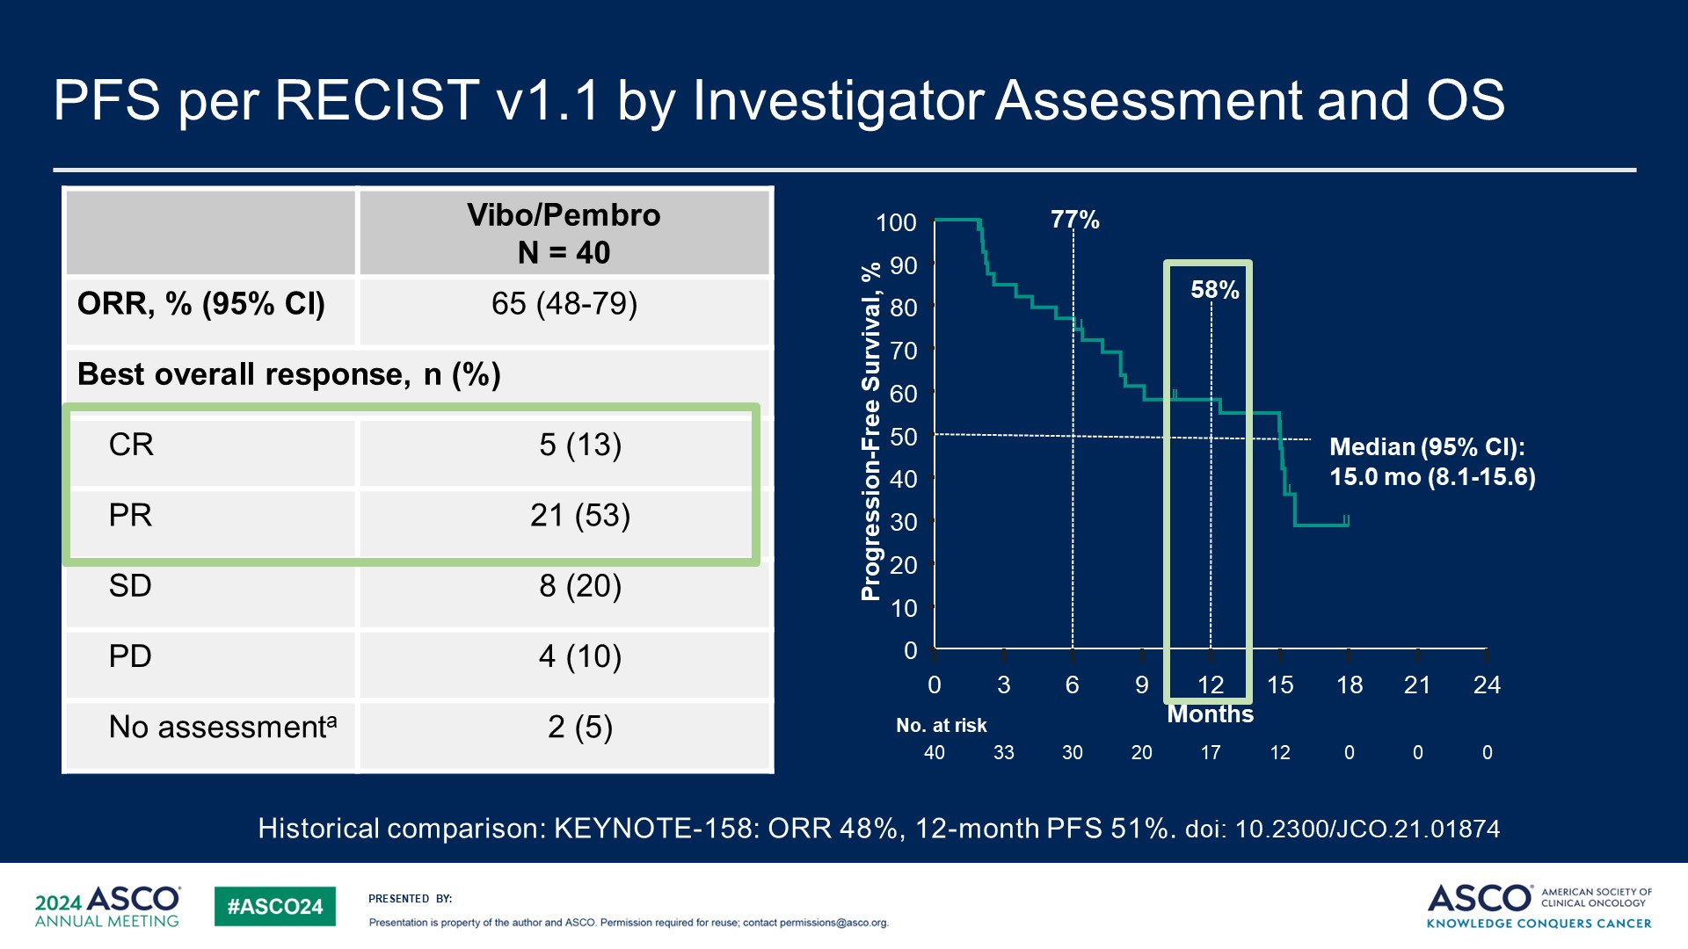
PFS per RECIST v1.1 by Investigator Assessment and OS
ORR 65%

Slide 58
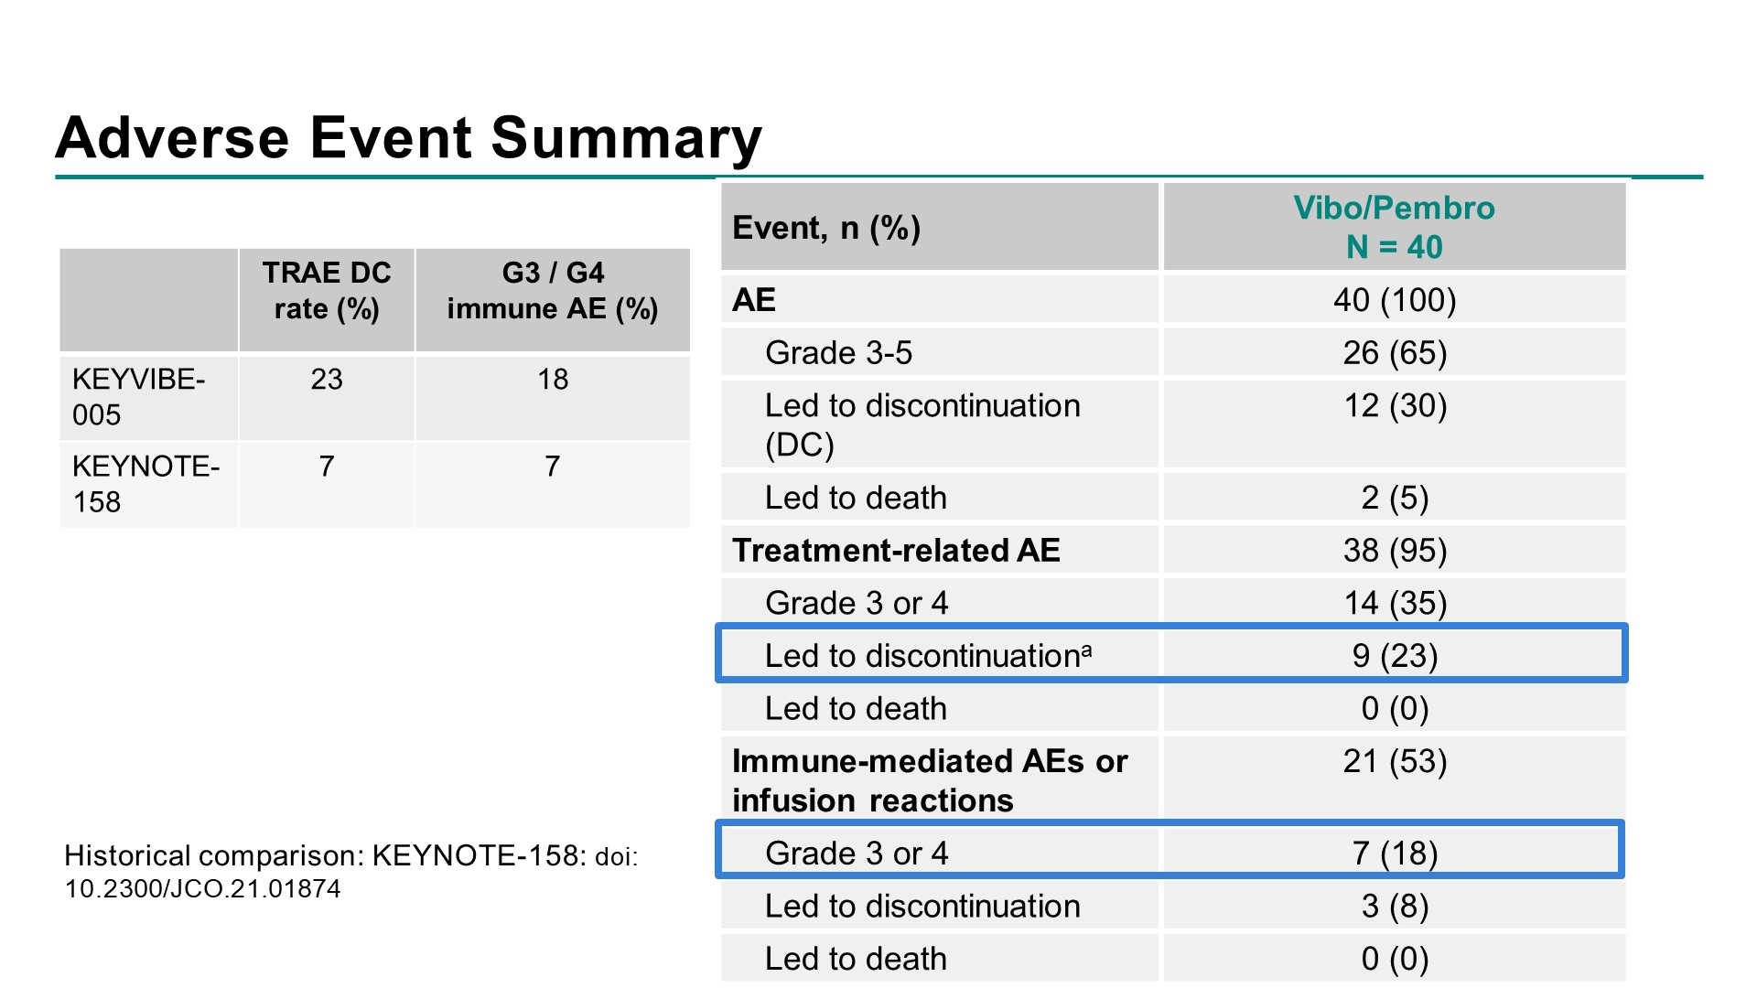
Adverse Event Summary
Content of this presentation is the property of the author, licensed by ASCO. Permission required for reuse.

Slide 59
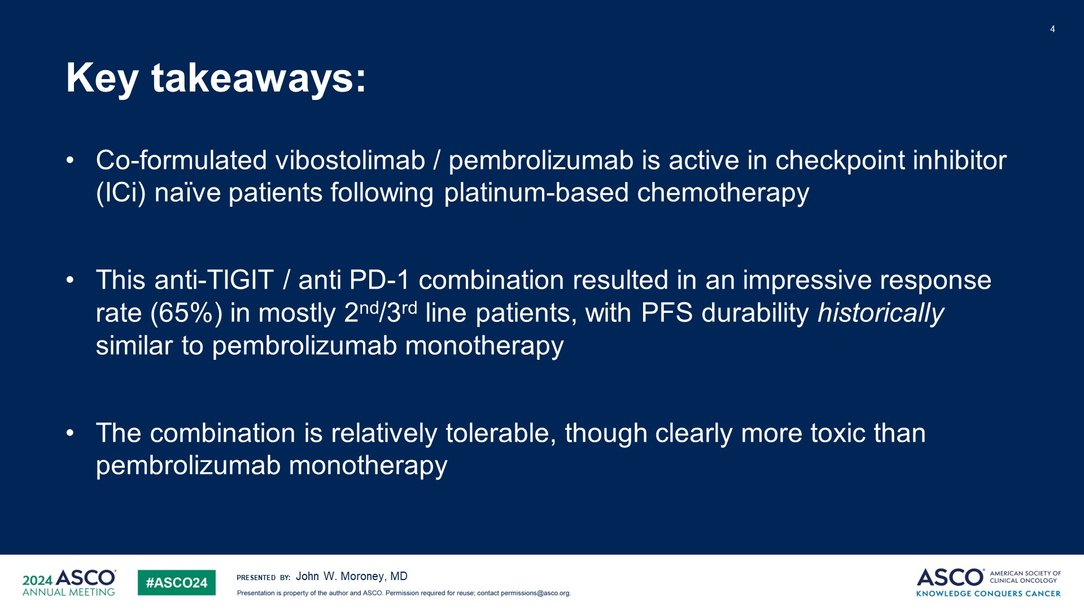
Key takeaways:
Content of this presentation is the property of the author, licensed by ASCO. Permission required for reuse.

Slide 60
Cervical Cancer

Slide 61
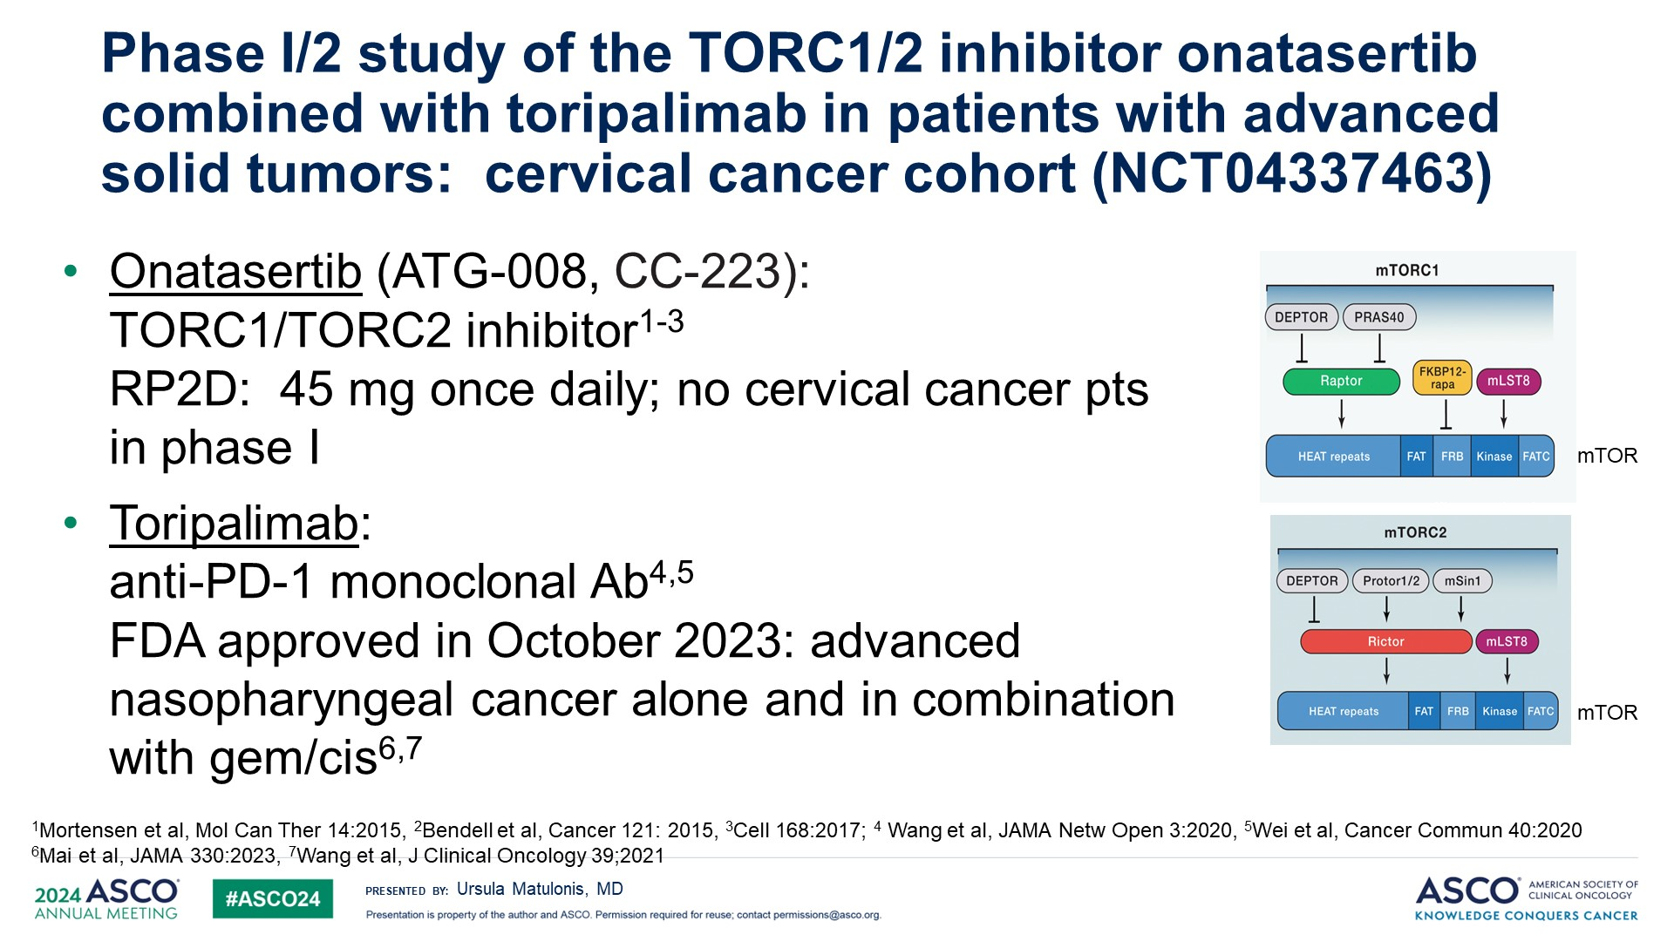
Phase I/2 study of the TORC1/2 inhibitor onatasertib combined with toripalimab in patients with advanced solid tumors: cervical cancer cohort (NCT04337463)<br />

Slide 62
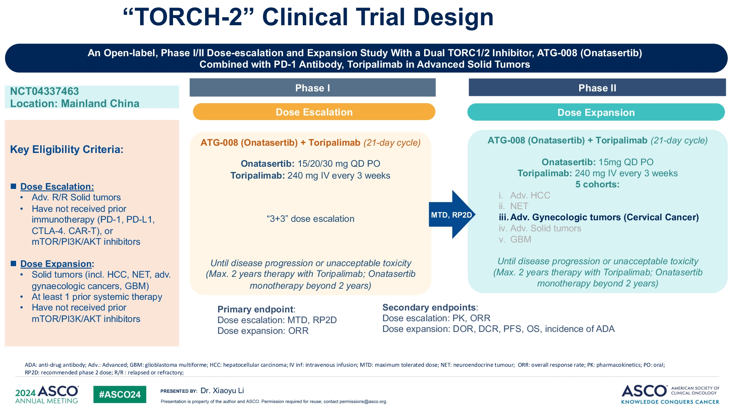
$Title$

Slide 63
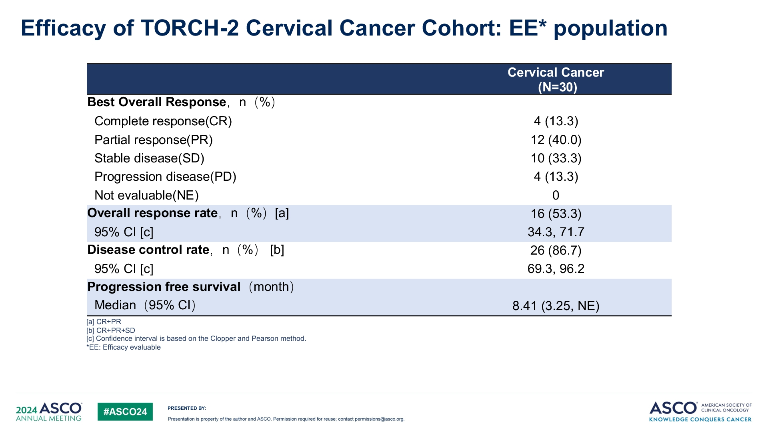
$Title$

Slide 64
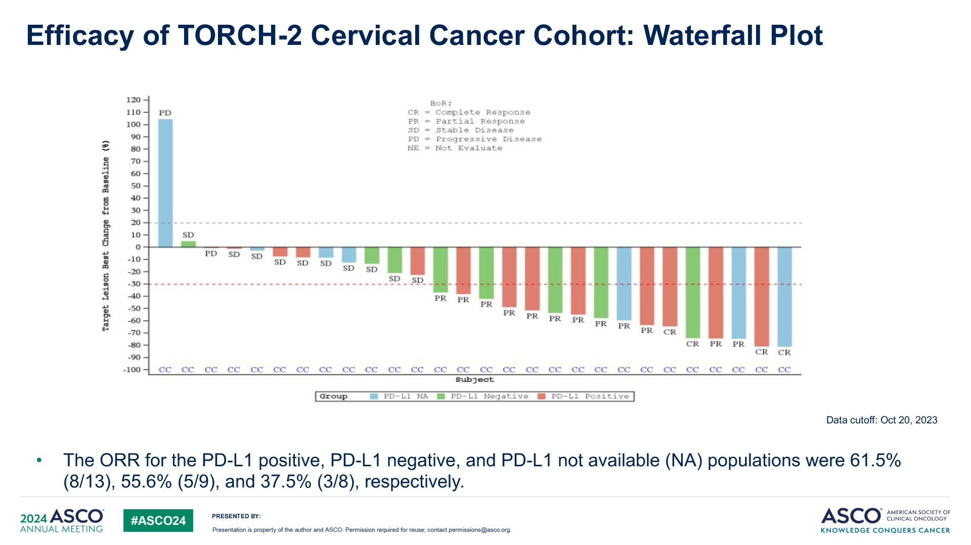
$Title$
ORR 53% (16/30)
10% CR
50% ongoing treatment

Slide 65
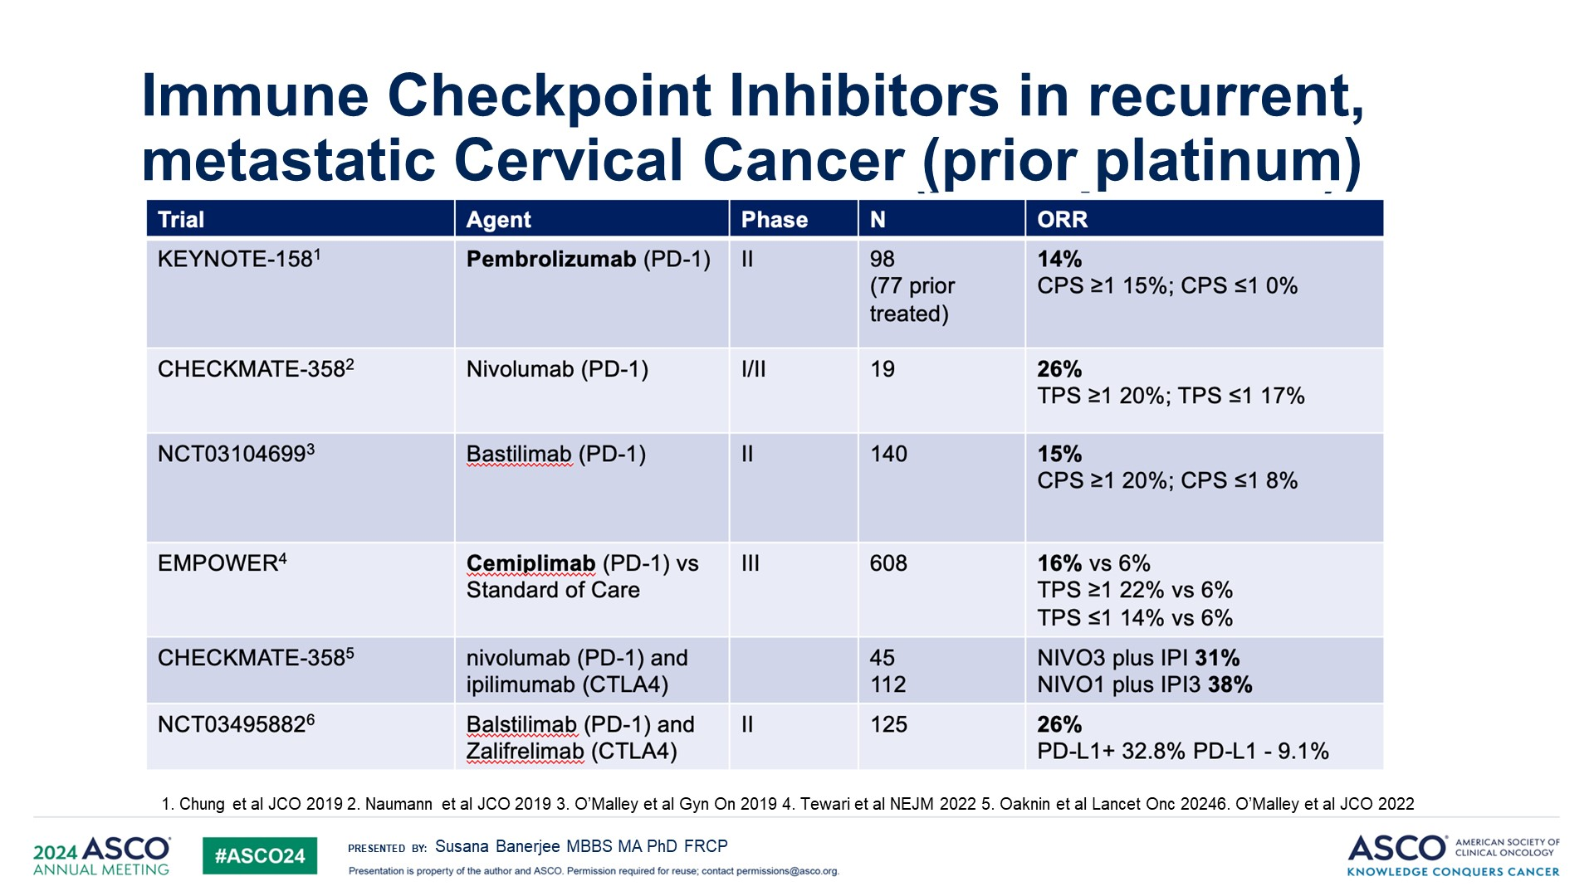
Immune Checkpoint Inhibitors in recurrent, metastatic Cervical Cancer (prior platinum)

Slide 66
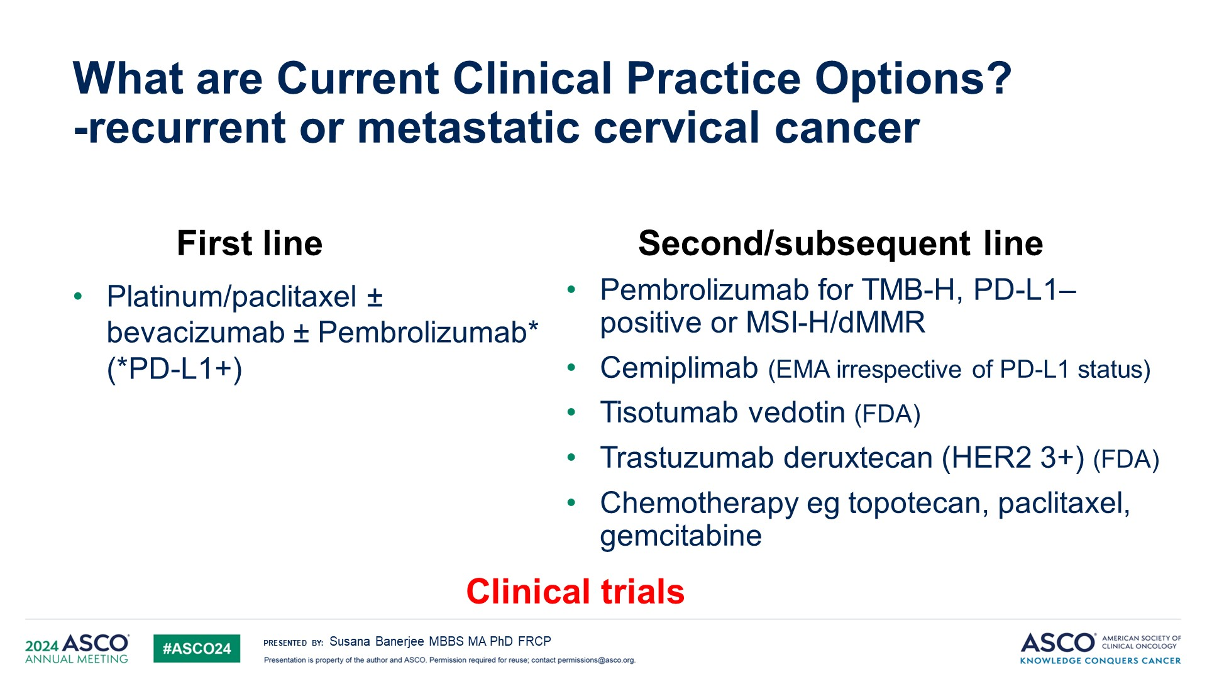
What are Current Clinical Practice Options?<br />-recurrent or metastatic cervical cancer

Slide 67
General Gyn

Slide 68
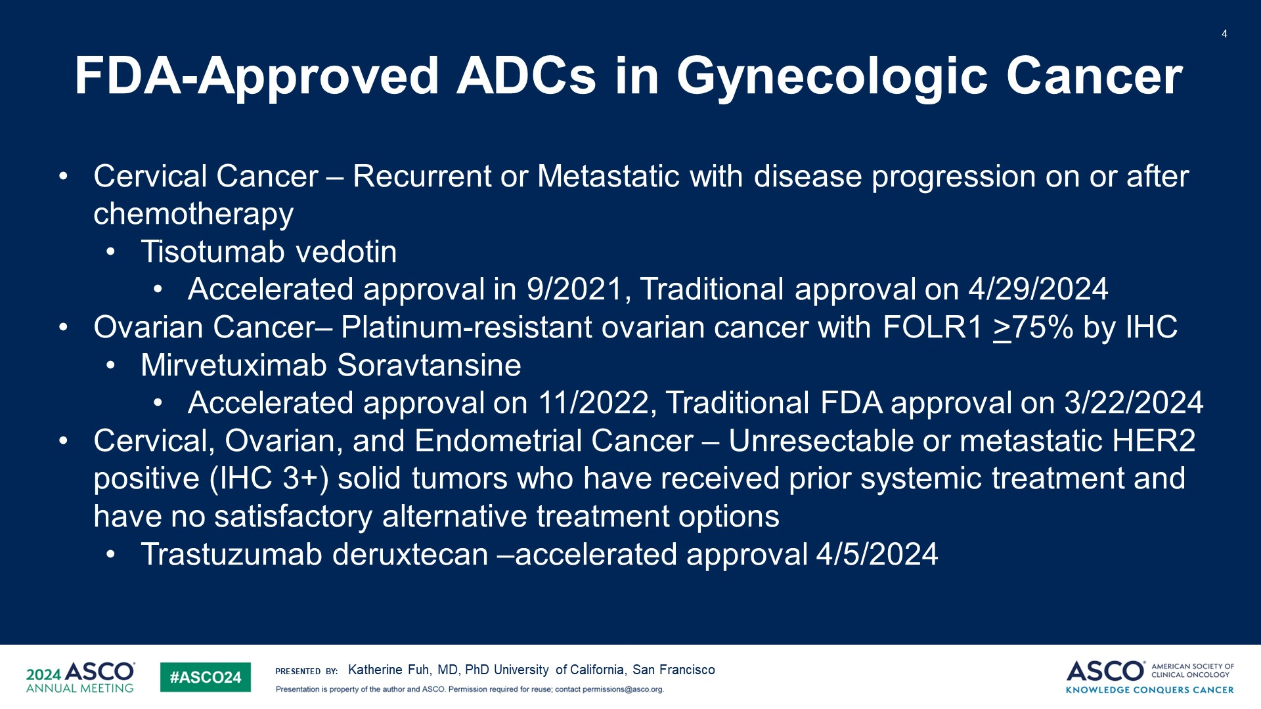
FDA-Approved ADCs in Gynecologic Cancer

Slide 69
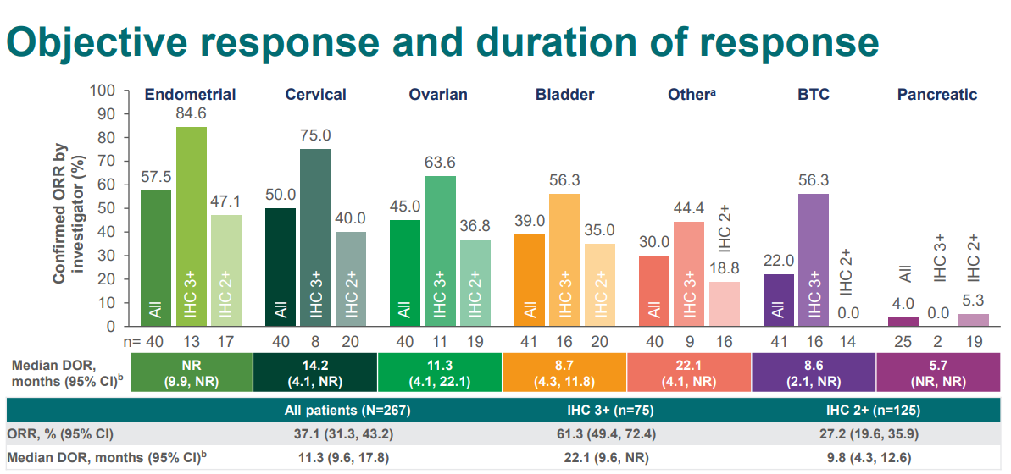
DESTINY-PanTumor02 Study: Trastuzumab deruxtecan in HER2-expressing solid tumors
Meric-Bernstam, et al. J Clin Oncol October 23, 2023
Notes:
For ovarian cancer, eligibility was not restricted by platinum sensitivity and results were not provided with that breakdown. However, almost half the patients had had 4 or more systemic regimens (table below are in order, endometrial, cervical and ovary) so this is likely a largely platinum resistant population. Additionally, in ovary, Her2 amplification is more common in the non-serous histology, so that breakdown may also be relevant, but was not reported.

Slide 70

NCCN Guidelines for ADCs in Gynecologic Cancers

