Slide 1


Best of ASCO Part 1
June 15, 2024
Notes:
Welcome everyone to our Best of ASCO (Part 1) Virtual CME event.

Slide 2

Mark Socinski, MD
Dr. Mark A. Socinski is a board-certified, fellowship trained medical oncologist, specializing in all thoracic malignancies, including small cell and non-small cell lung cancers and mesothelioma. He is an internationally recognized expert in the development of novel chemotherapy agents and treatment strategies for advanced non-small cell lung cancer and small cell lung cancer. His research has focused on incorporating personalized medicine and molecular biomarkers in the treatment of lung cancer. Dr. Socinski formerly served as Co-Chair of the Thoracic Malignancies Steering Committee for the National Cancer Institute. He also serves on the Respiratory Core Committee of the Cancer and Leukemia Group B (Alliance) and has been instrumental in the development of many cooperative clinical trials. He is the Executive Medical Director of the AdventHealth Cancer Institute.

Slide 3
ASCO Review 2024 – Lung Cancer Mark A. Socinski, MD Executive Medical Center AdventHealth Cancer Institute

Slide 4
Agenda
EGFR
LAURA
MARIPOSA/PALOMA
Atypicals
CNS/LMP disease
New Agents
Ivonescimab
ALK – CROWN
KRAS – KRYSTAL-12/combos
SCLC – ADRIATIC
ADCs – EVOKE-01
Palliative Care – REACH PC

Slide 5
EGFR Mutations

Slide 6
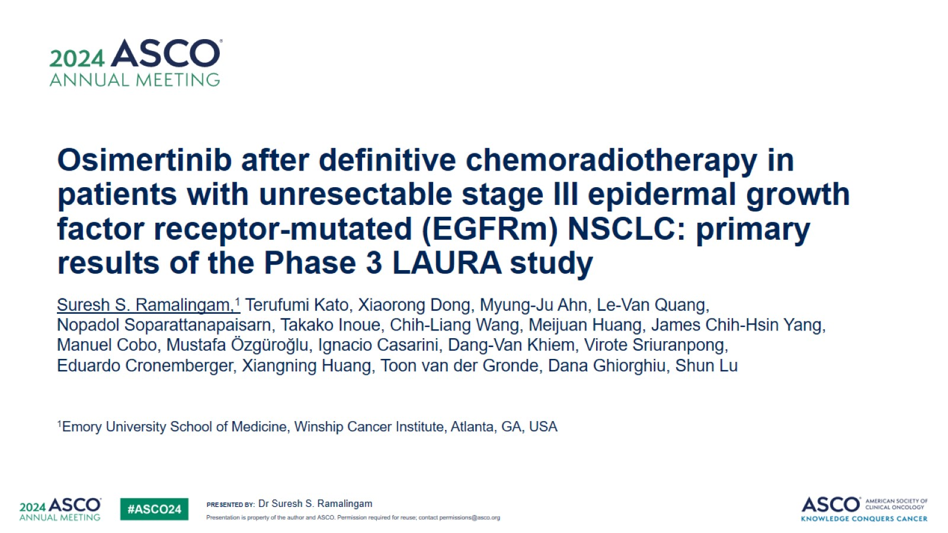
Osimertinib after definitive chemoradiotherapy in patients with unresectable stage III epidermal growth factor receptor-mutated (EGFRm) NSCLC: primary results of the Phase 3 LAURA study

Slide 7
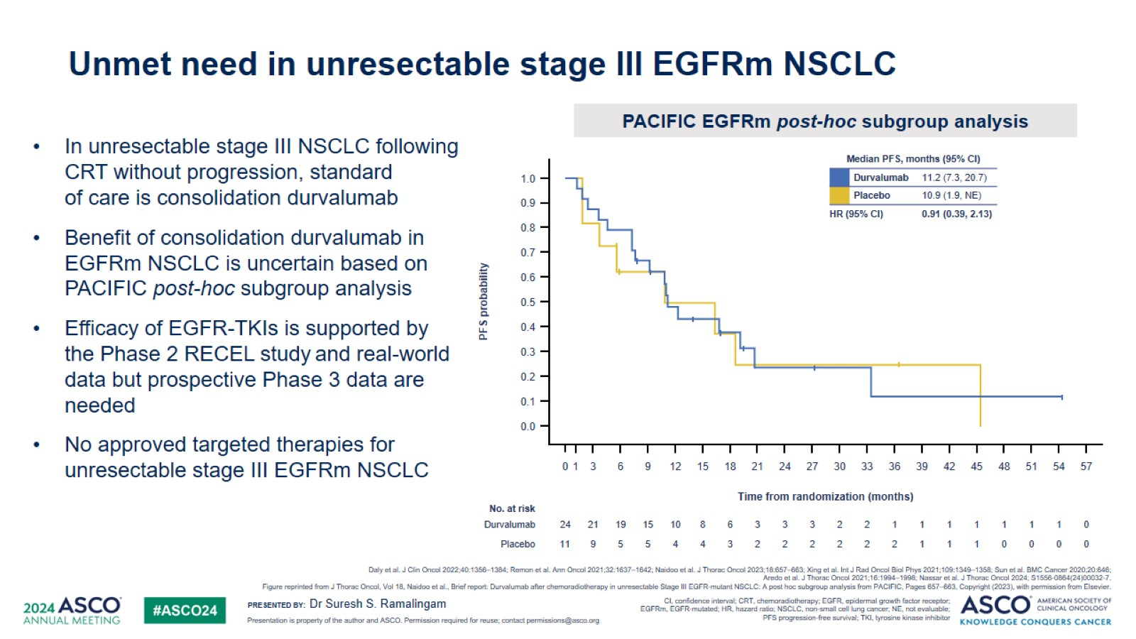
Unmet need in unresectable stage III EGFRm NSCLC

Slide 8
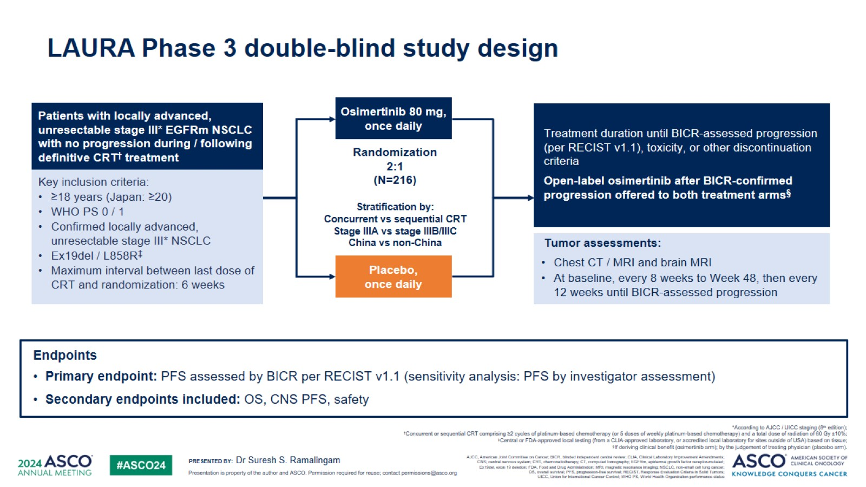
LAURA Phase 3 double-blind study design

Slide 9
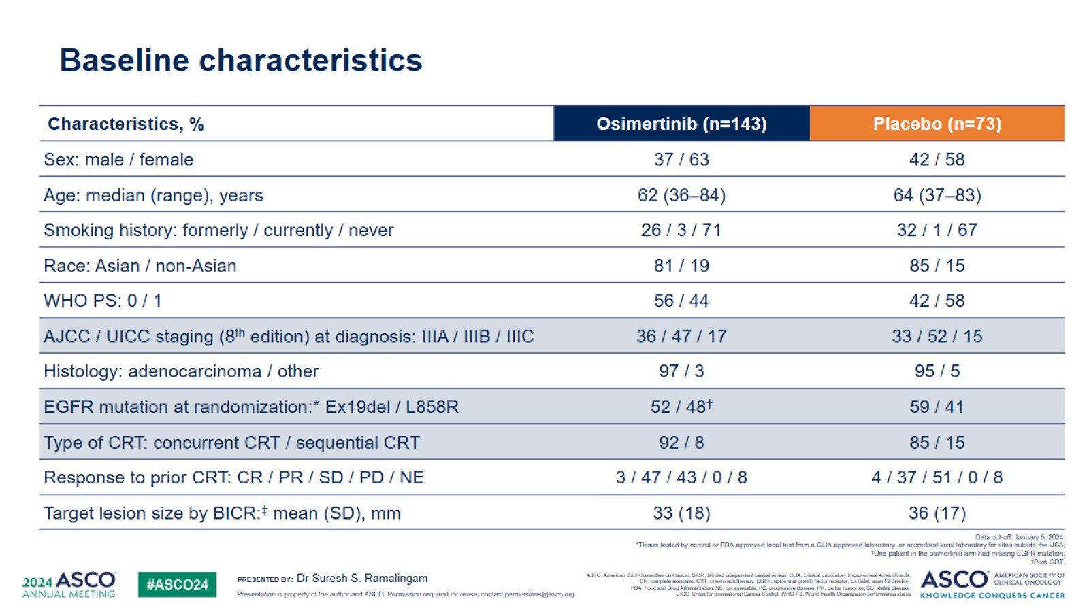
Baseline characteristics

Slide 10
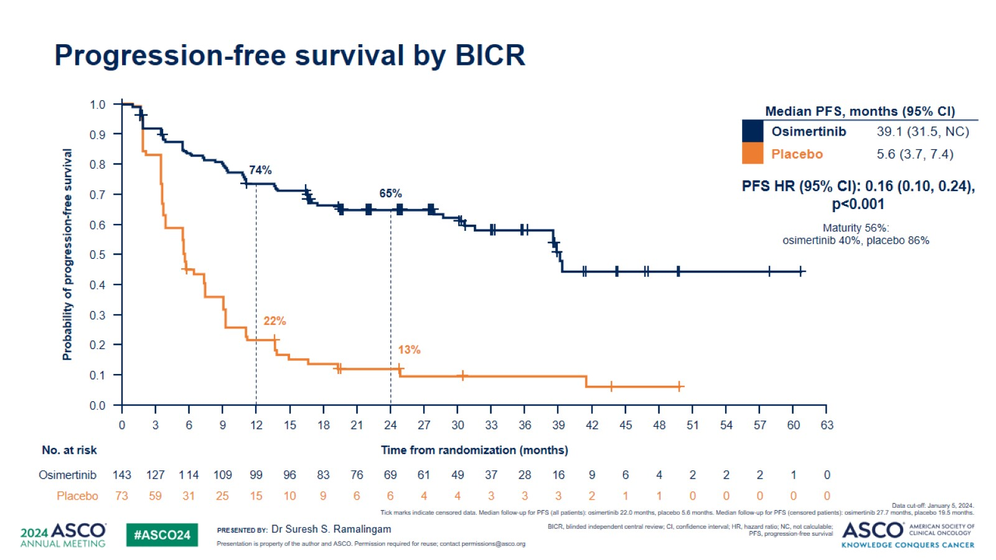
Progression-free survival by BICR

Slide 11
Progression-free survival by BICR
Investigator-assessed HR 0.19

Slide 12
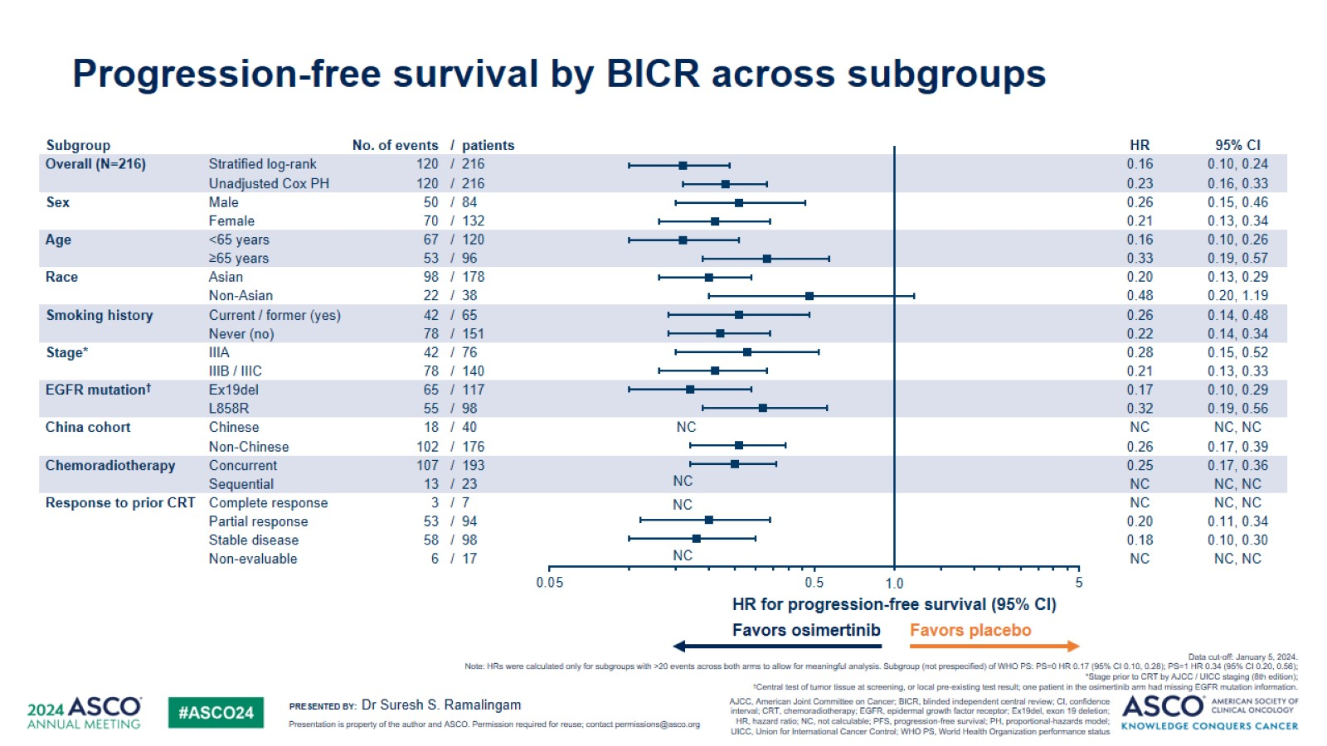
Progression-free survival by BICR across subgroups

Slide 13
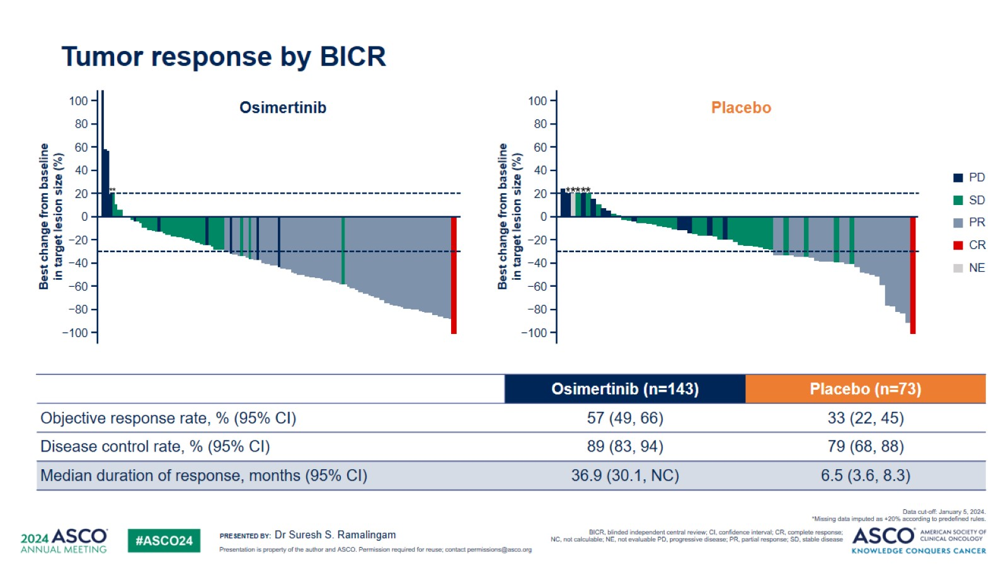
Tumor response by BICR

Slide 14
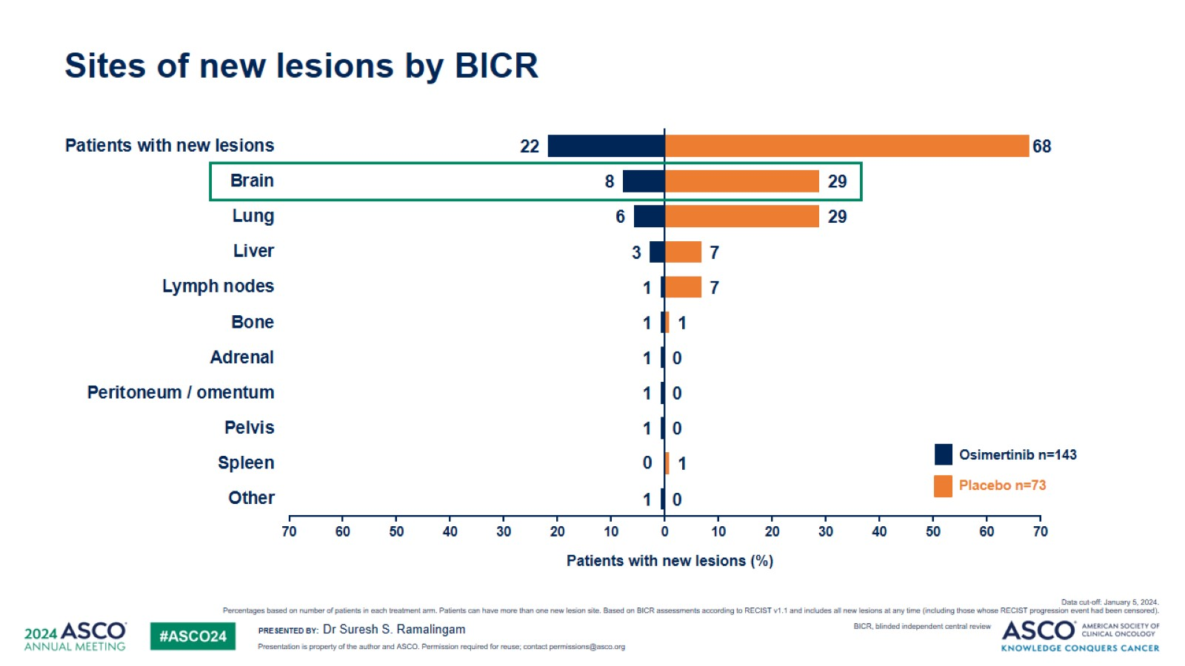
Sites of new lesions by BICR

Slide 15
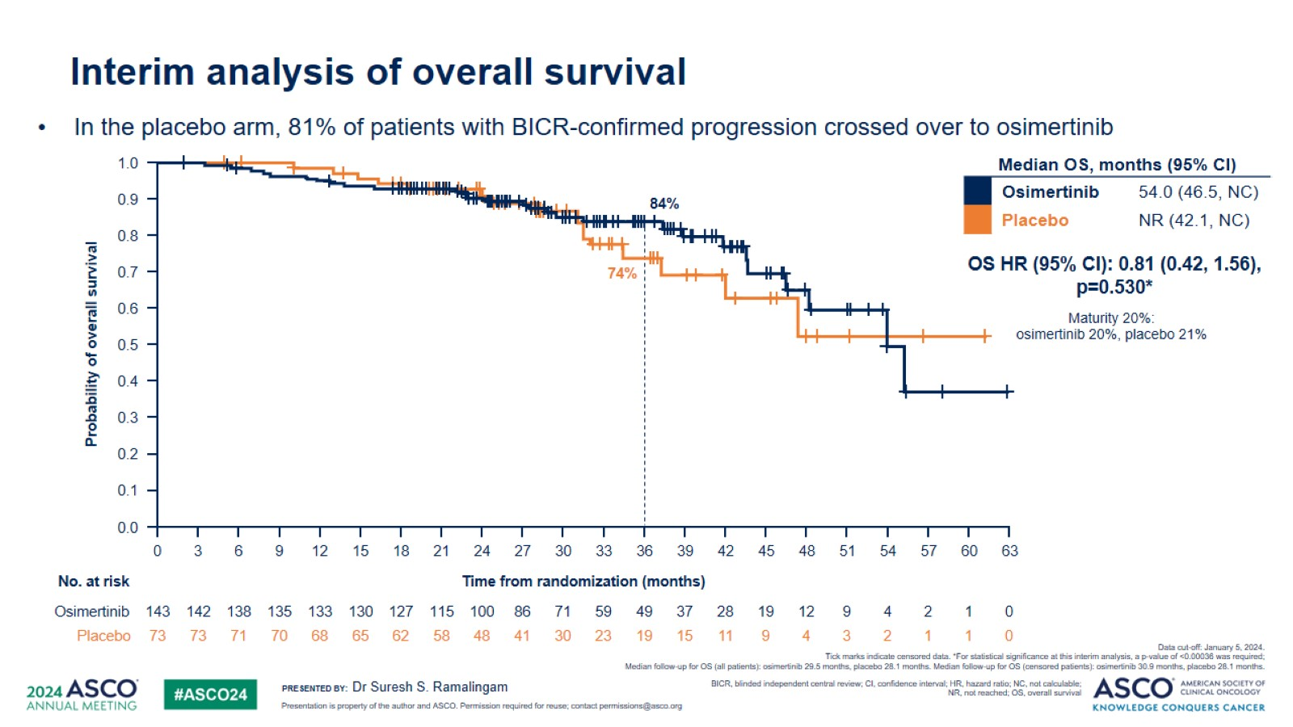
Interim analysis of overall survival

Slide 16
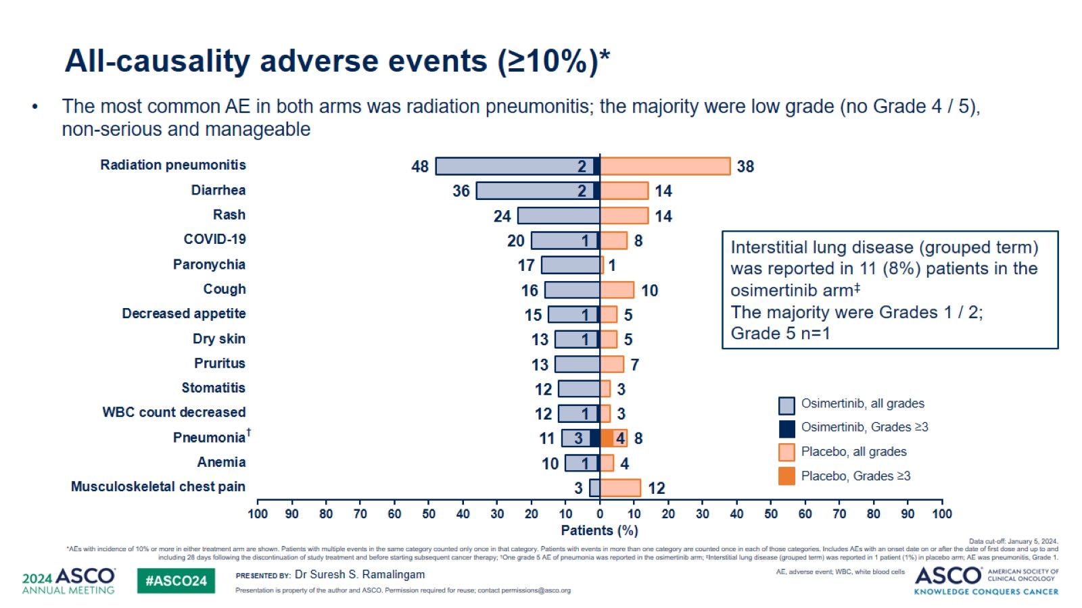
All-causality adverse events (≥10%)*

Slide 17
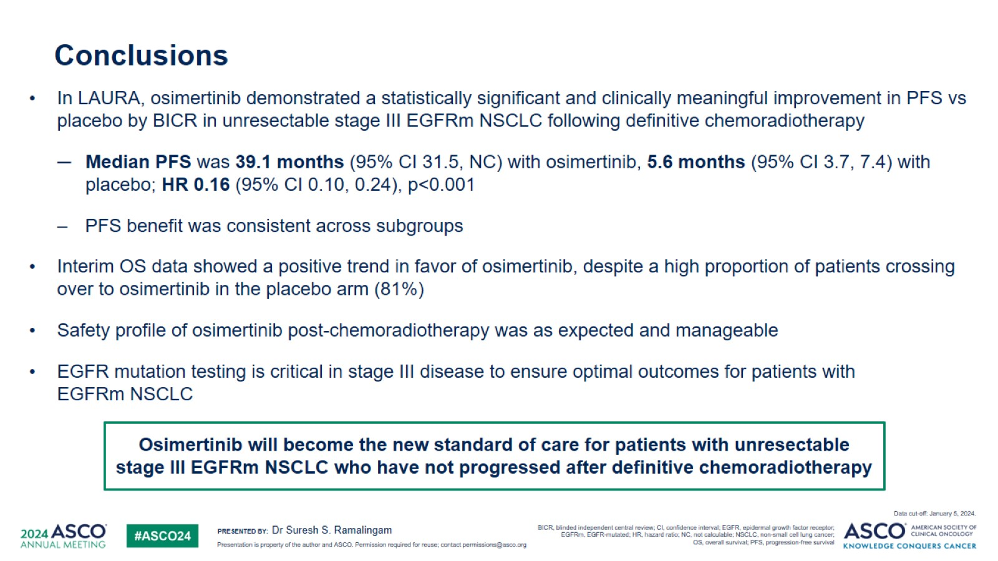
Conclusions

Slide 18
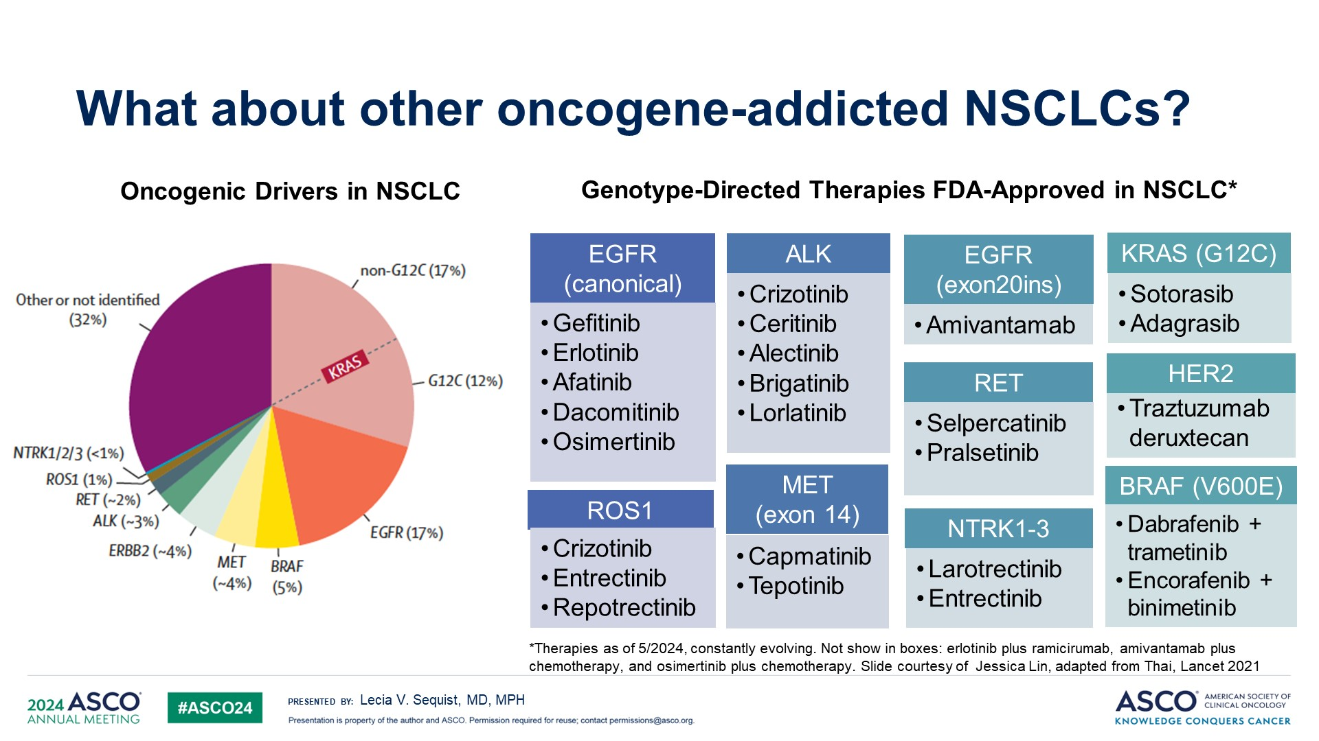
What about other oncogene-addicted NSCLCs?

Slide 19
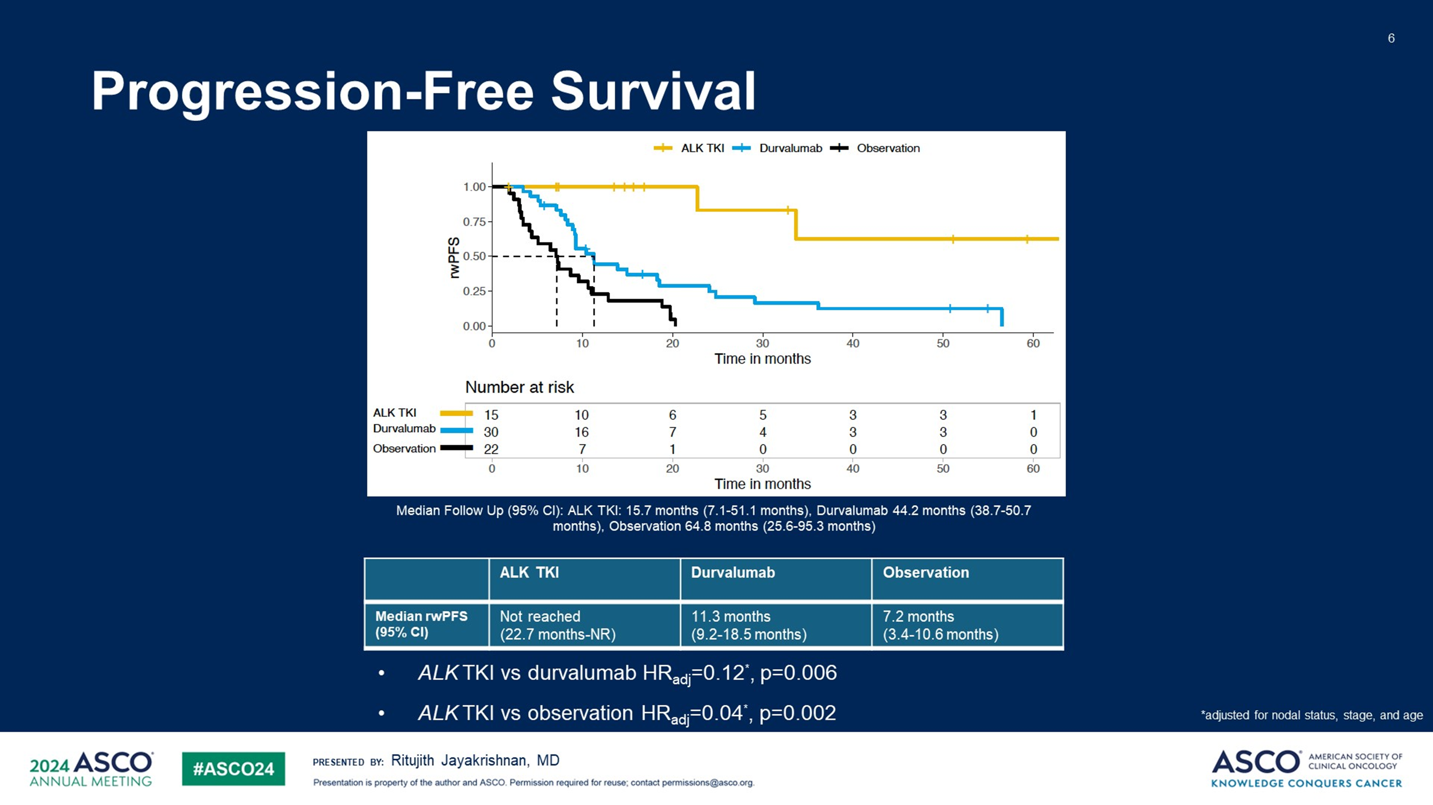
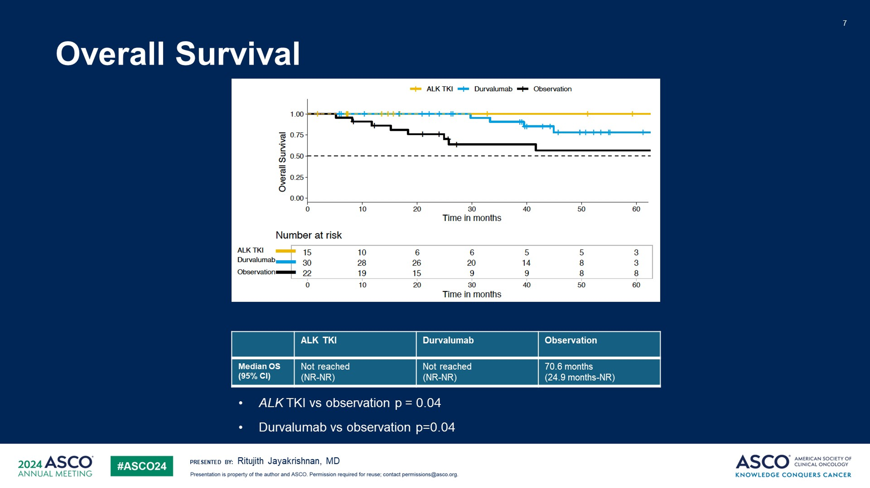
Stage III ALK +: Consolidation ALK TKI Vs Durvalumab Vs Observation – RWD

Slide 20


























































































Slide 21

























































































•
•
•
•
•
•
•
•
•
•
•
•
•
•
•

Slide 22















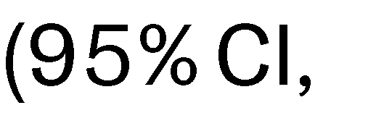













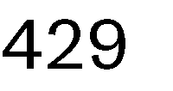

























100
Patients who are progression-free (%)
75
50
25
0
0
3
6
9
12
15
Months
18
21
24
27
30
33

Slide 23
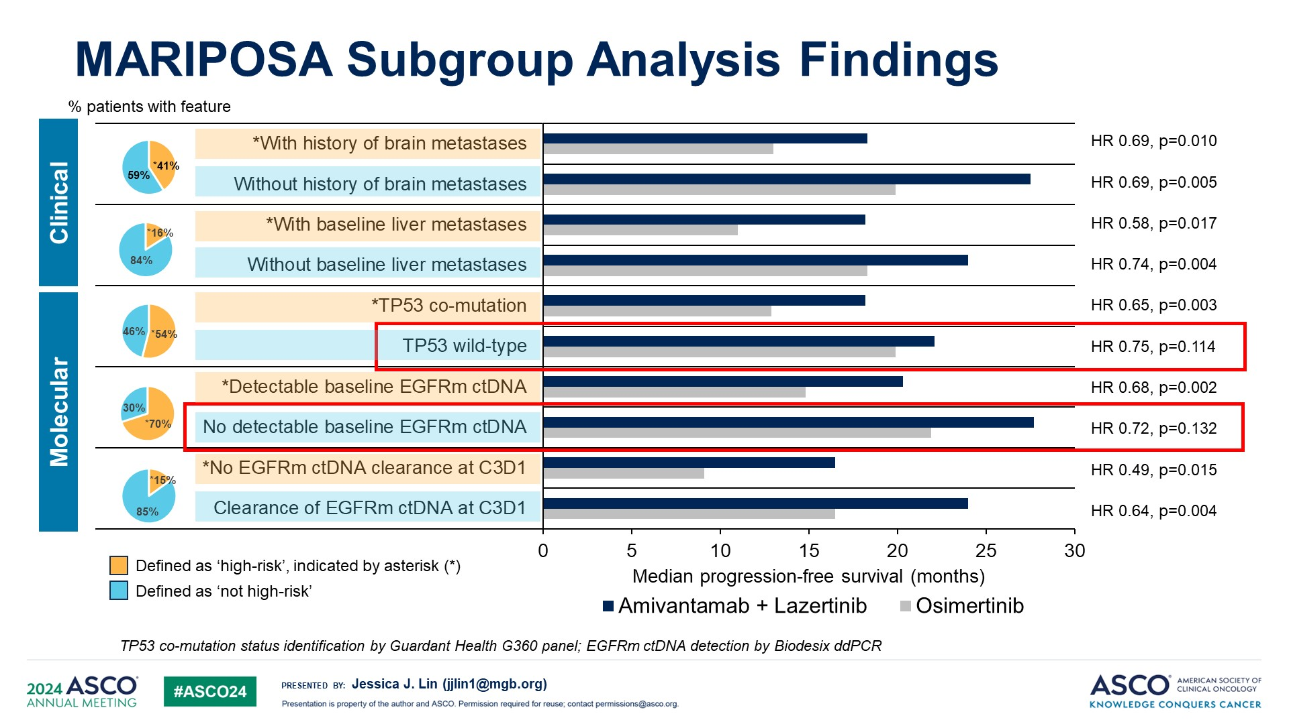
MARIPOSA Subgroup Analysis Findings

Slide 24












































Slide 25



















































































•
•
•
•
•
•
•
•
•
•
•
•
•
•
•
•

Slide 26





















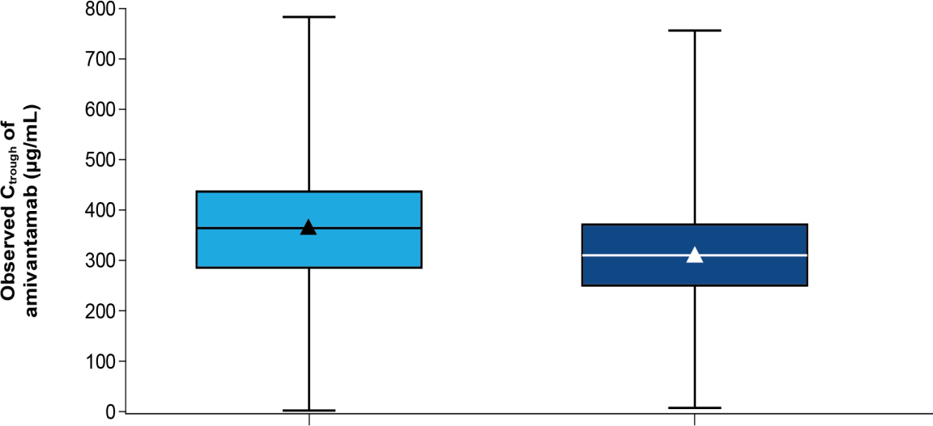
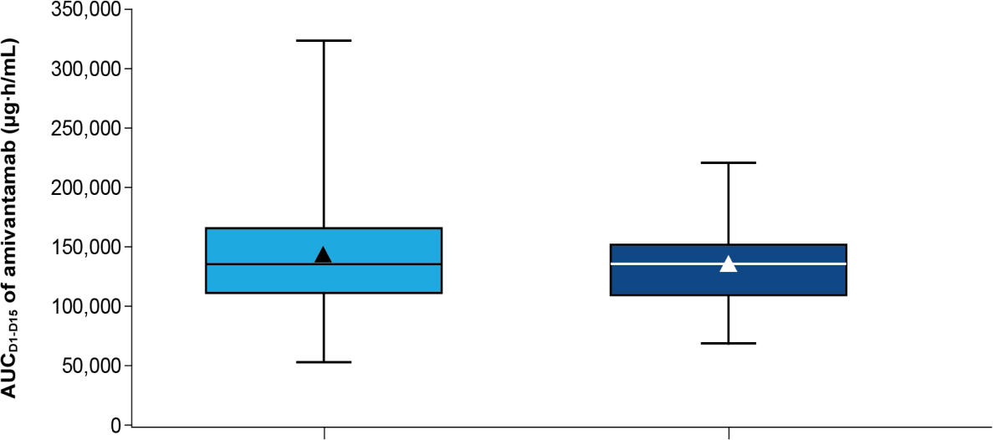



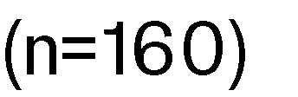
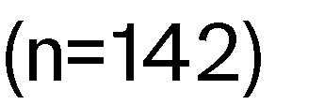
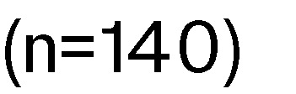
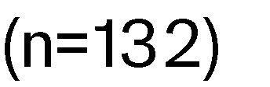









•

Slide 27






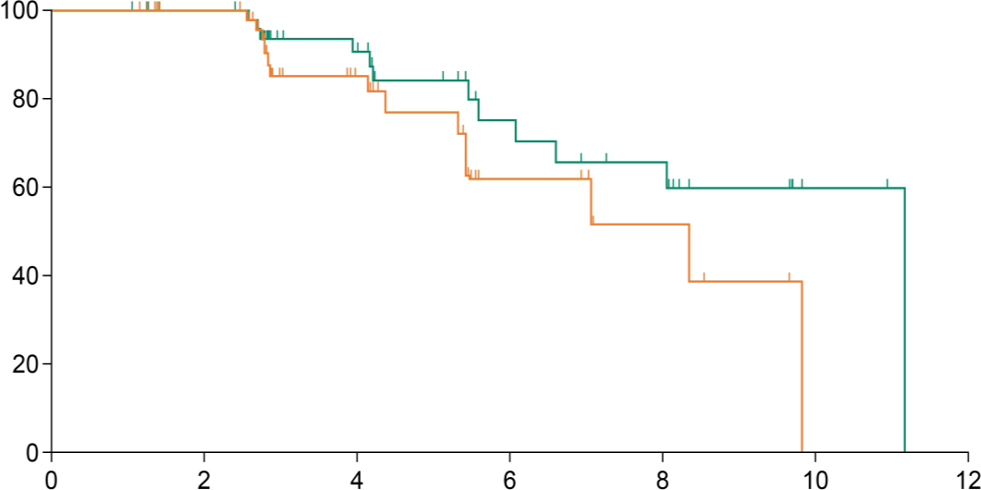






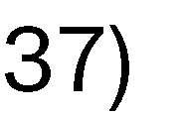



























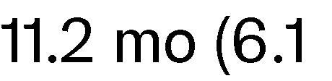



























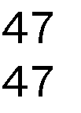















•
•
Patients who are responding (%)

Slide 28










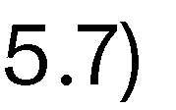

















100
80
60
40
20
0
0
2
4
6
8
10
12
14
16

Slide 29
100
80
60
40
20
0
0
2
4
6
8
10
12
14
16

Slide 30


Slide 31
•
Chills Pyrexia Dyspnea Nausea Vomiting Cough Hypoxia Hypotension
Sinus tachycardia
Erythema Chest discomfort Hypertension
Flushing Dizziness
Rash Hyperhidrosis Increased heart rate
–
–
•
•
100%
75%
50%
25%
0%
25%
50%
75%
100%

Slide 32
•
•
•
50
40
•
30
26%
20
14%
17%
9%
12%
10
7%
0
n=206
SC Amivanta ma bArm
n=210
n=164
n=171
n=42
n=39
IVAmivantamabArm
SC AmivantamabArm
IVAmivantamabArm
SC AmivantamabArm
IVAmivantamabArm

Slide 33
•
•
100
90
80
70
60
50
40
30
20
10
0
SC Amivantamab
Arm (n=193)
IV Amivantamab
Arm (n=195)
SC Amivantamab
Arm (n=61)
IV Amivantamab
Arm (n=51)

Slide 34








•
•
–
–
•
•
•

Slide 35











































Byoung Chul Cho¹, Yongsheng Wang², Enriqueta Felip³, Jiuwei Cui⁴, Alexander I Spira⁵,
Joel W Neal⁶, Christina Baik⁷, Melina E Marmarelis⁸, Eiki Ichihara⁹, Jong-Seok Lee¹⁰, Se-Hoon Lee¹¹,
James Chih-Hsin Yang¹², Sebastian Michels¹³, Zacharias Anastasiou¹⁴, Joshua C Curtin¹⁵, Xuesong Lyu¹⁶, Levon Demirdjian¹⁷, Isabelle Leconte¹⁸, Leonardo Trani¹⁵, Mahadi Baig¹⁹, Joshua M Bauml¹⁵, Pascale Tomasini²⁰

Slide 36






































































•
•
•
•
•
•
•
•
•

Slide 37





































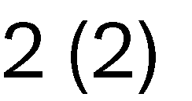


































•

Slide 38



























































40
20
0
-20
-40
-60
-80
-100
•

Slide 39












































0
-20
-40
-60
-80
-100
•
•

Slide 40






























•
–
▪
–
•
•

Slide 41













Slide 42



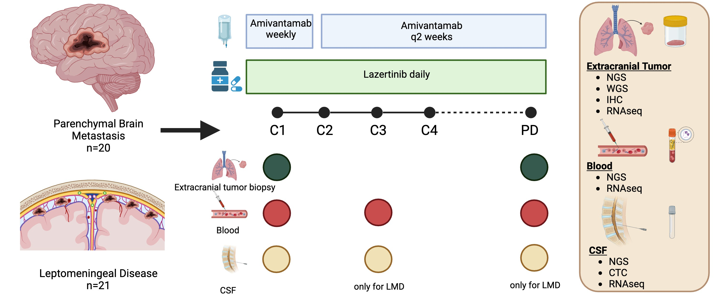




























Slide 43



































Slide 46
•
•
•
•

Slide 47
New Agents – NSCLC ASCO 2024
Abstr# | Target | Combination | n | ORR (%) | Comment
8513 | EGFR Exon 20 | Sunvozertinib* | 107 2nd L+ | 45 | R seen after Ami
8514 | HER2 | Zongertinib | 83 2nd L+ | 44 | R seen after T-Dxd
ESMO23 | HER2 | BAY2927088 | 20 2nd L+ | 60 | -
8515 | FGFR alterations | Erdafitinib | 23 2nd L+ | 26 | -
* Breakthrough Therapy designation by US FDA and China NMPA

Slide 48
Ivonescimab combined with chemotherapy in patients with EGFR-mutant non-squamous non-small cell lung cancer who progressed on EGFR-TKIs treatment: a randomized, double-blind, multi-center, phase 3 trial (HARMONi-A study)
Li Zhang¹, Wenfeng Fang¹, Yuanyuan Zhao¹, Yongzhong Luo², Runxiang Yang³, Yan Huang¹, Zhiyong He⁴, Hui Zhao⁵, Mingjun Li⁶, Kai Li⁷, Qibing Song⁸, Xiaobo Du⁹, Yulan Sun¹⁰, Wei Li¹¹, Fei Xu¹², Zhiyu Wang¹³, Kunning Yang¹⁴, Yun Fan¹⁵, Wenting Li¹⁶, Michelle Xia¹⁶
¹Sun Yat-sen University Cancer Center, Guangzhou, China; ²Hunan Cancer Hospital, Changsha, China; ³Yunnan Cancer Hospital, Kunming, China; ⁴Fujian Provincial Tumor Hospital, Fuzhou, China; ⁵The Second Hospital of Anhui Medical University, Hefei, China; ⁶The First Affiliated Hospital of Zhengzhou University, Zhengzhou, China; ⁷Tianjin Medical University Cancer Institute&Hospital. Tianjin, China; ⁸Renmin Hospital of Wuhan University, Wuhan, China; ⁹Mianyang Central Hospital, Mianyang, China; ¹⁰Shandong Cancer Prevention and Treatment Institute, Jinan, China; ¹¹The First Affiliated Hospital of Bengbu Medical University, Bengbu, China; ¹²The First Affiliated Hospital of Nanchang University, Nanchang, China; ¹³The Fourth Hospital of Hebei Medical University, Shijiazhuang, China; ¹⁴Weifang No.2 People's Hospital, Weifang, China; ¹⁵Zhejiang Cancer Hospital, Hangzhou, China; ¹⁶Akeso Biopharma, Inc., Zhongshan, China
Li Zhang, MD

Slide 49
Background
For patients with EGFR-mutant NSCLC, upfront treatment with tyrosine kinase inhibitors is standard. However, drug resistance remains a challenge, and an effective therapy after progression is needed.
Ivonescimab (AK112/SMT112) is an anti-PD-1/VEGF bispecific antibody displaying cooperative binding characteristics.
Phase II clinical studies have shown potential efficacy of Ivonescimab plus chemotherapy in NSCLC patients with EGFR mutations who progressed on prior EGFR-TKIs therapies¹⁻².
This phase 3 study aimed to evaluate and confirm the efficacy and safety of ivonescimab combined with chemotherapy compared to chemotherapy alone in this population (NCT05184712).
Each slide:
No more than 30-40 words per slide
No more than 6 lines of text
Include citations, where applicable
1. L Zhang et al: ASCO 2023; 2. YY Zhao et al: eClinicalMedicine 2023;62: 102106.
Li Zhang, MD

Slide 50
HARMONi-A Study Design
Key Eligibility Criteria
nsq-NSCLC (Stage IIIB/C ineligible for surgery or local therapy and IV )
EGFR sensitive mutation positive
ECOG PS 0 or1
Regardless PD-L1 expression
Stratification Factors:
Exposure to 3rd EGFR-TKI before (yes vs. no)
Brain metastases (yes vs. no)
Ivonescimab
20mg/kg
+
Pemetrexed 500 mg/m²
Carboplatin AUC5
Q3W for 4 cycles
Ivonescimab
20mg/kg Q3W
+
Pemetrexed 500 mg/m² Q3W
Treatment until:
Intolerable toxicity
No clinical benefit
Initiation of new anti-tumor therapy
Up to 24 months
R
(1:1)
Placebo
+
Pemetrexed 500 mg/m²
Carboplatin AUC5
Q3W for 4 cycles
Placebo
Q3W
+
Pemetrexed 500 mg/m² Q3W
ClinicalTrials.gov, NCT05184712; NSCLC, non-small cell lung carcinoma; EGFR, epidermal growth factor receptor; ECOG, eastern copperative oncology group; TKI, tyrosine-kinase inhibitor; Q3W, every 3 weeks.
Endpoints
Primary: Progression-free survival by independent radiologic review committee (IRRC)
Secondary: Overall survival, Response rate, Duration of response, Time to response and Safety
Li Zhang, MD

Slide 51
Study Met Primary Endpoint of PFS per IRRC
HR and P-value were stratified by previous 3rd Gen EGFR-TKI ues (yes vs. no) and presence of brain metastases (yes vs. no), and were calculated with stratified Cox model and log rank test. The two-sided P-value boundary is 0.024 as calculated using Lan-Demets spending function with O’Brien-Fleming approximation.
HR, hazard ratio; CI, confidence interval; IRRC, independent radiology review committee.
Li Zhang, MD

Slide 52
Conclusions
Ivonescimab plus chemotherapy significantly improved PFS in patients who progressed on prior EGFR-TKIs treatments: PFS HR 0.46 (95% CI: 0.34, 0.62), P<0.001
The prespecified subgroup analysis showed PFS benefit favoring patients receiving ivonescimab over those receiving the placebo across all subgroups.
OS analyses show a favorable trend for prolonged OS for ivonescimab-chemotherapy
The safety profile was generally manageable, without any unexpected adverse events and a low rate of treatment discontinuation.
This study is being expanded globally, HARMONi (NCT06396065), to include patients from North America and Europe.
With the recent approval in China, ivonescimab plus chemotherapy is a new
standard treatment option for NSCLC patients who progress after EGFR-TKI treatment
Li Zhang, MD

Slide 53
ALK Fusions

Slide 54
Lorlatinib vs Crizotinib in Treatment-Naive Patients With Advanced ALK+ Non-Small Cell Lung Cancer: 5-Year Progression-Free Survival and Safety From the CROWN Study

Slide 55
CROWN: A Randomized Global Phase 3 Study

Slide 56
Current Post Hoc Analyses at 5 Years

Slide 57
At 60.2 Months of Median Follow-Up, Median PFS by Investigator Was Still Not Reached With Lorlatinib

Slide 58
PFS Benefit With Lorlatinib Was Observed Across Patient Subgroups

Slide 59
Time to IC Progression by Investigator Assessment Was Longer With Lorlatinib (ITT Population)

Slide 60
Safety Profile of Lorlatinib Was Consistent With That Observed in Prior Analyses

Slide 61
Dose Reduction Did Not Impact Efficacy of Lorlatinib in Patients Who Had Dose Reduction in the First 16 Weeks

Slide 62
Conclusions

Slide 63
KRAS Mutations

Slide 64
KRYSTAL-12: phase 3 study of adagrasib versus docetaxel in patients with previously treated locally advanced or metastatic non-small cell lung cancer (NSCLC) harboring a KRAS^{G12C} mutation
Tony S. K. Mok,¹ Wenxiu Yao,² Michaël Duruisseaux,^{3–5} Ludovic Doucet,⁶ Aitor Azkárate Martínez,⁷ Vanesa Gregorc,⁸ Oscar Juan-Vidal,⁹ Shun Lu,¹⁰ Charlotte De Bondt,¹¹ Filippo de Marinis,¹² Helena Linardou,¹³ Young-Chul Kim,¹⁴ Robert Jotte,¹⁵ Enriqueta Felip,¹⁶ Giuseppe Lo Russo,¹⁷ Martin Reck,¹⁸ Mary F. Michenzie,¹⁹ Wenjing Yang,¹⁹ Julie N. Meade,^{19a} Fabrice Barlesi²⁰
¹Chinese University of Hong Kong, Hong Kong Special Administrative Region, China; ²Sichuan Cancer Hospital & Institute, Chengdu, China; ³Louis Pradel Hospital, Hospices Civils de Lyon Cancer Institute, Lyon, France; ⁴Cancer Research Center of Lyon, UMR INSERM 1052, CNRS 5286, Lyon, France; ⁵Université Claude Bernard Lyon 1, Université de Lyon, Lyon, France; ⁶Institut de Cancérologie de l'Ouest, Nantes, France; ⁷Hospital Universitario Son Espases, Mallorca, Spain; ⁸Candiolo Cancer Institute, FPO-IRCCS, Candiolo, Italy; ⁹Hospital Universitari i Politècnic La Fe, Valencia, Spain; ¹⁰Shanghai Chest Hospital, Shanghai Jiao Tong University, Shanghai, China; ¹¹Antwerp University Hospital, University of Antwerp, Antwerp, Belgium; ¹²Istituto Europeo di Oncologia, IRCCS, Milan, Italy; ¹³Fourth Oncology Department & Comprehensive Clinical Trials Center, Metropolitan Hospital, Athens, Greece; ¹⁴Chonnam National University Medical School and CNU Hwasun Hospital, Hwasun-Gun, Republic of Korea; ¹⁵Rocky Mountain Cancer Center, US Oncology Research, Denver, CO, USA; ¹⁶Vall d’Hebron Institute of Oncology, Vall d’Hebron Barcelona Hospital Campus, Universitat Autonoma de Barcelona, Barcelona, Spain; ¹⁷Fondazione IRCCS Istituto Nazionale dei Tumori, Milan, Italy; ¹⁸Airway Research Center North, German Center for Lung Research, LungenClinic, Grosshansdorf, Germany; ¹⁹Mirati Therapeutics, a Bristol Myers Squibb company, San Diego, CA, USA; ²⁰Gustave Roussy & Paris Saclay University, Villejuif, France ªAffiliation at the time of study
Abstract number LBA8509

Slide 65
KRYSTAL-12ª study design
Key eligibility criteria
Locally advanced or metastatic NSCLC with KRAS^{G12C} mutation^{b}
Prior treatment with platinum-based chemotherapy and anti-PD-(L)1 therapy^{c}
ECOG PS 0–1
Stable brain metastases allowed
ADA 600 mg BID PO^{d}
N = 453
R
2:1
DOCE 75 mg/m² Q3W IV
Crossover from DOCE to ADA was allowed in cases where disease progression per RECIST v1.1 was confirmed by real-time BICR^{e}
Stratified by:
Region (non-Asia-Pacific vs Asia-Pacific)
Prior treatment (sequential vs concurrent chemotherapy and immunotherapy)
Primary endpoint
PFS by BICR (RECIST v1.1)
Secondary endpoints
ORR by BICR (RECIST v1.1)
DOR
OS
Safety
Patient-reported outcomes
Database lock: March 19, 2024. Data cut-off: December 31, 2023. ªNCT04685135. ^{b}Detected in tumor tissue using sponsor-approved local or central testing. ^{c}No washout period was required between prior therapy and study treatment. ^{d}Tablet formulation, except for four patients who initially received the capsule formulation. ^{e}Other crossover criteria: ECOG PS 0–2, recovery from DOCE-related AEs to grade 1 or baseline (except peripheral neuropathy and alopecia for which grade 2 is acceptable).

Slide 66
Primary endpoint: PFSª per BICR
100
 | ADA (n = 301) | DOCE (n = 152)
Events, n (%) | 164 (55) | 93 (61)
Median PFS, mo (95% CI) | 5.5 (4.5–6.7) | 3.8 (2.7–4.7)
HR (95% CI) | 0.58 (0.45–0.76)
P value | < 0.0001
80
60
PFS (%)
45%
40
30%
20
DOCE
ADA
0
0
3
6
9
12
15
18
21
24
27
30
Months from randomization
No. at risk
ADA
301
160
77
41
19
8
5
1
0
0
0
DOCE
152
51
24
9
2
0
0
0
0
0
0
Median follow-up: 7.2 months. ªTime from randomization to the date of disease progression per BICR or death due to any cause, whichever occurs first. For patients who started a subsequent anticancer therapy prior to disease progression or death, PFS was censored at the date of the last tumor assessment prior to the start of the new therapy.

Slide 67
Tumor response per BICR
Odds Ratio, 4.68 (95% CI, 2.56–8.56) P < 0.0001
100
ADA (n = 256)^{d}
80
32
60
40
20
Change from baseline in
sum of diameters (%)
ORRª (%)
0
­­­­­−20
−40
9
−60
−80
Confirmed BOR
−100
CR
PR
DOCE (n = 120)^{d}
100
SD
ADA
DOCE
80
PD
n/N:
96/301
14/152
NE
60
Tumor response | ADA (n = 301) | DOCE (n = 152)
DCR,^{b} n (%) | 236 (78) | 89 (59)
Median DOR,^{c} mo (95% CI) | 8.3 (6.1–10.4) | 5.4 (2.9–8.5)
Remaining in response at 6 mo, % | 64 | 39
40
20
Change from baseline in
sum of diameters (%)
0
­­­­­−20
−40
−60
−80
−100
ªORR is defined as the percent of patients documented to have a confirmed CR/PR by BICR (per RECIST v1.1). ^{b}Disease control rate (DCR) is defined as the percent of patients documented to have a confirmed CR/PR/SD by BICR (per RECIST v1.1). ^{c}DOR is defined as the time from the date of first documentation of CR/PR to the first documentation of PD or death due to any cause in the absence of documented PD. DOR is only calculated for patients with confirmed CR/PR. ^{d}Waterfall plots include patients with at least one target lesion at baseline and at least one post-baseline tumor assessment.

Slide 68
Time to deteriorationª of Lung Cancer Symptom Scale
100
 | ADA (n = 301) | DOCE (n = 152)
Events, n (%) | 181 (60) | 94 (62)
Median TTD, mo (95% CI) | 3.0 (2.7–4.1) | 1.5 (1.3–1.9)
HR (95% CI) | 0.57 (0.45–0.74)
80
60
Event-free (%)
40
20
0
DOCE
ADA
0
3
6
9
12
15
18
21
24
27
30
Months
No. at risk
ADA
301
107
55
28
15
7
5
1
1
0
0
DOCE
152
26
9
6
3
1
0
0
0
0
0
ªTime to deterioration defined as time to first deterioration of ≥ 10 points in any individual item score or average symptom burden index or average total score vs baseline score, and no subsequent improvement of ≥ 10 points vs baseline score before the end of follow-up, radiographic disease progression or death. Patients with no definitive deterioration before the end of follow-up, radiographic disease progression or death were censored at the last available Lung Cancer Symptom Scale assessment.

Slide 69
Most frequent TRAEs (> 15% in either treatment armª)
Grade
1
3-4
2
ADA
DOCE
Patients with an event (%)
Diarrhea
Vomiting
Nausea
AST increased
ALT increased
Decreased appetite
Blood creatinine increased
Anemia
Asthenia
Fatigue
Neutrophil count decreased
Alopecia
ªFor each TRAE, patients are included only once at the maximum severity.

Slide 70
Summary
In the phase 3 KRYSTAL-12 trial, ADA demonstrated a statistically significant and clinically meaningful improvement in PFS over DOCE in patients with previously treated KRAS^{G12C}-mutated NSCLC (median PFS, 5.5 vs 3.8 mo, respectively; HR, 0.58; P < 0.0001)
PFS benefit was observed across key subgroups
ORR was also significantly higher with ADA vs DOCE (32% vs 9%; odds ratio, 4.68; P < 0.0001); overall, the responses were deep and appear to be durable
ADA showed intracranial efficacy among patients with brain metastases at baseline, with a response rate that was more than double that observed with DOCE (intracranial ORR, 24% vs 11%)
The safety profiles of ADA and DOCE were consistent with previous reports, with no new safety signals
These results reinforce ADA as an efficacious treatment option for patients with KRAS^{G12C}-mutated NSCLC after disease progression on prior chemotherapy and immunotherapy
A phase 3 trial comparing first-line ADA plus pembrolizumab vs pembrolizumab alone is currently enrolling patients with advanced KRAS^{G12C}-mutated NSCLC and PD-L1 TPS ≥ 50% (KRYSTAL-7; NCT04613596)

Slide 71
KRAS G12C – New Agents and Combinations ASCO 2024
Abstr# | Combination | n | ORR (%) | Comment
8510 | Olomorasib + pembro | 64 (20 1L, 44 2nd L) | 50 | ORR – 77% 1L, 40% 2nd L
3007 | Olomorasib | 39 Prior G12C inhibitor* | 41 | mPFS – 8.1 mos
LBA8511 | Fulzerasib + cetuximab | 33 1L | 82 | DCR – 100%
8512 | Sotorasib + CbPem | 53 (34 1L, 19 2nd L) | 57 | ORR – 65% 1L, 42% 2nd L
468214 | Glecirasib | 117 2nd L+ | 48 | DCR – 86%
* 63% G12C inhibitor was most recent treatment

Slide 72
Efficacy of Olomorasib + Pembrolizumab
First-line Metastatic
Previously Treated
Efficacy Evaluable Patients^{b} | First-line Metastatic (N=17) | Previously Treated (N=43)
Objective Response Rate^{c}, % (n/N) | 77% (13/17) | 40% (17/43)
Best overall response
CR, n (%) | - | -
PR, n (%) | 13 (77) | 17 (40)
SD, n (%) | 2 (12) | 18 (42)
PD, n (%) | 1 (6) | 7 (16)
NE, n (%) | 1 (6) | 1 (2)
DCR, % (n/N) | 88% (15/17) | 81% (35/43)
*
*
*
*
*
*
*
*
*
*
*
*
*
*
*
*
*
*
*
81% (35/43) of previously treated patients had received prior immunotherapy
Median time to response was 1.4 months; median duration of response was NE
*
*
*
*
*
*
*
*
*
*
*
*
PD-L1 scoreª
PR
*
≥50%
SD
*
*
1-49%
Olomorasib Dose
NE
*
<1%
50 mg BID
PD
*
Prior KRAS G12Ci therapy
Unknown
100 mg BID
*
Prior Immunotherapy
PD-L1 Score
 |  |  |  |  |  |  |  |  |  |  |  | ​ |  | ​ | ​ | ​ |  | ​ | ​
Olomorasib Dose
Data cutoff date of 18 Mar 2024. ªPD-L1 frequency - 30% with ≥50%, 25% with 1-49%, 28% with <1%, and 17% unknown. ^{b}Efficacy evaluable patients are those treated at 50 and 100 mg olomorasib doses who had at least one post-baseline response assessment or had discontinued treatment before the first post-baseline response assessment. Data for 5 patients are not shown in the waterfall plot; 1 discontinued prior to first post-baseline response assessment, and 4 did not have a first post-baseline response assessment and are ongoing. ^{c}ORR includes patients with a best response of PR (confirmed, and pending confirmation and ongoing). 2 patients in first-line metastatic and 1 patient in previously treated have unconfirmed PRs pending confirmation and ongoing. Investigator assessed response per RECIST v1.1.
Timothy F. Burns

Slide 73
- Olomorasib
Heist ASCO 24

Slide 74
Primary Endpoint: Best Overall Response
Fulzerasib + cetuximab

Slide 76
Small Cell Lung Cancer

Slide 77
ADRIATIC: durvalumab as consolidation treatment for patients with limited-stage small-cell lung cancer (LS-SCLC)

Slide 78
ADRIATIC study design

Slide 79
Baseline characteristics

Slide 80
Overall survival (dual primary endpoint)
ADRIATIC

Slide 81
OS subgroup analysis

Slide 82
Most frequent AEs*

Slide 83
Pneumonitis/radiation pneumonitis

Slide 84
Conclusions

Slide 85
DeLLphi-301: Tarlatamab phase 2 trial in small cell lung cancer (SCLC)—Efficacy and safety analyzed by presence of brain metastases

Slide 86
Introduction

Slide 87
Slide 4

Slide 88
Efficacy Summary

Slide 89
Intracranial Activity*

Slide 90
Conclusions

Slide 91
ADCs

Slide 92
Sacituzumab Govitecan vs Docetaxel in Patients With Metastatic Non-small Cell Lung Cancer Previously Treated With Platinum-Based Chemotherapy and PD-(L)1 Inhibitors: Primary Results From the Phase 3 EVOKE-01 Study

Slide 93
Sacituzumab Govitecan Is a First-in-Class <br />Trop-2‒Directed Antibody-Drug Conjugate

Slide 94
EVOKE-01: Global, Randomized, Open-Label, <br />Phase 3 Study

Slide 95
Primary End Point: Overall Survival (ITT)

Slide 96
Secondary End Points (ITT)

Slide 97
Treatment-Emergent Adverse Events

Slide 98
Conclusions

Slide 99
Palliative Care

Slide 100
Comparative Effectiveness Trial of Early Palliative Care Delivered via Telehealth versus In Person among Patients with Advanced Lung Cancer: The REACH PC Trial

Slide 101
Enhancing Access to Early Palliative Care

Slide 102
Study Aims and Design

Slide 103
Slide 6
1250 Patients

Slide 104
Primary Outcome: Patient Quality of Life (QOL)

Slide 105
Exploratory Patient Outcomes at Week 24

Slide 106
Main Study Findings from the REACH PC Trial

Slide 107
Thank You

